Slide 1



Pathways to Funding
Community Grant Schemes
Information Sessions 2026
Longford County Council – Atrium – Tuesday 20 January
Ballymahon Library – Wednesday, 21 January
Granard Library – Thursday, 22 January
longfordcoco.ie

Slide 2

Agenda
Longford LCDC
Community based projects - how to select a project
Identifying the right scheme
Standard requirements for applying for grants
Drawing down a grant
Overview of available funding schemes
Membership of Longford Public Participation Network
Longford Community Resources Clg – LEADER funding
Notes:
there are over 10 speakers so Max 2 slides per scheme ( 1 text and 1 photo slide). Keep text to a minimum on slides- you should use your script to expand and explain detail

Slide 3

Longford Local Community
Development Committee
Committee of the local authority whose role is to seek co-ordination of local and community development in the county
Representatives from statutory agencies, community reps through the PPN and civic interests.
Oversee the implementation of the community elements of the Local Economic and Community Plan (LECP) as well as a number of funding schemes
Acts as the Local Action Group for the LEADER Programme, with Longford Co. Council as the Financial Partner and Longford Community Resources Clg as the Implementing Partner
Notes:
there are over 10 speakers so Max 2 slides per scheme ( 1 text and 1 photo slide). Keep text to a minimum on slides- you should use your script to expand and explain detail

Slide 4
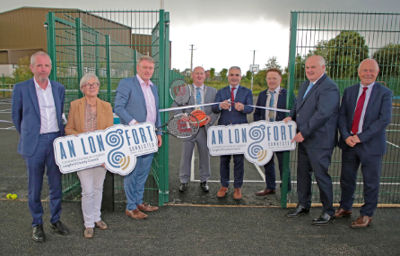
Selecting Community Projects
What purpose or need is it fulfilling for the community?
Capacity and manpower - can you manage and complete it?
Does it align with any national or local plan/strategy?
You need to highlight the benefits this project will bring in your application - evidence the need.
Notes:
there are over 10 speakers so Max 2 slides per scheme ( 1 text and 1 photo slide). Keep text to a minimum on slides- you should use your script to expand and explain detail

Slide 5

Standard requirements for groups applying
Governance structures
Membership of the PPN
Bank account in groups name
Procurement - evidence of quotes/full tender process
Insurance - public liability and adequate cover
Child protection
Event management plan
Compliance – tax, planning, building regulations, health and safety and fire codes
Acknowledgement of the funding source
Notes:
Event management plan has to include traffic management plan

Slide 6
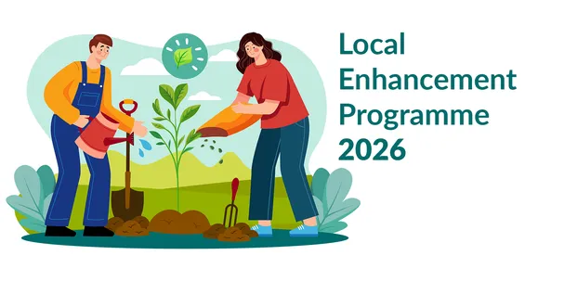


Identify the right funding scheme
Read the scheme outline – some departmental schemes have particular target areas or types of projects they will fund, or conditions to funding
Note eligible and ineligible expenditure
Funding thresholds – how much do you need from the scheme? Can you provide match funding?
Notes:
Have they costed the project? The amount of funding required may dictate the grant to apply for. Look at ‘Typical Grant Range’ on handout
Some schemes have specific activities or types of expenditure that are ineligible.
Match funding requirement could be a barrier
Highlight importance of reading the Guidelines and interacting with the relevant contact in in council before the Deadline.
If in Doubt call Community Development for advice and direction

Slide 7




Importance of completing the application
Most schemes are competitive - need to submit application with detail about project
Complete all questions on the application
The quality of your application is compared to others
Poor applications with little detail may result in no funding being awarded, or less funding than you are seeking
Drawing down your grant
Know the deadline for your claim
Grants paid retrospectively and based on actual expenditure incurred - keep your invoices and receipts
For capital works - you may need evidence of tax compliance, engineers sign off at each stage - be aware of this before the project starts
Notes:
Sell us your idea- what benefit is your project bringing to your area. Why should we fund you over another project?

Slide 8
Community Grant Support Scheme 2026
Community Development Section, commgrants@longfordcoco.ie
Small grants to Voluntary and Community Groups registered with Longford PPN
Application must meet the values and objectives in Longford Local Community Development Committee (LCDC) Equality Human Rights Statement
No minimum or maximum grants, typically around €750-1,000. Match funding is not required. Separate fund in 2026 for community groups with a county-wide remit.
Online applications will open in March 2026 and close in April 2026. Must be completed by Chairperson, Secretary or Treasurer. Decisions by Councillors in May.
Invoices, receipts and photographs required if grant award is >€1,000
Drawdown by the end of October 2026
See longfordcoco.ie for more or call 043 334 33 13 / 334 34 72
Notes:
This includes grants for intercultural events or activities, general community events and celebrations, projects to enhance the area, training, etc

Slide 9
Community Grant Support Scheme
2025 grant awards examples
Name of Community Group
Abbeylara Mullinalaghta Community Games
Ardagh Moydow Active Age
Ballymahon/Landevant Twinning (French Connection)
Bo Dearg Residents Association
Coolamber ICA
Dromard Area Mens Shed
Goldsmith Festival Committee
Granard Agricultural Show Society
Lanesboro Christmas Lights
Legan Tidy Towns
Longford Indian Community
Longford Vintage Club Mullinalaghta Community Centre

Slide 10



CLÁR Programme
Community Development Section, clar@longfordcoco.ie
Measure 1 - enhancement of existing, and/or the development of new, accessible Community Recreation Facilities. Funded by Department for Rural and Community Development and the Gaeltacht (DRCDG)
Community Groups, schools, sports clubs – areas, projects and eligibility set by DRCD.
90% grant funding. Minimum grant €5,000, maximum grant €65,000. Match funding is required. Longford County Council will fund up to 5% also.
2025 approvals were announced by the Department in November. CLÁR 2026 will open later this year.
Follow Public Procurement and employ an engineer. Retrospective grant payment, bridging finance may be required. Ownership/15-year lease, planning permission, open to the public without appointment, disability friendly, evidence of need.
Notes:
there are over 10 speakers so Max 2 slides per scheme ( 1 text and 1 photo slide). Keep text to a minimum on slides- you should use your script to expand and explain detail

Slide 11
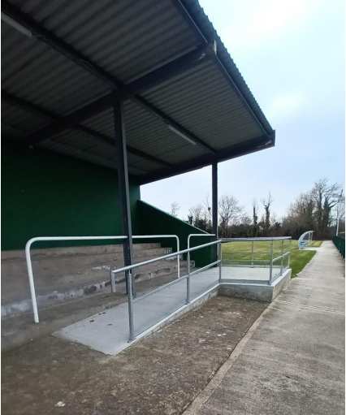
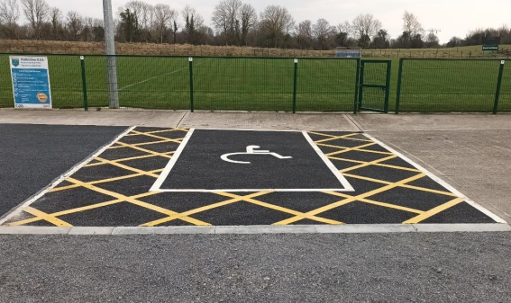
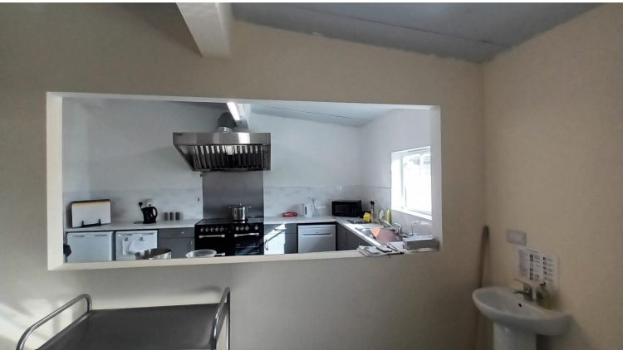
CLÁR Programme – sample of funded projects
Rathcline GAA –
Accessibility works
Granard Community Centre – upgrade of kitchen and service area
Page 3

Slide 12



Local Enhancement Programme (LEP) 2026
Community Development Section
Funded by Department for Rural and Community Development (DRCD), administered by Longford LCDC.
Longford Co. Council has been awarded funding of €152,827 for the 2026 Local Enhancement Programme (LEP) by the Department of Rural and Community Development and the Gaeltacht. The Department has recommended that 30% of the funding be ring-fenced to provide small capital grants of €1,000 or less. No minimum / maximum grant however It should be noted that in the last 2 years the vast majority of grants awarded have been for amounts less than €5,000. Oversubscribed, competitive process. Align with LECP.
The Local Enhancement Programme (LEP) 2026 will provide capital funding to support community, particularly in disadvantaged areas to carry out necessary repairs and improvements to their facilities, and/or to purchase equipment, such as tables and chairs, tools and signage, laptops and printers, lawnmowers, canopies and training equipment, and so on.
Applications will open on the 27 January 2026 and will close @ 4pm 27 February 2026. Online application process
Quotation Invoices, receipts and photographs are required. Contract ≤ €5000.00 ONE quotation must be uploaded. Contract ≥ €5000.00 THREE quotations must be uploaded.
INCOMPLETE APPLICATIONS WILL NOT BE ACCEPTED.
Contact lep@longfordcoco.ie
Notes:
there are over 10 speakers so Max 2 slides per scheme ( 1 text and 1 photo slide). Keep text to a minimum on slides- you should use your script to expand and explain detail

Slide 13
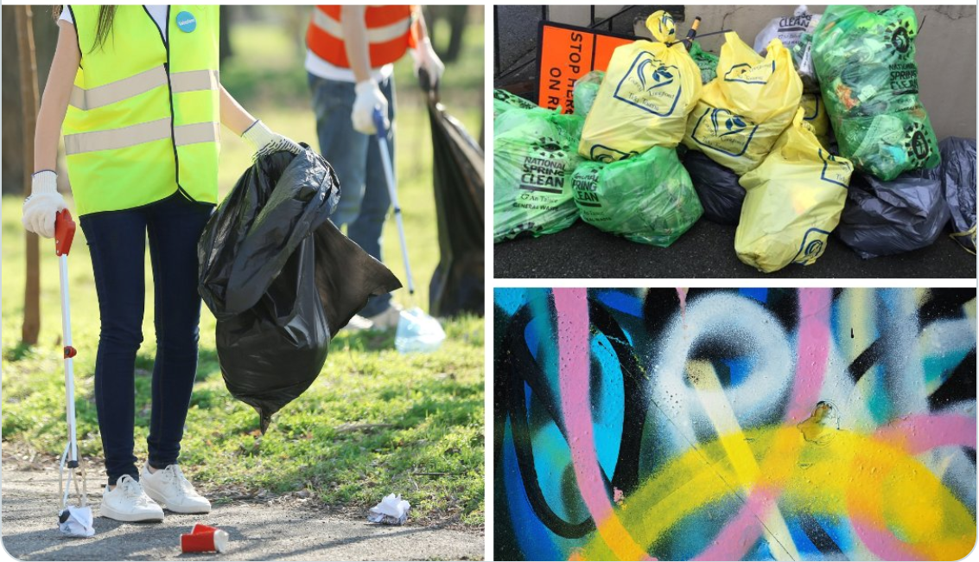
Environment
Anti-Litter Anti-Litter and Anti-Graffiti Grant Scheme (ALAG):
  Funds initiatives which promote public awareness and education to prevent litter and graffiti.
  TidyTowns groups, community groups and schools are encouraged to apply.
  Grant announced approximately in June.
  100% funded - maximum grant of €1,000 per group.
  Projects to be completed by October.
  Receipts of expenditure required before grant drawdown
  Contact: litter@longfordcoco.ie
Cemetery Support Scheme
  Maintenance and upkeep of cemeteries
  Grant announced approximately in April.
  Maximum €400 funding - One grant per group annually.
  Receipts of expenditure required before grant drawdown.
  Contact: burials@longfordcoco.ie

Slide 14


Healthy Ireland Fund (Longford) ​
Expression of Interest 2026
Community Development Section
Healthy Ireland Fund (Longford) Expression of Interest 2026 is open to community projects that can deliver the following outcomes:​
Increase percentage of people meeting physical activity guidelines ​
b. Increase people’s level of positive mental health as per Energy and Vitality Index​
Grants of up to €8,000 may be applied for ​in 2026
Expression of Interest is open since Monday January 12 and will close at 4pm on Monday 9 February - this is an online process​
This is a two-phase application and decisions on the successful community groups who will be asked to submit a Full application will be made by Monday 2 March 2026 where groups will be​ contacted.

Slide 15

All details are available on Healthy Longford webpage on Longfordcoco.ie. This includes:
Guidance Document on how to complete your online Expression of Interest.
Guidance & Terms & Conditions Document when applying for Healthy Ireland funding through Healthy Longford.
Frequently Asked Questions to support you in applying for Healthy Ireland funding.
Please contact HealthyLongfordcoco.ie any queries you may have.
Page 2
Notes:
there are over 10 speakers so Max 2 slides per scheme ( 1 text and 1 photo slide). Keep text to a minimum on slides- you should use your script to expand and explain detail

Slide 16
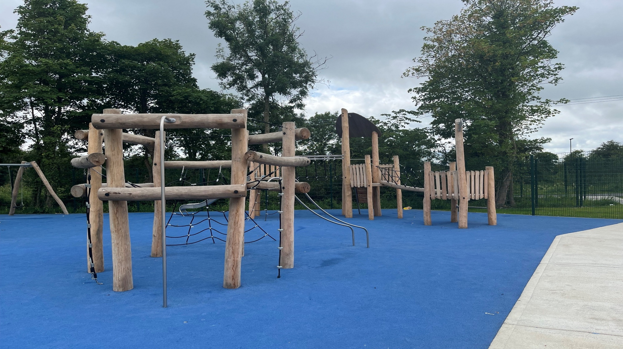



Town and Village Renewal Scheme (TVRS)
The Town and Village Renewal Scheme provides funding to revitalise rural towns and villages by supporting projects that boost town‑centre vibrancy, tackle vacancy, and improve social and economic life.
Notes:
---

Slide 17
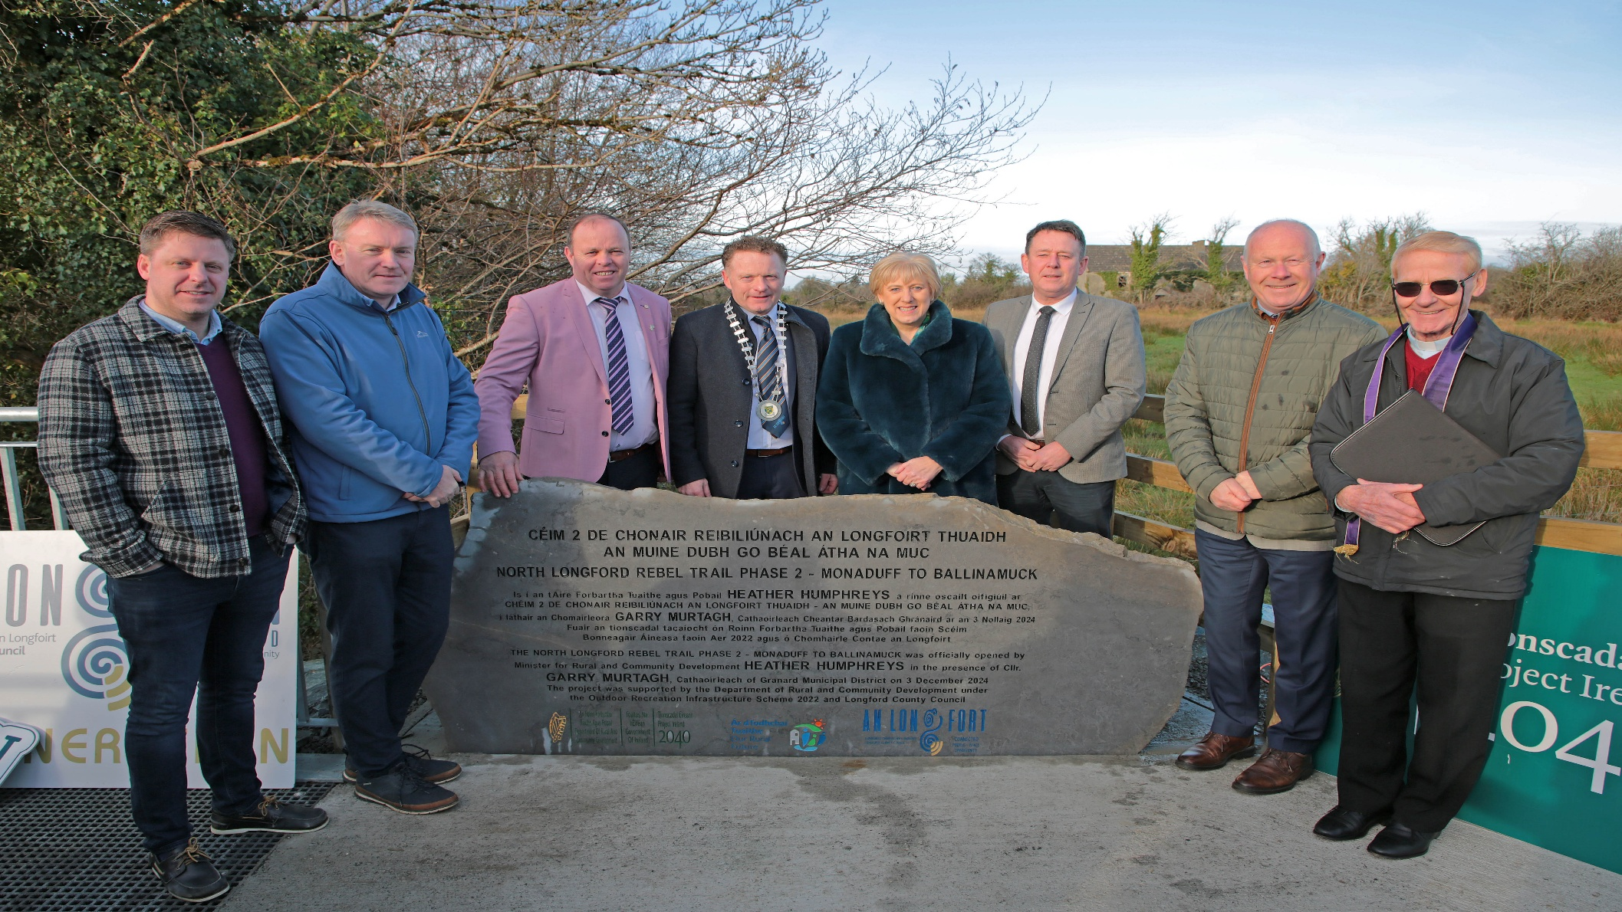
Outdoor Recreation and Infrastructure Scheme (ORIS)
The Outdoor Recreation Infrastructure Scheme funds the development and improvement of trails, outdoor amenities and recreation facilities in rural Ireland to support healthy lifestyles and boost local tourism.
Notes:
---

Slide 18
RRDF and URDF
Aspect | RRDF | URDF
Focus Area | Rural towns & villages | Longford Town
Project Scale | €3m–€12m (Category 1) Category 2 “provides smaller grants to enable the development of projects suitable for future Category 1 applications.” | €2 million and larger
Match Funding | 25% | 25%
Examples | Community hubs, major public realm works | Town Centre Redevelopment, vacant building renewal, housing, public spaces
Application | LCC applies, community collaborates | LCC applies, community collaborates
Latest Priority | Strategic rural transformation | Turning derelict buildings into homes
Notes:
Community groups need to understand that they do not apply directly for RRDF (Rural Regeneration and Development Fund) or URDF (Urban Regeneration and Development Fund), unlike schemes such as ORIS and TVRS. Instead, Longford County Council (LCC) leads all applications and collaborates with communities to identify needs, shape project concepts, prepare designs, and deliver projects if funded. This partnership approach ensures that projects align with strategic regeneration goals and meet eligibility requirements.
RRDF focuses on rural towns and villages, funding large-scale, transformative projects that restructure the future of these areas. Examples include multi-phase regeneration, major public realm works, and community hubs. RRDF has two categories: Category 1 funds capital projects between €3 million and €12 million, requiring full planning permission, completed design, and costings, with 25% match funding. Category 2 supports preparatory work such as feasibility studies, masterplans, and design work, helping projects reach Category 1 readiness, though completion does not guarantee Category 1 funding.
URDF targets cities and large towns, such as Longford Town, with over €2 billion allocated nationally. It also requires 25% match funding from local authorities and community partners. URDF supports projects that regenerate run-down streets and sites, improve public spaces, enable housing and mixed-use development, and address long-term vacant or derelict buildings. Its goal is to make urban centres better places to live, work, and visit. There have been three funding calls since 2018, with the latest focusing on converting vacant and derelict buildings into homes.
For community groups, the key is to provide clear evidence of need, a strong long-term vision, and active engagement with LCC from the earliest stages. Projects should be large-scale, strategic, and community-backed. Understanding the distinction between RRDF (rural transformation) and URDF (urban transformation) is critical. Groups should also be prepared for requirements such as feasibility studies, planning permissions, and match funding commitments. By aligning with these principles, communities can play a vital role in shaping impactful regeneration projects that deliver lasting benefits.

Slide 19
Tips for Successful Applications
Show Local Need: Clearly outline why the project is needed and the benefits for the community.
Demonstrate Impact: Highlight expected outcomes such as health, tourism, or economic benefits.
Community Support: Provide evidence of broad local engagement and backing (meetings, surveys, letters).
Elected Representative: Engage early with your local representative.
Match Funding: Provide evidence of Match Funding.
Accessibility & Inclusion: Include measures for people with disabilities and older adults.
Environmental Considerations: Show how the project protects biodiversity and supports climate action.
Provide Visuals: Include maps, photos, or sketches to illustrate the project concept.
Realistic Delivery: Indicate achievable timelines and practical steps for implementation.
Notes:
To maximize success under TVRS, applicants should focus on several best practices. First, ensure robust community engagement to validate project need and secure stakeholder buy-in. Second, align proposals with strategic frameworks such as Town Centre First and Our Rural Future, highlighting contributions to economic resilience, social inclusion, and climate action. Third, prepare comprehensive documentation, including detailed costings, timelines, and governance structures, supported by maps, drawings, and letters of support. Incorporating universal design principles and sustainability measures, such as energy-efficient upgrades and biodiversity enhancements, strengthens competitiveness. Demonstrating readiness through planning consents and technical assessments is critical, particularly for capital projects. Applicants should also emphasize innovation, such as multi-functional spaces or digital infrastructure, and outline clear, measurable outcomes. Engaging technical experts for design and feasibility work can enhance quality and compliance. Finally, adhere strictly to scheme guidelines and deadlines, and maintain transparent communication with the Department throughout the process. By adopting these practices, communities and local authorities can secure funding that delivers transformative regeneration and long-term benefits for rural towns and villages.

Slide 20
📞 Contact Details
Eoghan Dwyer
Senior Staff Officer
Regeneration
Longford County Council
📧 Email: edwyer@longfordcoco.ie
📱 Phone: 043 334 4204
🏢 Office: Church Street, Longford
🌐 Website: www.longfordcoco.ie/services/regeneration

Slide 21
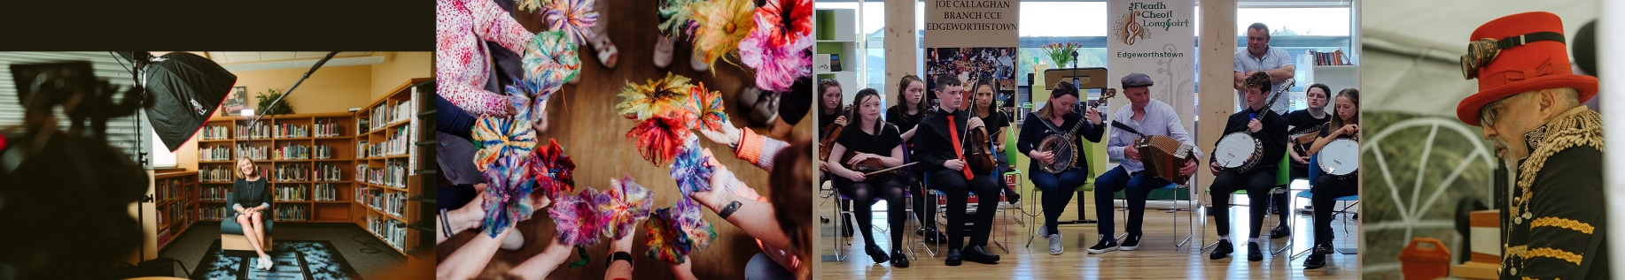
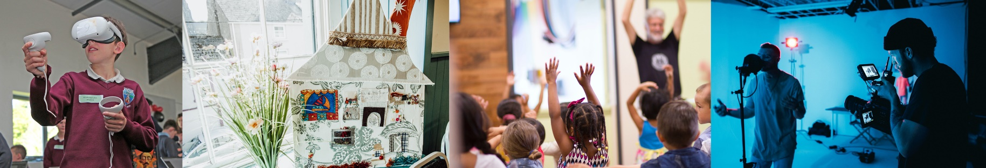
Arts Office
Creative Ireland (CI)
Longford County Archives & Local Studies

Slide 22
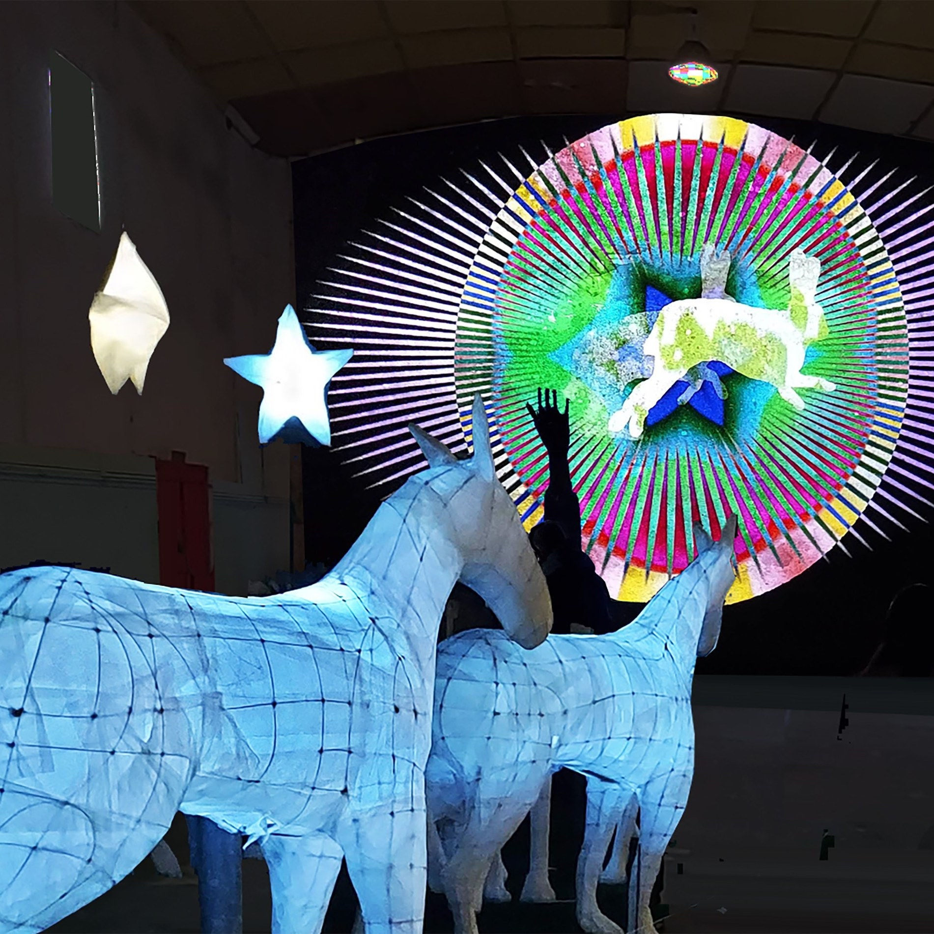
Arts Project Grant, Arts and Cultural Promotion Grants - Longford Arts Service
Arts Project Grant
To support the development of ambitious art projects that significantly benefit the cultural well-being of citizens
Amount Min €1,000 / Max €5,000
Timeline: Opens 14 Oct, closes 2 Dec 2026.
Examples: Arts based events, festivals, ambitious art works in development
Film Bursary Grant
Support emerging filmmakers in County Longford. Awarded for Production of a Short drama or documentary film
Amount: €7000.00
Timeline: opens 14 Oct – Closes 6 Dec 2026
Examples: Invitation to participate in a prominent international exhibition
Contact Shane Crossan
scrossan@longfordcoco.ie
Notes:
there are over 10 speakers so Max 2 slides per scheme ( 1 text and 1 photo slide). Keep text to a minimum on slides- you should use your script to expand and explain detail

Slide 23

Artist Bursary and Culture Night Grant
Longford Arts Service
Artist Bursary
Purpose: The professional development of artists. For example, training, mentoring, travel, equipment.
Amount: Min €500 / Max €3,000.
Timeline: Opens 14 Oct – Closes 6 Dec 2026
Culture Night Grant
To support citizens/organisations with costs associated with Culture Night events for example, venue rental, marketing, materials
Amount: Min €200 / Max €500. Fund limit €4,500
Timeline: Opens 27 May, closes 11 July 2026
Culture Night is on Friday, 18 September 2026
Contact Arts Officer
Shane Crossan
scrossan@longfordcoco.ie

Slide 24
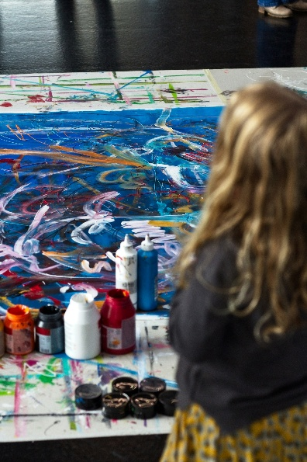
Artist Collaboration Award
Purpose: Support of Longford based artists from any one or multiple arts disciplines.
Collaboration includes but is not limited to, groups of artists, visual artist collaborations, theatre companies, music collectives etc.
Development of new work – Costs relating to research and development by a group of artist for exhibition, performance or publication.
Presentation of work – Costs relating to presentation of work, or engagement with communities, by a group of artists.
Amount: Up to €3,000.
Timeline: Opens 03 Feb – Closes 19 Mar 2026
Contact Arts Officer
Shane Crossan
scrossan@longfordcoco.ie

Slide 25


Creative Ireland (CI) & Cruinniú na nÓg
This Longford County Council programme supports innovative, creative, and cultural initiatives within the county.
CI: Events and projects involving arts, creative industries, heritage, film, animation and others. Projects ‘as Gaeilge’ are also welcome.
Open to: Individuals, organisations, community groups, cultural/creative artists.
All projects: must be community-focused and involve a community element
Cruinniú: 6th June 2026 – A free day of creative activity for children and young people up to 18 years of age.
Expressions of interest - groups: (Closed - 5th January) Reopens - November 2026.
Artist / Creatives / Facilitator Panel: Closing date – 26th January 2026.
Contact: Ciarán Lennon
creativelongford@longfordcoco.ie
Notes:
there are over 10 speakers so Max 2 slides per scheme ( 1 text and 1 photo slide). Keep text to a minimum on slides- you should use your script to expand and explain detail

Slide 26

Creative Ireland project examples
For further information visit: https://www.longfordlibrary.ie/creative-ireland-longford/
Email creativeireland@longfordcoco.ie or call (043) 334 11 24

Slide 27
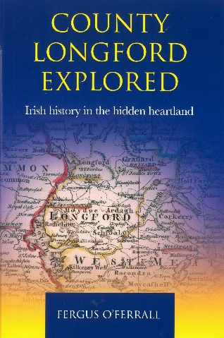
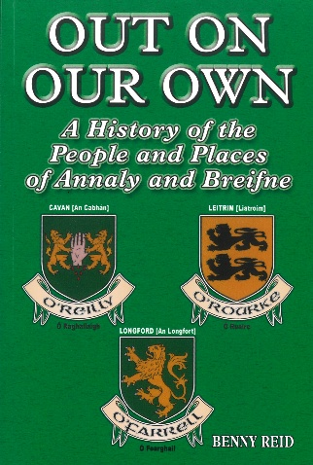
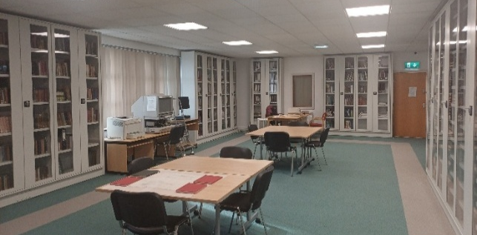
Longford County Archives & Local Studies
€5000 available in total.
Grants to a maximum of €1000 per project.
A full draft of book must be submitted with the application, to be assessed,
plus a quotation for design and printing.
Deadline for applications: 1 June 2026.
More information: archivist@longfordcoco.ie
Notes:
there are over 10 speakers so Max 2 slides per scheme ( 1 text and 1 photo slide). Keep text to a minimum on slides- you should use your script to expand and explain detail

Slide 28
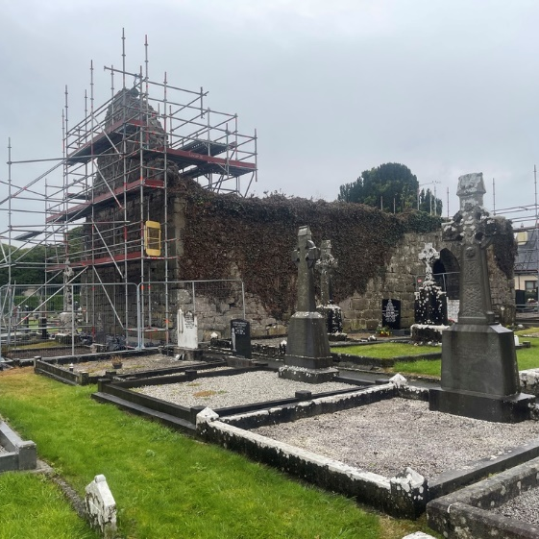
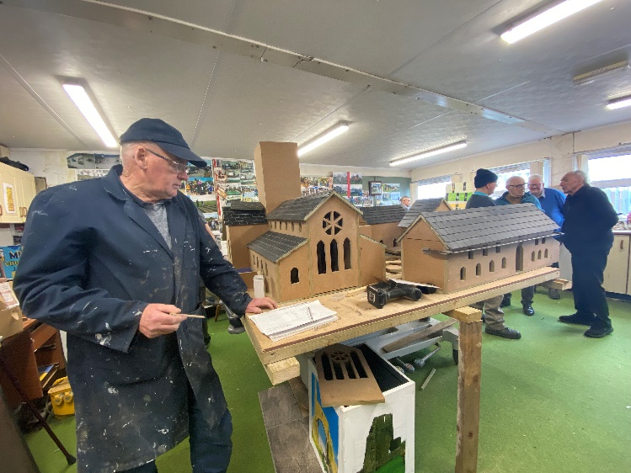
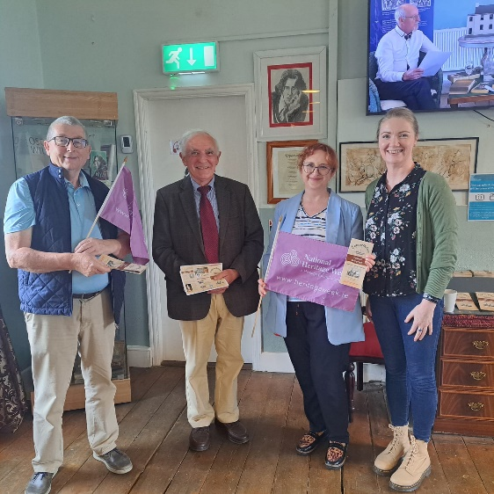



Heritage Funding Opportunities for Communities
There are a number of funding opportunities for communities to support their research, conservation and awareness of built and cultural heritage in Co. Longford and beyond.

Slide 29

Heritage Funding Opportunities – The Heritage Council
Community Heritage Grant Scheme 2026 (opening Feb 2026. Online Application)
Open to voluntary & community groups, as well as NGOS and not-for-profit trusts,
& Adopt a Monument Programme participants.
Typically supported projects are:
Workshops and training events. Development of Digital Heritage Resources.
Conservation surveys, reports, plans, and audits. Conservation repairs to heritage objects, habitats, monuments, structures.
Heritage Organisations Support Fund 2026 (closing 5pm, 26 Jan 2026. Online Application)
The scheme is open to not-for-profit heritage-focused organisations with national/regional relevance. Aims to build capacity and foster innovation in Ireland. Approx 30-40 orgs supported each year.
Provides providing funding towards their core costs; max grant of €50,000.
Heritage Stewardship Fund (opening Nov 2026)
Primarily aimed at State bodies and Local Authorities; does include Educational Institutions.
Supports heritage-focused projects, including those that build climate resilience.
www.heritagecouncil.ie/funding
Notes:
there are over 10 speakers so Max 2 slides per scheme ( 1 text and 1 photo slide). Keep text to a minimum on slides- you should use your script to expand and explain detail

Slide 30

Heritage Funding – Built Heritage & Archaeology
Community Monuments Fund 2026 (closing date 30 January 2026)
To support community-based Conservation Management Plans, Capital Repair Works & Access/ Interpretation for Archaeological Monuments and Sites. Up to €30,000 for CMPs and €100,000 for repairs.
Built Heritage Investment Scheme 2027 (opening mid-2026)
Funding conservation works to protected structures, and other historic buildings in limited circumstances. Grants will be between €2,500 – 50,000, up to a max of 80% of the project costs. Typical grant amounts are between €8,000-20,000. Dependant on allocation received from DHLGH.
Historic Thatched Building Stream 2027 (opening mid-2026)
A very limited fund, aimed to supplement other grant schemes, for repair of thatch to historic buildings.
Historic Structures Fund 2027 (opening December 2026)
For larger-scale repairs, reuse and refurbishment to historic Protected Structures, at risk of significant deterioration. A clear community, public or residential benefit must be demonstrated.
Grants will be between €50,000 – 200,000, up to a max of 50% of the project costs.
For information & application forms visit:
www.longfordlibrary.ie/heritage/heritage-funding

Slide 31
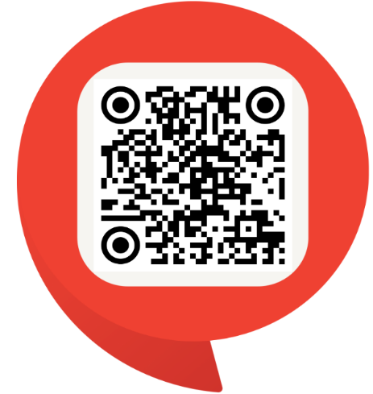

Heritage Funding Opportunities – Other
Longford Heritage Initiatives Fund 2026 (open)
Open to community groups and others to develop local heritage research projects and engagement events. Must include an element for National Heritage Week 2026.
Books that are not part of a broader heritage project will not ordinarily be supported.
Support may be subject to funding being made available from other sources.
Application via online application process.
To fill in the form visit: https://forms.office.com/e/XY7P8CX4w7 email: heritage@longfordcoco.ie
The Local Authorities Water Programme (LAWPRO) runs a number of grant schemes: Community Water Development Fund, Catchment Support Fund and Small Grants & Events Scheme. www.lawaters.ie/funding.
Waterways Ireland Community Heritage & Biodiversity Grant Scheme. Webinar 21 Jan 2026. Closing 31 Jan 2026.
The Irish Georgian Society Conservation Grants Scheme. Opening January 2026. www.igs.ie
The Royal Irish Academy regularly runs research grants. www.RIA.ie/grants

Slide 32
Fáilte Ireland Regional Festival and Participative Events Fund - Longford Tourism
Aim: to support festivals/events in driving both domestic and international tourism
Objective: to support community/voluntary groups organising a diverse range of projects and events
The festival or event must:
Take place in County Longford
Aim to attract international visitors
Run for two consecutive days in duration minimum
Fit into one of the following categories:
- General festivals (literary, historic, fairs, traditional culture or family focused)
- Arts, music and theatre
- Family sports and outdoors
Amount: A maximum of €4,000 per organisation can be received in any one year with a maximum of three events funded
Timeline: This fund is open until Thursday 29 January 2026 @ 5pm for events taking place in 2026. This is the only opportunity to access this fund for this year.
Contact:
Denise Canavan, Tourism Officer
tourism@longfordcoco.ie
Notes:
there are over 10 speakers so Max 2 slides per scheme ( 1 text and 1 photo slide). Keep text to a minimum on slides- you should use your script to expand and explain detail

Slide 33
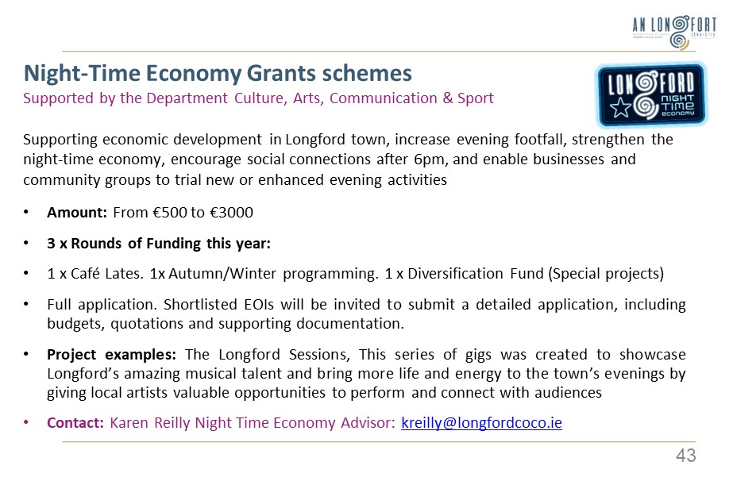

Night Time Economy Small Grants scheme
Supported by the Department of Tourism, Culture, Arts, Gaeltacht, Sport and Media to develop Longford’s Night Time economy
Purpose: To encourage cultural vibrancy, enhance safety, and improve accessibility during evening hours through community driven initiatives and partnerships.
Amount: From €500 to €3000
2 Phase application:
Phase 1: Expression of interest(EOI).Submit a brief overview of your project.
Phase 2: Full application. Shortlisted EOIs will be invited to submit a detailed application, including budgets, quotations and supporting documentation.
Project examples: Develop a late-night arts trail with exhibitions and performances, Start a town-based walking group with cuppa after
Contact: Karen Reilly Night Time Economy Advisor: kreilly@longfordcoco.ie
Notes:
there are over 10 speakers so Max 2 slides per scheme ( 1 text and 1 photo slide). Keep text to a minimum on slides- you should use your script to expand and explain detail

Slide 34

County Longford Public Participation Network (PPN)
What is County Longford PPN?
Main link through which Longford County Council and other decision-making bodies connect with the community, voluntary, social inclusion and environmental sectors.
Allows diversity of voices and interests to be facilitated and involved in the decision-making process.
How is this achieved?
Facilitates the election of community representatives to all Longford County Council Committees and other policy making boards and agencies.
Engage, encourage and support members to participate in public consultations.
Act as an information hub

Slide 35
County Longford Public Participation Network (PPN)
Criteria for joining?
  Are active and have a postal address in County Longford
  Operate on a not-for-profit basis
  Are volunteer-led
  Have a constitution / set of rules / Memorandum of Understanding
  Meet regularly
  Are non-party political
How to apply for membership?
Visit: www.longfordppn.ie
Contact details: Siobhán Cronogue 087 261 5583 or email: scronogue@longfordcoco.ie or publicparticipationnetwork@longfordcoco.ie
Amy Leavy, 043 33 43365 or email aleavy@longfordcoco.ie

Slide 36
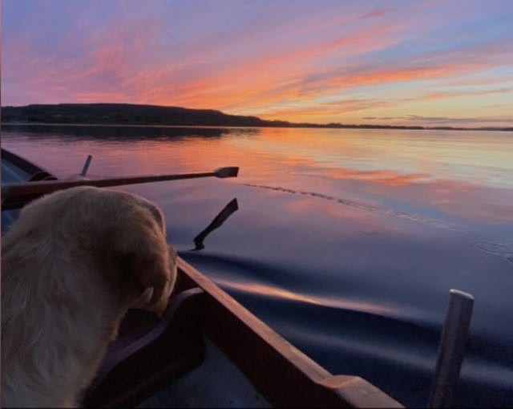

David Quinn
Community Water Officer
Longford & Westmeath

Slide 37
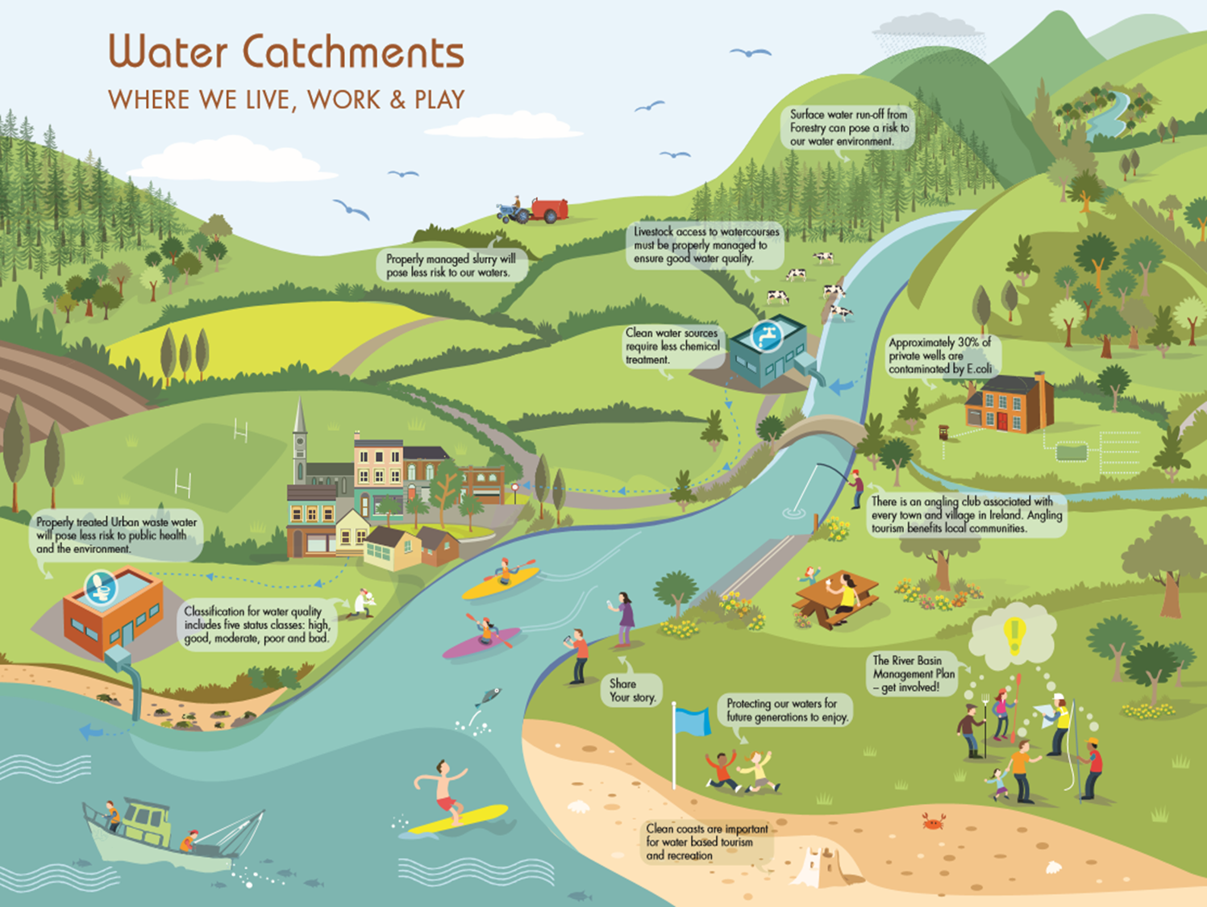
Who are LAWPRO?
The Local Authority Waters Programme (LAWPRO) is working to identify the issues affecting water quality in every county in Ireland. Where issues are identified, we collaborate with the relevant local authority, public body, and water stakeholder to find a solution.
Work is guided by WFD 2000
https://lawaters.ie/
Notes:
LAWPRO is a local authority shared services, which is jointly managed for the country by Kilkenny and Tipp Co. Co. and are goal is…….
Guided by the EU WFD 2000 that requires all Member States to protect and improve water quality in all waters so that we achieve good ecological status by 2027.

Slide 38
LAWPRO Funding Streams
Small Grants and Events Scheme - Open
Grants range from €100 to €5,000
Less rigorous application and assessment process
Types of projects
  Water related events
  Rainwater harvesting
  Biodiversity workshops
  Screening for Appropriate Assessment
  Other environmental reports, feasibility studies
Catchment Support Fund- Closed for 2026
Community Water Development Fund – Closed for 2026
Notes:
CSF
New funding stream introduced in 2024
To build the capacity of water quality focused NGOs
Over €850,000 in grants awarded to 40 water focused NGOs with catchment or sub catchment relevance in 2025
Strand 1: grants towards insurance, legal costs, accounting fees, organisational promotional material , website costs, group development activities
Strand 2: grants towards organisation’s core costs (including staff costs)
Will open for applications later in the Autumn
SGES
Rolling call for smaller scale community water quality actions and awareness projects
Grants range from €100 to €5,000
Less rigorous application and assessment process
Types of projects elements
Elements listed for Open Call but smaller scale (lower cost) projects
River restoration plans / feasibility studies
Screening for Appropriate Assessment/other environmental reports and plans
Match funding with other funding streams
Water conservation
Rainwater harvesting
Biodiversity workshops
Citizen Science
Water related events

Slide 39
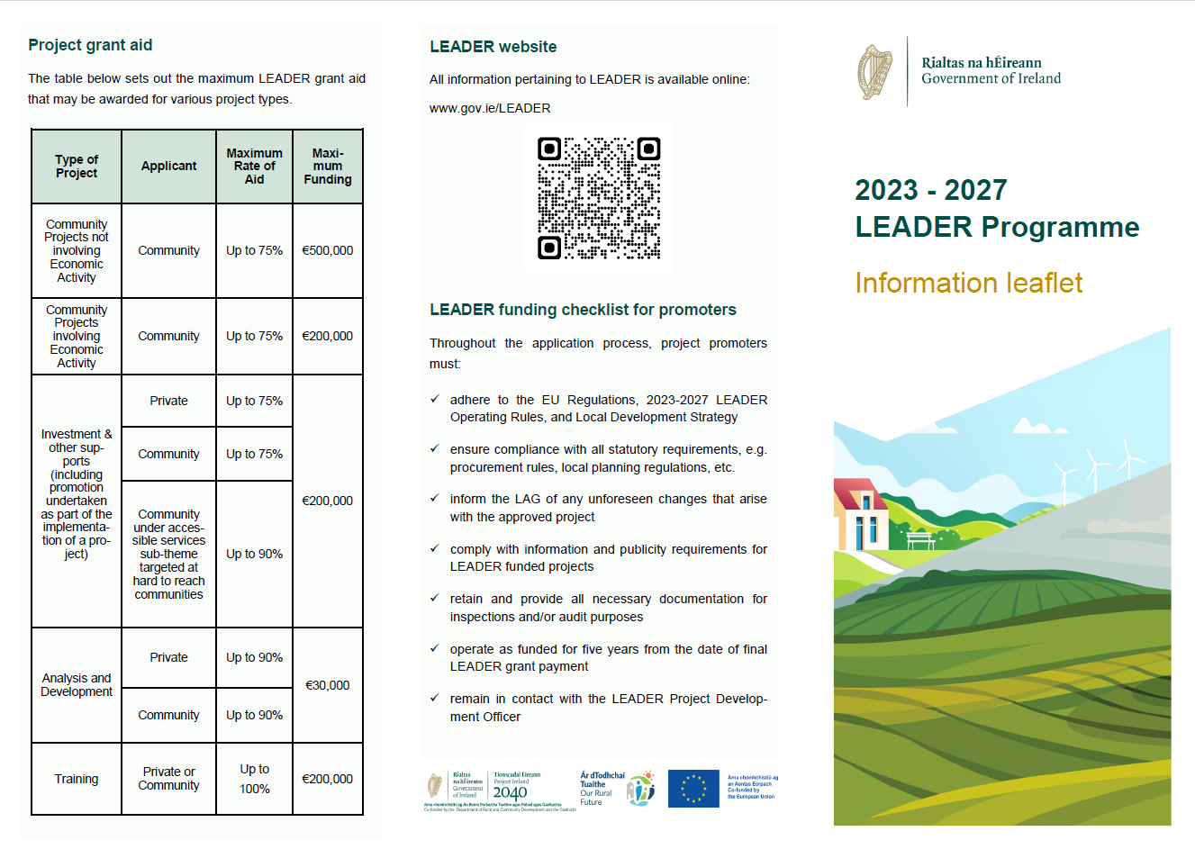

Slide 40
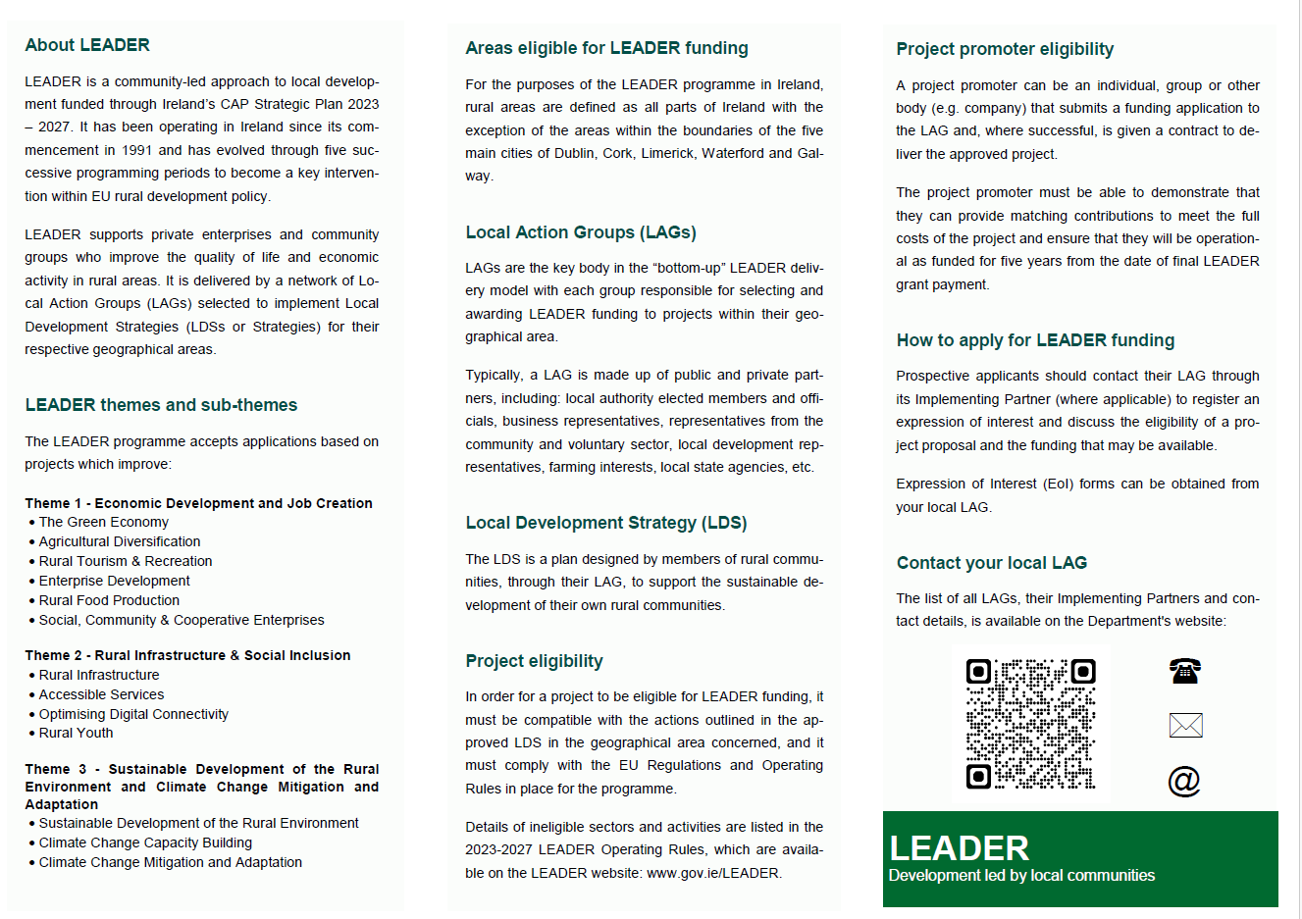

Slide 41
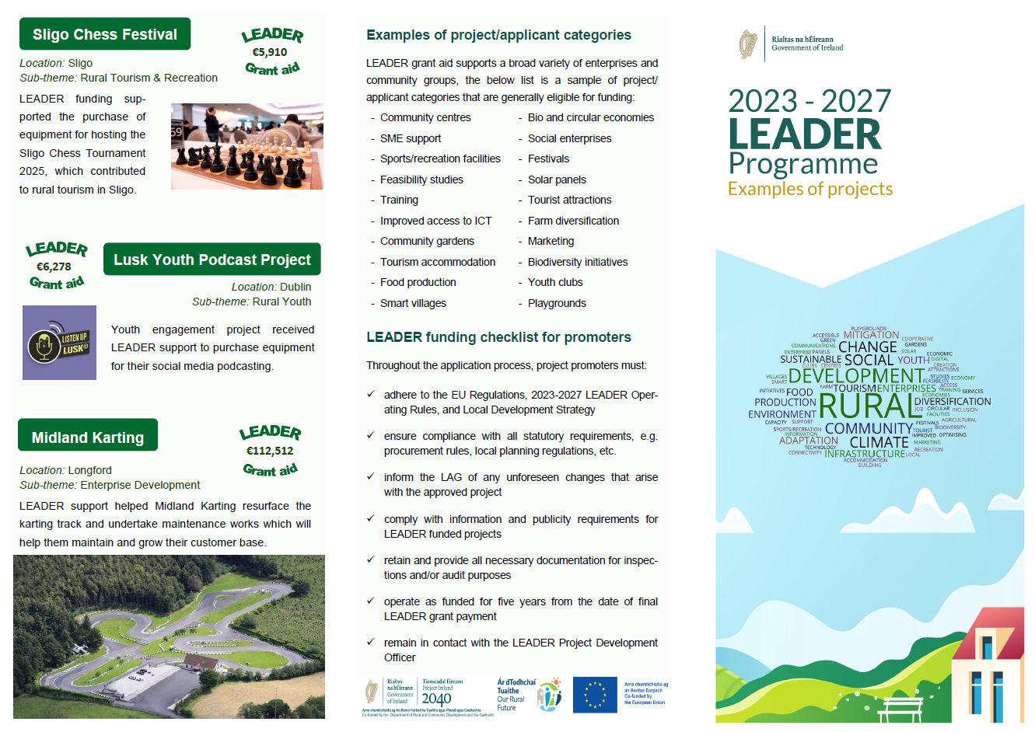

Slide 42
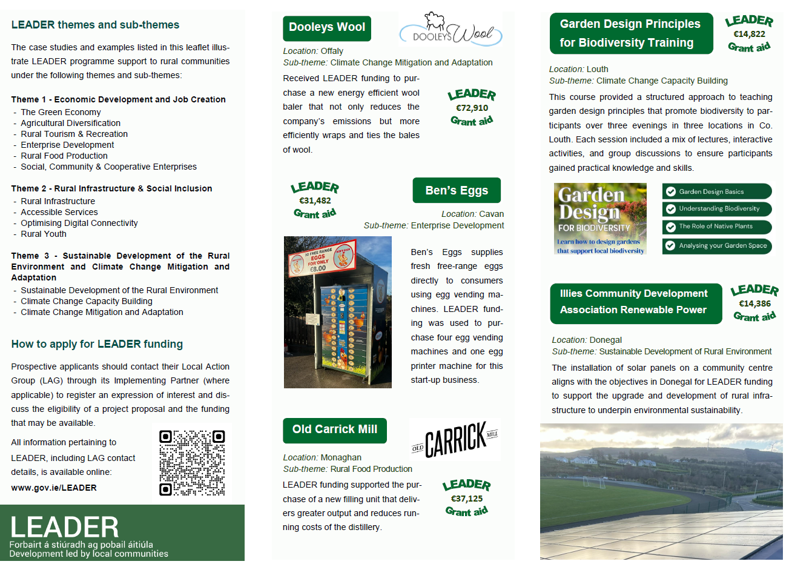

Slide 43


Slide 44

Summary of important points
Competitive process
Terms and Conditions of scheme
Eligibility
Costs and funding sources
Capital versus operational costs
Matched funding requirements?
Deadlines and timelines for delivery
Online applications vs paper forms
Apply for Tax Clearance status
GPS coordinates / Eircode
Supporting documentation
Changes to the project
Expectations
Help is Available
Notes:
Expectations- what is the responsibility of the community group vs what is the responsibility of the LA. What level of funding do you expect? If the max grant is 1,000 and your project caost 5,000 and you have no other funding source- is it realistic?
Conflict of Interst

