Slide 1



Pathways to Funding
Community Grant Schemes
Information Sessions 2025
Longford Library – Tuesday 14 January
Ballymahon Library – Wednesday, 15 January
Granard Library – Thursday, 16 January
longfordcoco.ie

Slide 2

Agenda
Longford LCDC
Community based projects - how to select a project
Identifying the right scheme
Standard requirements for applying for grants
Drawing down a grant
Overview of available funding schemes
Membership of Longford Public Participation Network
Longford Community Resources Clg – LEADER funding
Summary of important points
Notes:
there are over 10 speakers so Max 2 slides per scheme ( 1 text and 1 photo slide). Keep text to a minimum on slides- you should use your script to expand and explain detail

Slide 3

Longford Local Community
Development Committee
Committee of the local authority whose role is to seek co-ordination of local and community development in the county
Representatives from statutory agencies, community reps through the PPN and civic interests.
Oversee the implementation of the community elements of the Local Economic and Community Plan (LECP) as well as a number of funding schemes
Acts as the Local Action Group for the LEADER Programme, with Longford Co. Council as the Financial Partner and Longford Community Resources Clg as the Implementing Partner
Notes:
there are over 10 speakers so Max 2 slides per scheme ( 1 text and 1 photo slide). Keep text to a minimum on slides- you should use your script to expand and explain detail

Slide 4
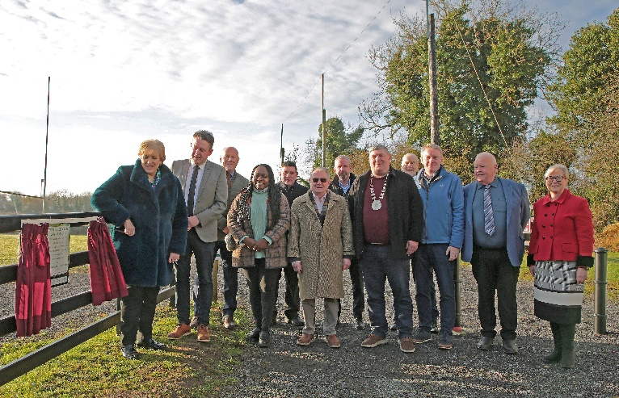
Selecting Community Projects
What purpose or need is it fulfilling for the community?
Capacity and manpower - can you manage and complete it?
Does it align with any national or local plan/strategy?
You need to highlight the benefits this project will bring in your application - evidence the need.
Notes:
there are over 10 speakers so Max 2 slides per scheme ( 1 text and 1 photo slide). Keep text to a minimum on slides- you should use your script to expand and explain detail

Slide 5

Standard requirements for groups applying
Governance structures
Membership of the PPN
Bank account in groups name
Procurement - evidence of quotes/full tender process
Insurance - public liability and adequate cover
Child protection
Event management plan
Compliance – tax, planning, building regulations, health and safety and fire codes
Acknowledgement of the funding source
Notes:
Event management plan has to include traffic management plan

Slide 6


Identify the right funding scheme
Capital funding or small scale/equipment or contribution to something else?
Read the scheme outline – some departmental schemes have particular target areas or types of projects they will fund, or conditions to funding
Note eligible and ineligible expenditure
Funding thresholds – how much do you need from the scheme? Can you provide match funding?
Notes:
Have they costed the project? The amount of funding required may dictate the grant to apply for. Look at ‘Typical Grant Range’ on handout
Some schemes have specific activities or types of expenditure that are ineligible.
Match funding requirement could be a barrier
Highlight importance of reading the Guidelines and interacting with the relevant contact in in council before the Deadline.
If in Doubt call Community Development for advice and direction

Slide 7



Importance of completing the application
Most schemes are competitive - need to submit application with detail about project
Complete all questions on the application
The quality of your application is compared to others
Poor applications with little detail may result in no funding being awarded, or less funding than you are seeking
What is your WOW?
Notes:
Sell us your idea- what benefit is your project bringing to your area. Why should we fund you over another project?

Slide 8


Drawing down your grant
Know the deadline for your claim
Grants paid retrospectively and based on actual expenditure incurred - keep your invoices and receipts
For capital works - you may need evidence of tax compliance, engineers sign off at each stage - be aware of this before the project starts
Notes:
Make sure you know what is required

Slide 9

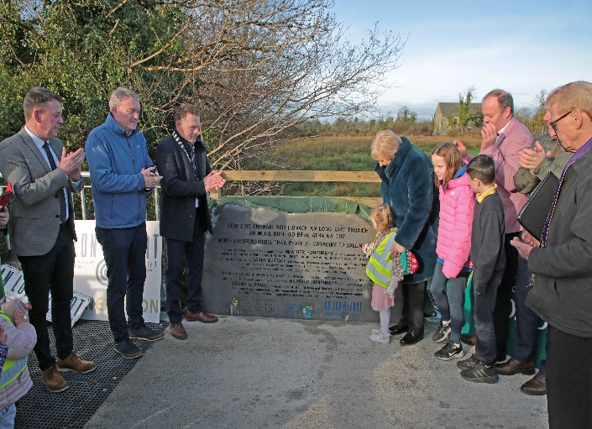
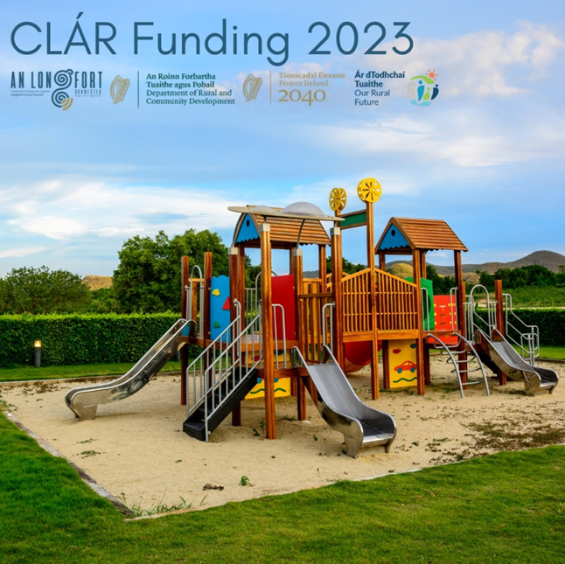
Overview of available funding schemes

Slide 10
Community Grant Support Scheme 2025
Community Development Sectioncommgrants@longfordcoco.ie
Small grants to Voluntary and Community Groups registered with Longford PPN
Application must meet the values and objectives in Longford Local Community Development Committee (LCDC) Equality Human Rights Statement
No minimum or maximum grants, typically around €750-1,000. Match funding is not required.
Online applications will open and close in March 2025. Must be completed by Chairperson, Secretary or Treasurer. Decisions by Councillors in late May.
Invoices, receipts and photographs required if grant award is >€1,000
Drawdown by the end of October 2025
See longfordcoco.ie for more or call 043 334 33 13 / 334 34 72
Notes:
This includes grants for intercultural events or activities, general community events and celebrations, projects to enhance the area, training, etc

Slide 11
Community Grant Support Scheme
2024 grant awards examples
Name of Community Group
Ardagh Community Centre Association
Ballymahon/Landevant Twinning (French Connection)
Colmcille Vintage Club
Drumlish Christmas Lights
Ethnic Minority Hub Longford
Forthill Residents Association
Killoe Mens Shed
Legan ICA
Longford Agricultural Show and Country Fair
Longford Community Games
Monaduff Social Club
Newtowncashel Tidy Towns
Page 3

Slide 12



CLÁR Programme
Community Development Section, clar@longfordcoco.ie
Measure 1 - enhancement of existing, and/or the development of new, accessible Community Recreation Facilities.
Funded by Department for Rural and Community Development (DRCD)
Community Groups, schools, sports clubs – areas, projects and eligibility set by DRCD.
Insure, manage and operate for five years.
90% grant funding. Minimum grant €5,000, maximum grant €50,000. Match funding is required. Longford County Council will fund up to 5% also.
2024 approvals were announced by the Department in October. CLÁR 2025 will open later this year.
Follow Public Procurement, engineer. Retrospective grant payment, bridging finance may be required. Ownership/15-year lease, planning permission, open to the public without appointment, disability friendly, evidence of need.
Notes:
there are over 10 speakers so Max 2 slides per scheme ( 1 text and 1 photo slide). Keep text to a minimum on slides- you should use your script to expand and explain detail

Slide 13
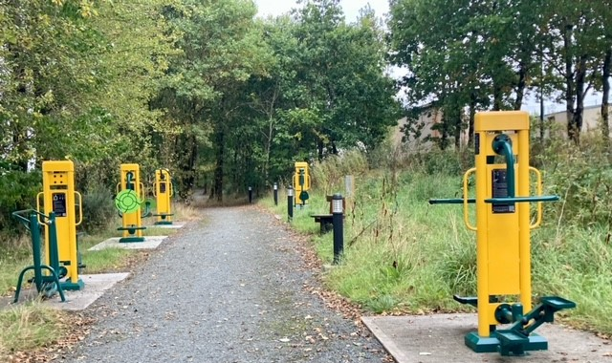
CLÁR Programme 2023 – sample funded projects
Lanesborough P.S. –
walkway and hedging
Dromard GAA –
outdoor exercise equipment

Slide 14


Local Enhancement Programme (LEP) 2024
Community Development Section
Funded by Department for Rural and Community Development (DRCD), administered by Longford LCDC.
The LEP 2025 Capital Funding will support groups, particularly in disadvantaged areas to carry out necessary repairs and improvements to their facilities, and/or to purchase equipment, such as tables and chairs, tools and signage, laptops and printers, lawnmowers, canopies and training equipment, and so on.
The LEP 2025 Current Funding will support groups/organisations with their non-pay running costs such as energy costs (electricity costs, refuse charges, heating charges) or other non-pay operating costs for e.g. rental lease costs, insurance bills. To ensure appropriate monitoring and governance, the Department is stating that only operating/running costs related to this period 1 June 2024 to 30 May 2025 are eligible.
No minimum / maximum grant. Oversubscribed, competitive process. Align with LECP. Seek three quotations. Invoices, receipts and photographs are required.
LEP 2024 opened on the 6 January 2025 and will close on the 30 January 2025. Online application process.
Contact lcdc@longfordcoco.ie
Notes:
there are over 10 speakers so Max 2 slides per scheme ( 1 text and 1 photo slide). Keep text to a minimum on slides- you should use your script to expand and explain detail

Slide 15


Healthy Ireland Fund (Longford) ​
Expression of Interest 2025 ​
Community Development Section
Healthy Ireland Fund (Longford) Expression of Interest 2025 is open to community projects that can deliver the following outcomes:​
Increase percentage of people meeting physical activity guidelines ​
b. Increase people’s level of positive mental health as per Energy and Vitality Index​
Grants of up to €3,000 may be applied for ​
Expression of Interest is open since Monday January 13 and will close at 4pm on Friday, 14 February - this is an online process​
This is a two-phase application and decisions on the successful community groups who will be asked to submit an application will be made by Monday 21 February 2025 where groups will be​ contacted.
For further info check out the Healthy Longford page on Longfordcoco.ie ​
Contact: Laura 087 277 7843 or 043 334 33 63 or email HealthyLongford@Longfordcoco.ie

Slide 16

Page 2
Notes:
there are over 10 speakers so Max 2 slides per scheme ( 1 text and 1 photo slide). Keep text to a minimum on slides- you should use your script to expand and explain detail

Slide 17
Town and Village Renewal Scheme (TVR)
Regeneration Department No Call made in 2024
5 Applications per County
Regeneration projects that assist in revitalising our Towns and Villages
Purpose: Regeneration projects that assist in revitalising our Towns and Villages.
Funding is generally for capital works
Amount: 4 grants up to €250,000.
    1 grant up to €500,000
    Grant is for 90% - Match funding of 10% required
Timeline: Expressions of interest usually advertised in June. 12- 18 months to complete
Examples: 50 projects funded since 2016 – recent examples include Rose Cottage War of Independence Centre
Contact Paul Newell regen@longfordcoco.ie
Notes:
there are over 10 speakers so Max 2 slides per scheme ( 1 text and 1 photo slide). Keep text to a minimum on slides- you should use your script to expand and explain detail

Slide 18
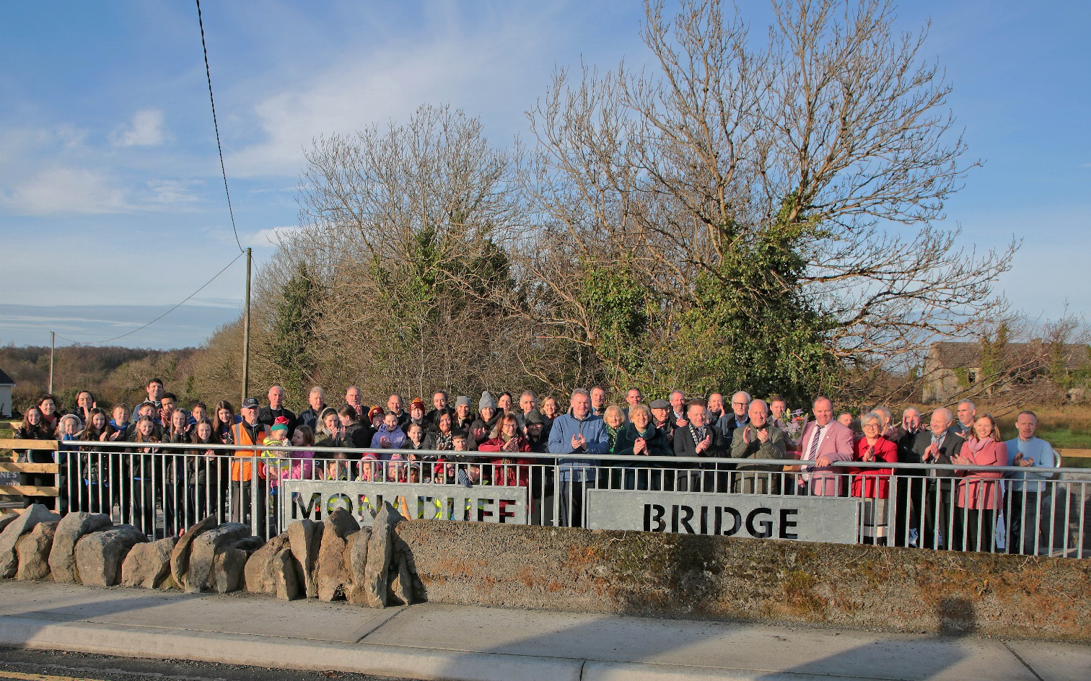
Monaduff to Ballinamuck – Officially opened in December 2024

Slide 19
Outdoor Recreation Infrastructure Scheme (ORIS)
Regeneration Department
9 Applications per County
Purpose: Projects that provide passive enjoyment of the outdoors
Funding is available for land based, water based and air-based activities
Amount: 6 Grants up to €40,000 (Measure 1)
    2 grants up to €200,00 (Measure 2)
    1 grant up to €500,000 (Measure 3)
    Grant is for 90% - Match funding of 10% required
Timeline: Expressions of interest usually advertised in June. 12- 18 months to complete
Examples: 59 projects funded since 2017
Contact: Paul Newell regen@longfordcoco.ie
Notes:
there are over 10 speakers so Max 2 slides per scheme ( 1 text and 1 photo slide). Keep text to a minimum on slides- you should use your script to expand and explain detail

Slide 20
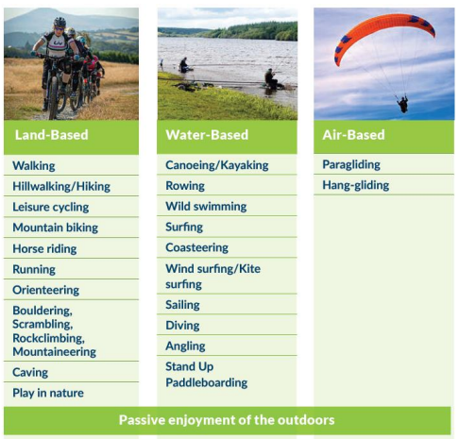
Examples of projects that can be funded:

Slide 21



Community Climate Action Programme
Phase 2
Contact Linda Beirne
Community Climate Action Officer lbeirne@longfordcoco.ie
Opening Date: TBC 2025

Slide 22
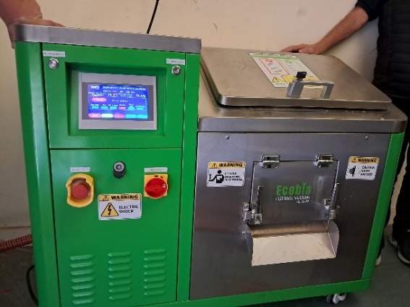
Main objectives of the programme: To help contribute to national climate and energy targets Support and empower communities to shape and build low carbon, sustainable communities in Longford Support small and large, rural and urban communities to take climate action Direct engagement with communities to promote and assist in the scale up of community climate action regardless of the starting point of the community Eligibility criteria: Located in County Longford. Not-for-Profit Organisation. (One application per organisation) Registered with PPN or with other collectives; Tidy Towns and/or a Community Group Proof of tax compliance (or otherwise), will be required
Up to 100% funded and approved by Department of Environment, Climate and Communications
EDI Training Centre, Longford Town: €23,154 Purchase of a Bio-composter for the Catering Training Kitchen

Slide 23
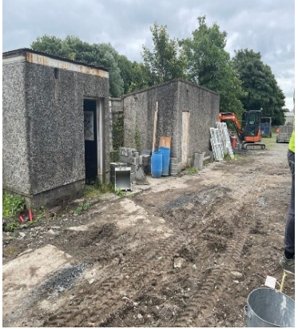
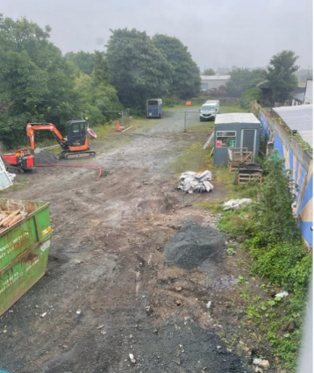
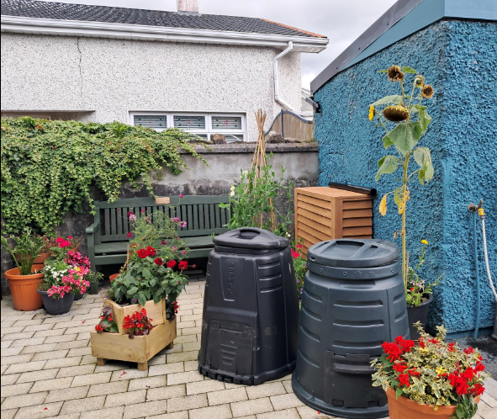
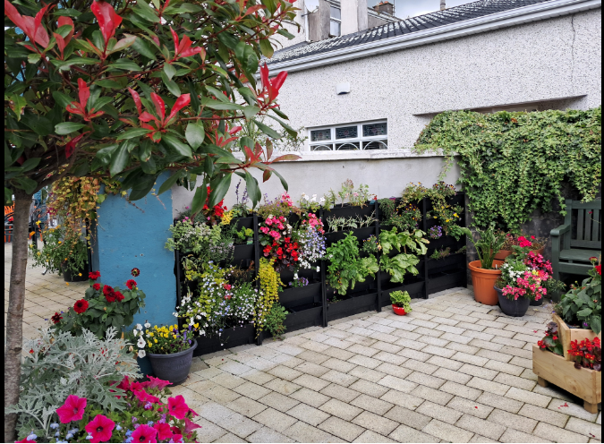

Lus na Greine FRC, Granard: €7,807.71 Purchase of garden tools for an allotment garden and a pollinator planting initiative was also undertaken to encourage biodiversity and wildlife into the garden.

Slide 24
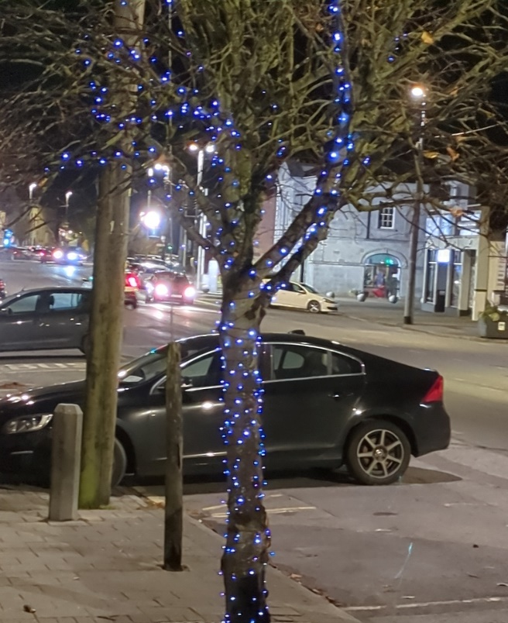
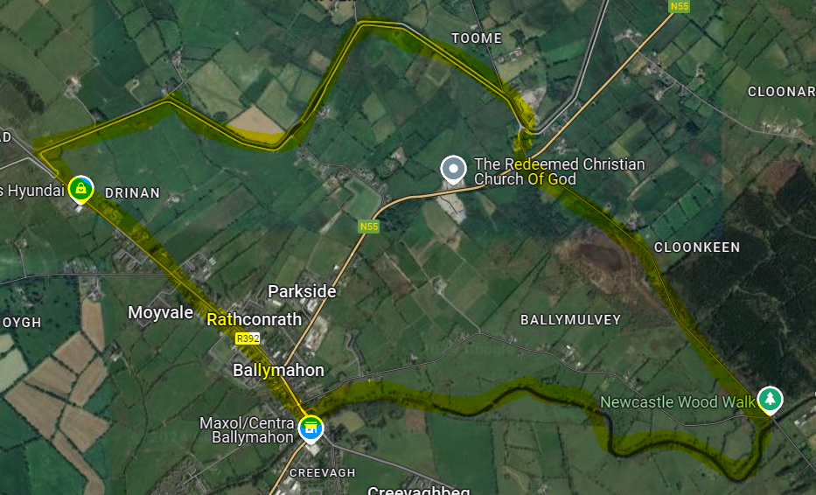
Ballymahon Tidy Towns Group: €16,561
Christmas Lights, Rambling Orchard, Bike Rack and repair station

Slide 25
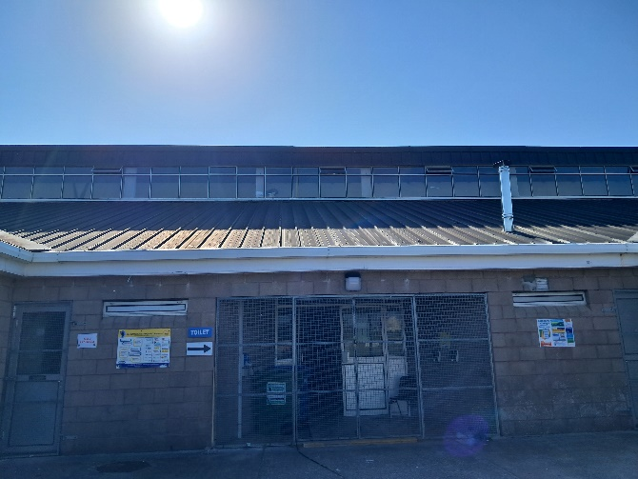
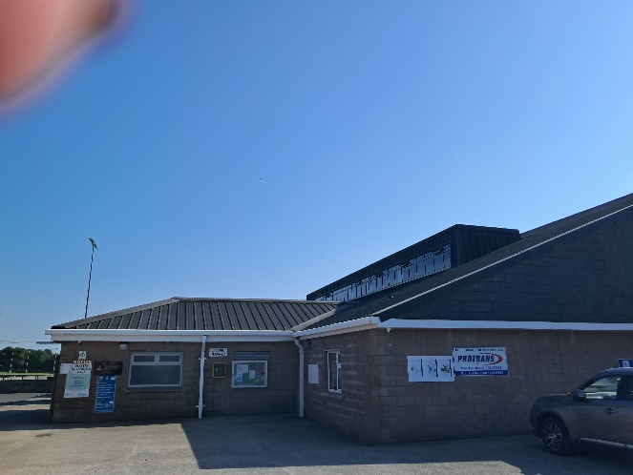

Clonguish GAA: €62,731.15
Windows and Doors Retrofit
Contact: Linda Beirne
Community Climate Action Officer
lbeirne@longfordcoco.ie

Slide 26

Environment
Anti-Litter Awareness Grant Scheme
  Promote public awareness / education and community engagement relating to litter / waste management, graffiti removal, etc.
  Focus on schools and young people and other voluntary initiatives.
  70% of verified expenditure. Max €1,000
  Projects completed and all receipts provided by September
Contact: litter@longfordcoco.ie
Cemetery Support Scheme
  Maintenance and upkeep of cemeteries
  Max €400 - receipts for costs incurred
  1 grant per group per year
  Projects completed and all receipts provided by 1 October
Contact: burials@longfordcoco.ie
Late applications in respect of either grant will not be accepted in 2025

Slide 27

Rural Water Programmes
Well Grants
  Improvement works to an existing private water supply to domestic houses in rural areas
  Up to 5,000 for improvements works – 85% cost
  Up to 1,000 for water treatment – 100%
Group Water Scheme Subsidies
  A contribution of up to €231 per household, towards the operational costs of GWS providing water for domestic use.
  Audited accounts or for smaller schemes (e.g. schemes below the drinking water monitoring threshold commonly called ‘exempted’ schemes), a statement of accounts together with supporting documentation, bank statement, paid invoices
Contact: ruralwater@longfordcoco.ie

Slide 28
Rural Water Programmes Continued
Domestic Water Treatment Systems Grants
This grant is available to assist with the costs of remediation, repair or upgrading works to, or replacement of, a domestic waste water treatment system (DWWTS) that serves a house. The grant is only available where an inspection carried out by Local Authority Staff, and a works advisory notice issues from the local authority.
The level of grant aid available is determined on the basis of 85% of the approved cost of the works subject to a maximum of €12,000. There is no minimum expenditure requirement on the eligible works in order to qualify for a grant.
Important:
Unlike other grant the DWWTS Grant is only available in instances where local authority staff carry out a planned inspection in a priority area for action and works are identified through an advisory notice.
Costs associated with the routine maintenance or servicing of DWWTS, or of de-sludging such systems, do not qualify for grant aid.

Slide 29
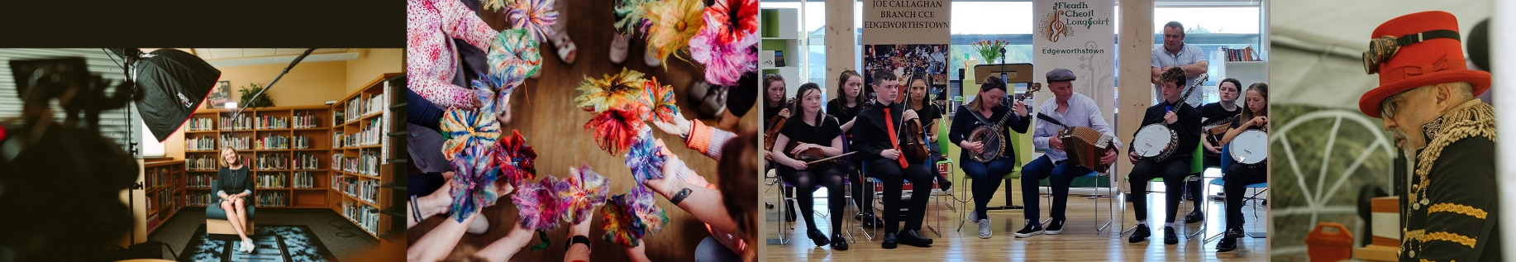
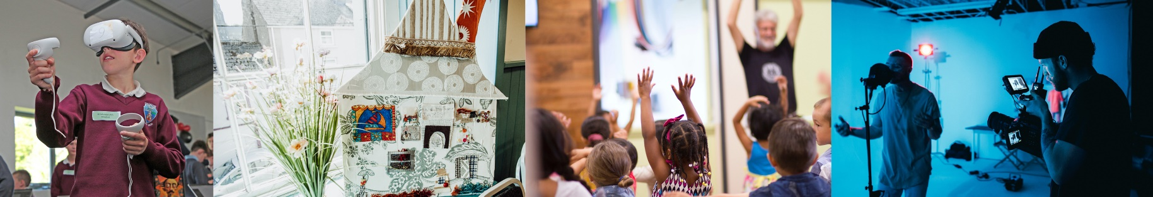
Creative Ireland (CI),
Cruinniú na nÓg (CnÓ)
Longford County Archives & Local Studies and Arts Office Funding

Slide 30
Creative Ireland (CI) and Cruinniú na nÓg (CnÓ)
Longford County Council is inviting applications to fund innovative, creative, and cultural initiatives as part of an open call grant for the following:
CI: Events and projects involving arts, creative industries, heritage, film, animation and others. Projects ‘as Gaeilge’ are also welcome.
CnÓ: Events and projects focused on creating a day of free creative activity for children and young people up to 18 years of age.
Open to: Individuals, organisations, community groups, cultural/creative artists.
All projects: must be community-focused and involve a community element
Grant Amounts: Creative Ireland: Up to a max of €5,000 with a limit of one application per group/person. .
Open Call: November 2025 & Applications Closing Date: January 2026
Funding letters: January 2026 with terms and conditions of funding.
Contact Ciarán Lennon: creativelongford@longfordcoco.ie
Notes:
there are over 10 speakers so Max 2 slides per scheme ( 1 text and 1 photo slide). Keep text to a minimum on slides- you should use your script to expand and explain detail

Slide 31

2023 Creative project examples in Longford
For further information visit: https://www.longfordlibrary.ie/creative-ireland-longford/
Email creativeireland@longfordcoco.ie or call (043) 334 11 24

Slide 32
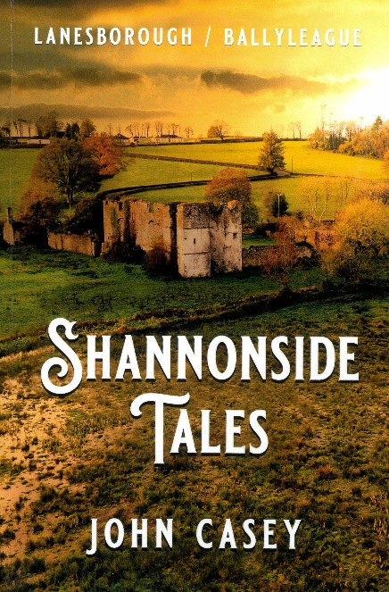
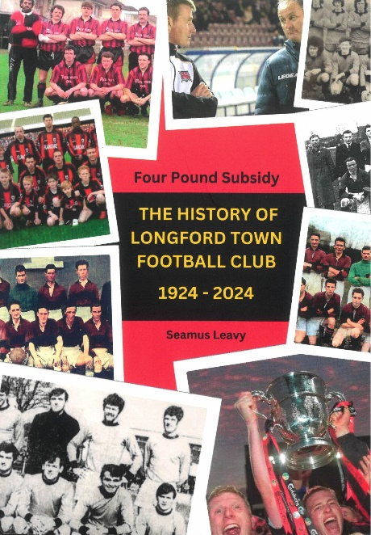
Longford County Archives & Local Studies
€5000 available in total.
Grants to a maximum of €1000 per project.
A full draft of book must be submitted with the application, to be assessed,
plus a quotation for design and printing.
Deadline for applications: 1 June 2025.
More information: archivist@longfordcoco.ie

Slide 33
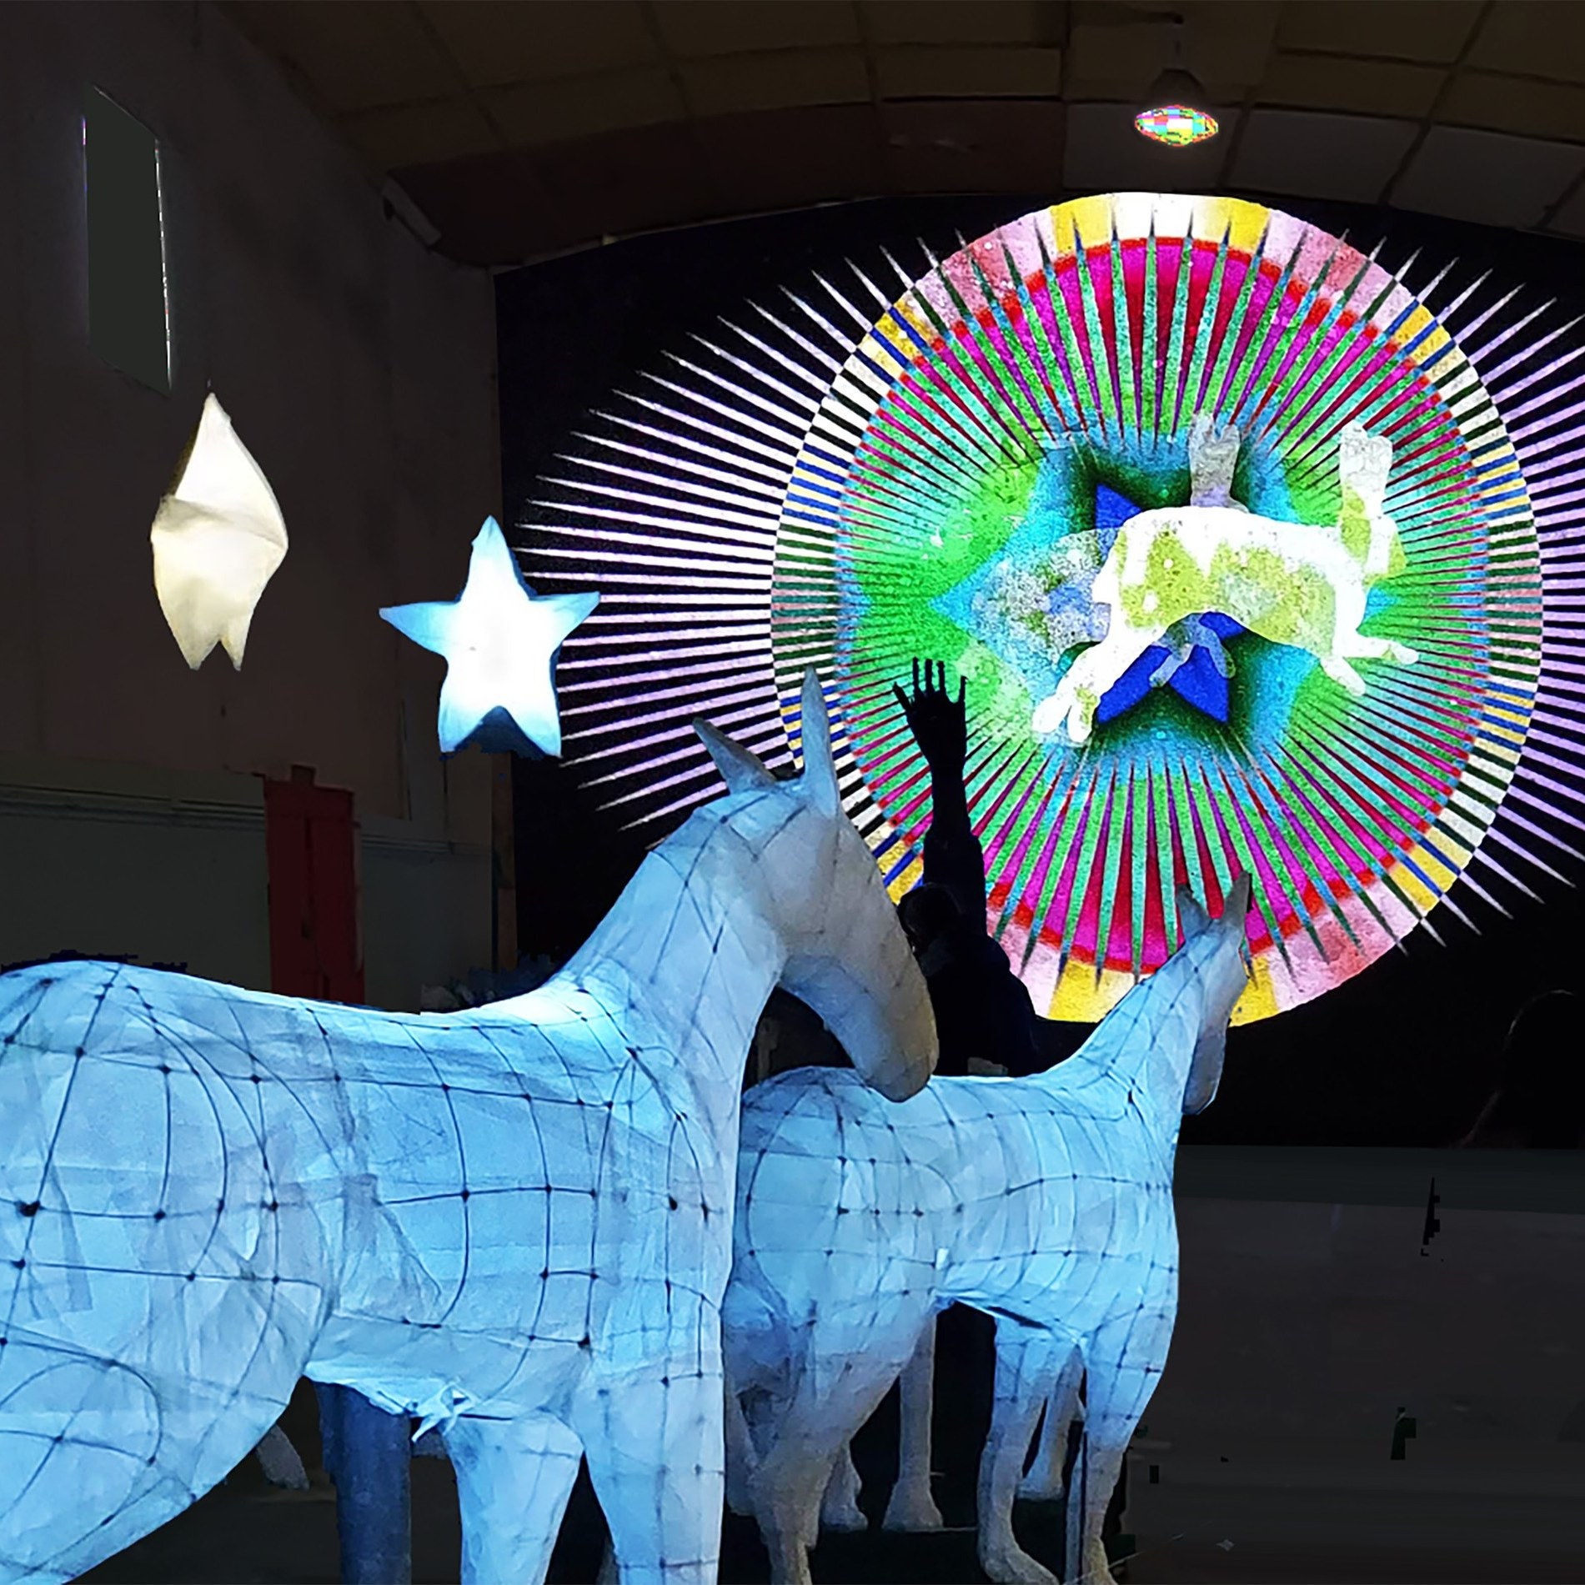
Arts Project Grant, Arts and Cultural Promotion Grants - Longford Arts Service
Arts Project Grant
To support the development of ambitious art projects that significantly benefit the cultural well-being of citizens
Amount Min €1,000 / Max €5,000
Timeline: Opens 16 Oct, closes 6 Dec 2025.
Examples: Arts based events, festivals, ambitious art works in development
Film Bursary Grant
Support emerging filmmakers in County Longford. Awarded for Production of a Short drama or documentary film
Amount: €7000.00
Timeline: opens 14 Oct – Closes 6 Dec 2025
Examples: Invitation to participate in a prominent international exhibition
Contact Shane Crossan
scrossan@longfordcoco.ie
Notes:
there are over 10 speakers so Max 2 slides per scheme ( 1 text and 1 photo slide). Keep text to a minimum on slides- you should use your script to expand and explain detail

Slide 34

Artist Bursary and Culture Night Grant
Longford Arts Service
Artist Bursary
Purpose: The professional development of artists. For example, training, mentoring, travel, equipment.
Amount: Min €500 / Max €3,000.
Timeline: Opens 14 Oct – Closes 6 Dec 2025
Culture Night Grant
To support citizens/organisations with costs associated with Culture Night events for example, venue rental, marketing, materials
Amount: Min €200 / Max €500. Fund limit €4,500
Timeline: Opens 27 May, closes 11 July 2025
Culture Night is on Friday, 19 September 2025
Contact Arts Officer
Shane Crossan
scrossan@longfordcoco.ie

Slide 35
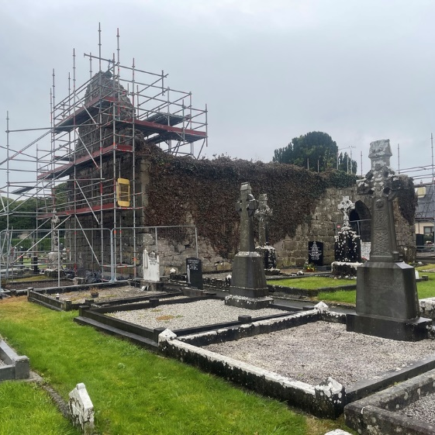
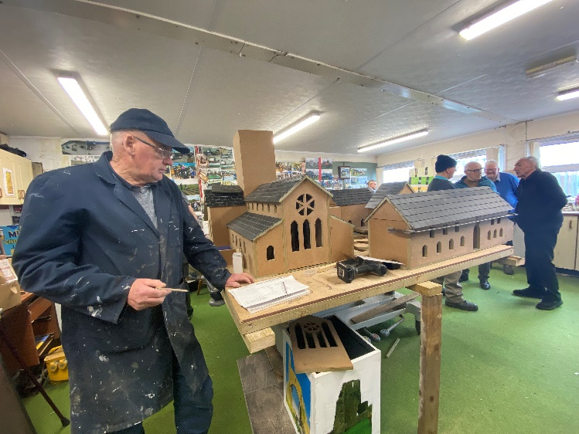
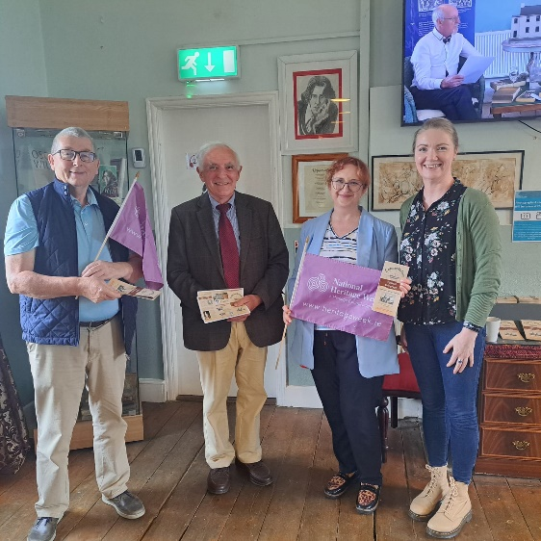



Heritage Funding Opportunities for Communities
There are a number of funding opportunities for communities to support their research, conservation and awareness of built and cultural heritage in Co. Longford and beyond.

Slide 36
Heritage Funding Opportunities – The Heritage Council
Heritage Organisations Support Fund 2025 (closing 27 January 2025)
The scheme is open to not-for-profit non-governmental heritage-focused organisations with demonstrated national and/or regional relevance.
It aims to build the capacity of non-governmental organisations working in the heritage sector, and foster innovation, in Ireland by providing funding towards their core costs.
Open to not-for-profit organisations, relating to one of the aspects of heritage in the Heritage Acts 1995 & 2018, or engaged in the protection of intangible cultural heritage; conditions apply.
Maximum grant of €50,000. Approximately 30-40 organisations nationally will be supported each year.
Information and application available at Heritagecouncil.ie/funding/heritage_orgs-fund
Notes:
there are over 10 speakers so Max 2 slides per scheme ( 1 text and 1 photo slide). Keep text to a minimum on slides- you should use your script to expand and explain detail

Slide 37
Heritage Funding Opportunities – The Heritage Council
Community Heritage Grant Scheme 2025 (opening soon)
The scheme is open to:
  Voluntary and community groups for example Tidy Towns groups, local action groups & societies, parish & church councils etc.
  Non-governmental organisations (NGOs) including not-for-profit trusts
  Adopt a Monument Programme participants
The type of initiatives supported are:
  Workshops and training events.
  Development of Digital Heritage Resources.
  Conservation surveys, reports, plans, and audits.
  Conservation works to buildings, monuments, habitats, objects or collections.
The scheme will likely open for applications in late January/early February 2025.
Heritagecouncil.ie/funding/community-heritage-grant-scheme-2

Slide 38
Heritage Funding Opportunities – Built Heritage
Historic Structures Fund 2025 (closing date, 17 January 2025)
This scheme works to safeguard protected structures at risk of significant deterioration for the benefit of communities and the public.
It supports conservation with a focus on larger enhancement, refurbishment or reuse projects involving heritage structures, where:
                a clear community or public benefit has been demonstrated or
a clear residential benefit has been demonstrated
Buildings must be on the current Longford County Council Record of Protected Structures, (RPS), - limited exceptions apply.
Grants will be between €50,000 – 200,000, up to a max of 50% of the project costs.
Info & application forms available at: longfordlibrary.ie/heritage/heritage-funding

Slide 39
Heritage Funding Opportunities – Built Heritage
Built Heritage Investment Scheme 2026 (opening mid-2025)
This scheme works to support the custodians of protected structures undertake necessary repairs and conservation to safeguard their historic structures.
The repairs will be necessary to safeguard the building and/or the public, and will use traditional materials and skills as far as possible.
It is open to structures on the current Longford County Council Record of Protected Structures, (RPS), - limited exceptions apply.
Grants will be between €2,500 – 50,000, up to a max of 80% of the project costs; however, it is anticipated final grant amounts may be significantly less than this: likely up to €15-20,000.
Info & application forms available at: longfordlibrary.ie/heritage/heritage-funding

Slide 40
Heritage Funding Opportunities – Archaeology
Community Monuments Fund 2025 (closing date 31 January 2025)
The core aims of this Fund are the conservation, maintenance, protection and presentation of archaeological monuments, by
Enabling urgent conservation works to be carried out on significant
building resilience in our monuments, to enable them to withstand climate change;
encouraging access to monuments and improve their presentation.
Communities are encouraged to apply for funding under one of three streams:
Stream 1: Up to €100,000 - Essential repairs and capital works to conserve monuments.
Stream 2: Up to €30,000 - Develop conservation and management plans.
Stream 3: Up to €30,000 - Help public access and interpretation of monuments.
Info & application forms available at:
longfordlibrary.ie/heritage/heritage-funding

Slide 41

Heritage Funding Opportunities – Local
Longford Heritage Initiatives Fund 2025, (opening February 2025)–
This is a new initiative developed in 2024, to enable communities and heritage groups develop local heritage research and engagement projects.
Types of projects supported may include:
Heritage Research: Longford Field Names Project recording, aerial photogrammetry and LiDAR recording of archaeological sites.
Support for projects and events to celebrate National Heritage Week (August 2025)
Applications will be via an online application process.
Support may be subject to funding being made available from other sources.
Double-funding with other Longford CoCo schemes will not be supported.
For further information email: heritage@longfordcoco.ie

Slide 42
Fáilte Ireland Regional Festival and Participative Events Fund - Longford Tourism
Aim: to support festivals/events in driving both domestic and international tourism
Objective: to support community/voluntary groups organising a diverse range of projects and events
The festival or event must:
Take place in County Longford
Aim to attract international visitors
Run for two consecutive days in duration minimum
Fit into one of the following categories:
- General festivals (literary, historic, fairs, traditional culture or family focused)
- Arts, music and theatre
- Family sports and outdoors
Amount: A maximum of €4,000 per organisation can be received in any one year with a maximum of three events funded
Timeline: This fund is advertised twice a year for festivals from January to June and from July to December. Round 1 is currently open, accepting applications until Friday, 31 January 2025.
Contact:
Denise Canavan, Tourism Officer
tourism@longfordcoco.ie
Notes:
there are over 10 speakers so Max 2 slides per scheme ( 1 text and 1 photo slide). Keep text to a minimum on slides- you should use your script to expand and explain detail

Slide 43

Night Time Economy Small Grants scheme
Supported by the Department of Tourism, Culture, Arts, Gaeltacht, Sport and Media to develop Longford’s Night Time economy
Purpose: To encourage cultural vibrancy, enhance safety, and improve accessibility during evening hours through community driven initiatives and partnerships.
Amount: From €500 to €3000
2 Phase application:
Phase 1: Expression of interest(EOI).Submit a brief overview of your project.
Phase 2: Full application. Shortlisted EOIs will be invited to submit a detailed application, including budgets, quotations and supporting documentation.
Project examples: Develop a late-night arts trail with exhibitions and performances, Start a town-based walking group with cuppa after
Contact: Karen Reilly Night Time Economy Advisor: kreilly@longfordcoco.ie
Notes:
there are over 10 speakers so Max 2 slides per scheme ( 1 text and 1 photo slide). Keep text to a minimum on slides- you should use your script to expand and explain detail

Slide 44

County Longford Public Participation Network (PPN)
What is County Longford PPN?
Main link through which Longford County Council and other decision-making bodies connect with the community, voluntary, social inclusion and environmental sectors.
Allows diversity of voices and interests to be facilitated and involved in the decision-making process.
How is this achieved?
Facilitates the election of community representatives to all Longford County Council Committees and other policy making boards and agencies.
Engage, encourage and support members to participate in public consultations.
Act as an information hub

Slide 45
County Longford Public Participation Network (PPN)
Criteria for joining?
  Are active and have a postal address in County Longford
  Operate on a not-for-profit basis
  Are volunteer-led
  Have a constitution / set of rules / Memorandum of Understanding
  Meet regularly
  Are non-party political
How to apply for membership?
Visit: www.longfordppn.ie
Contact details: Siobhán Cronogue 087 261 5583 or email: scronogue@longfordcoco.ie or publicparticipationnetwork@longfordcoco.ie

Slide 46
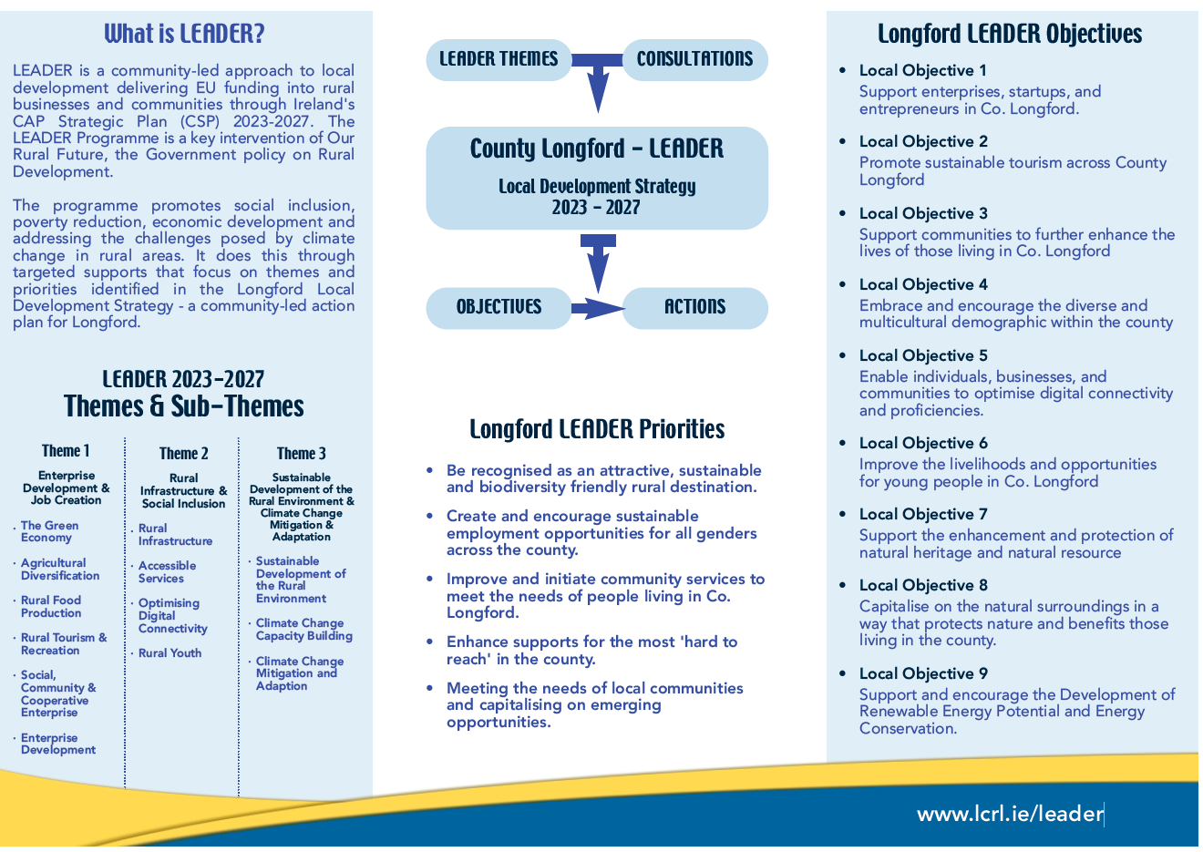

Slide 47
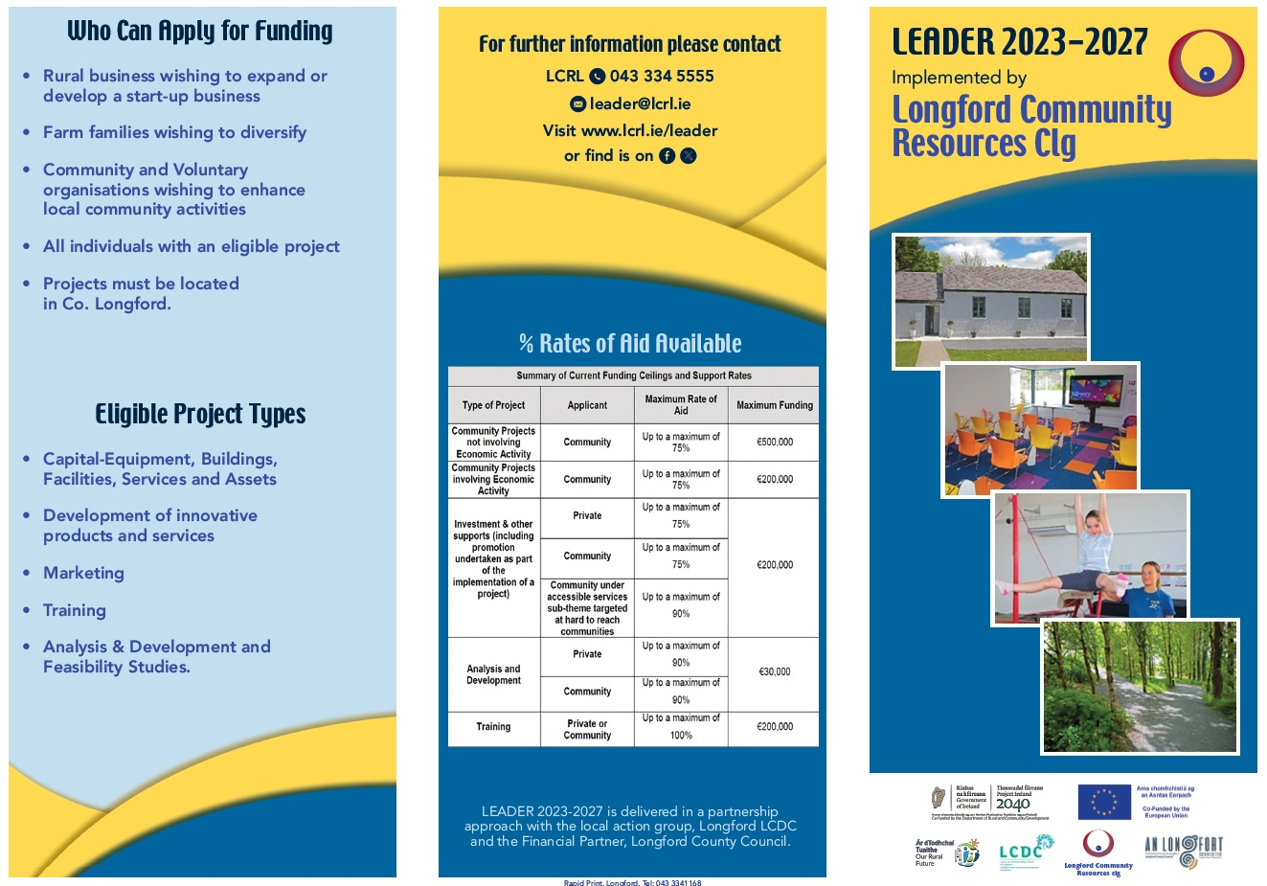
Longford LCRL

Slide 48

Summary of important points
Competitive process
Terms and Conditions of scheme
Eligibility
Costs and funding sources
Capital versus operational costs
Matched funding requirements?
Deadlines and timelines for delivery
Online applications vs paper forms
Apply for Tax Clearance status
GPS coordinates / Eircode
Supporting documentation
Changes to the project
Expectations
Help is Available
Notes:
Expectations- what is the responsibility of the community group vs what is the responsibility of the LA. What level of funding do you expect? If the max grant is 1,000 and your project caost 5,000 and you have no other funding source- is it realistic?
Conflict of Interst

Slide 49
Pathways to Funding
Community Grant Schemes
Information Sessions 2025
Longford Library – Tuesday 14 January
Ballymahon Library – Wednesday, 15 January
Granard Library – Thursday, 16 January
longfordcoco.ie

