Slide 1


Tidy Towns Engagement Event
What the Adjudicator Considers
Ann O’Leary April 2024

Slide 2
Community Your Involvement & Planning
Maximum Mark 80

Slide 3
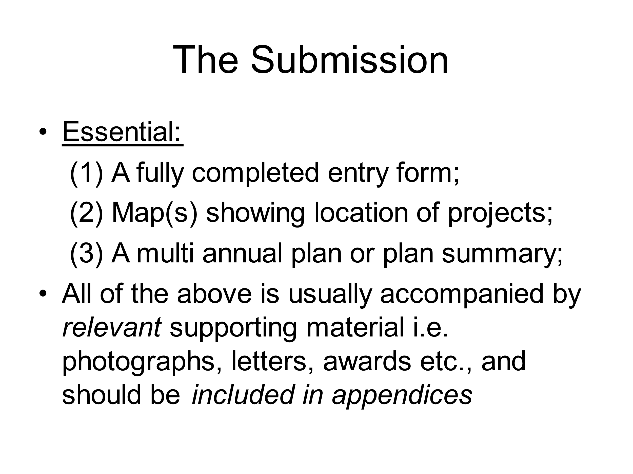

Slide 4
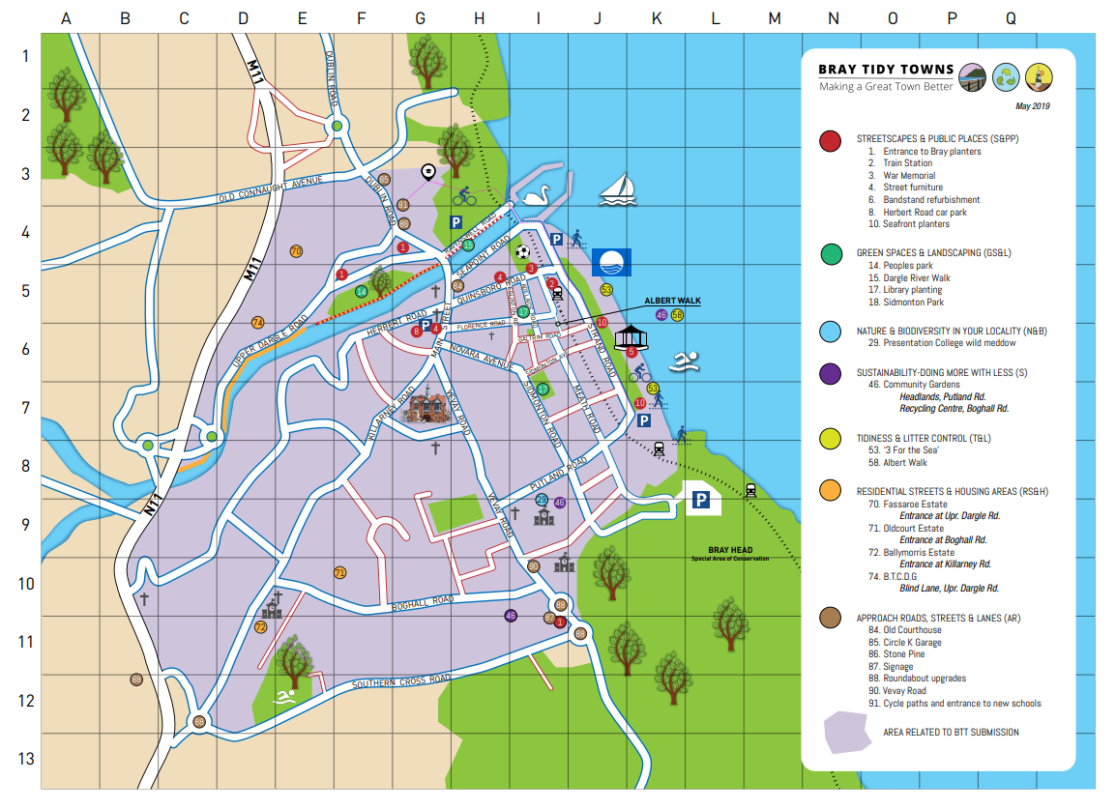
Bray
Town Map

Slide 5
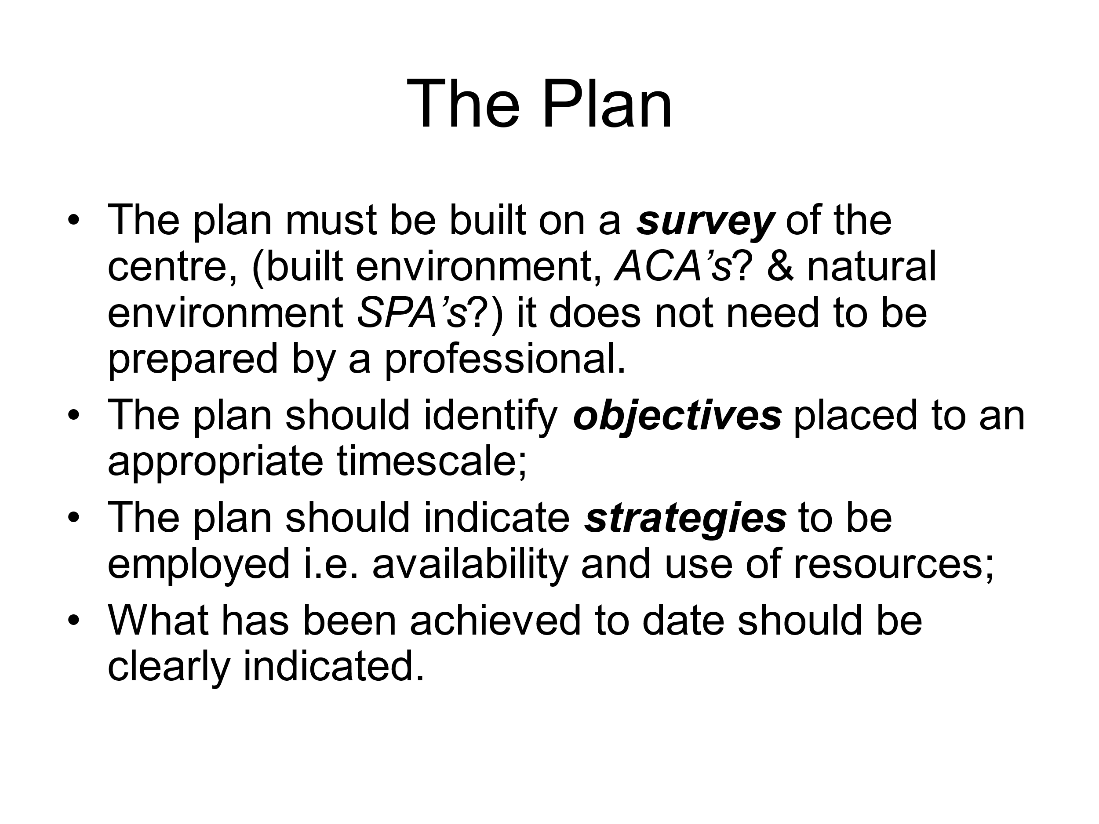

Slide 7
The Entry Form
Evidence of Liaison with Community Groups and Schools, The Local Authority and Other Statutory Agencies, (web site, newsletter, Facebook, WhatsApp and other media).
Organisational Structure (committee / volunteers – an umbrella group / subgroup? Junior TT group?)
Frequency of meetings
Inclusivity e.g. universal accessibility, generation mix?
Project most proud of (Biodiversity Plan? Sensory Garden? Fitness Park? Spring Clean?)
Communicating TT activities and achievement; e.g. exhibitions? Thank you awards evenings?

Slide 8
What your Adjudicator considers
What is it that makes your area special?
What features are characteristic of the area - what type of atmosphere is there?
Are there any special considerations which affect development pressures such as tourism or commuter housing?
What are the places and features that are important to the history or distinctiveness of the area?
What are the facilities like? Are there facilities such as play areas, shops, clubs for young people, cafes, pubs, access for the disabled or baby buggies, recycling points etc?
How do visitors to the area perceive it and what facilities are available to enable visitors enjoy the area?

Slide 9
Streetscape & Public Places
Maximum Mark 80

Slide 10
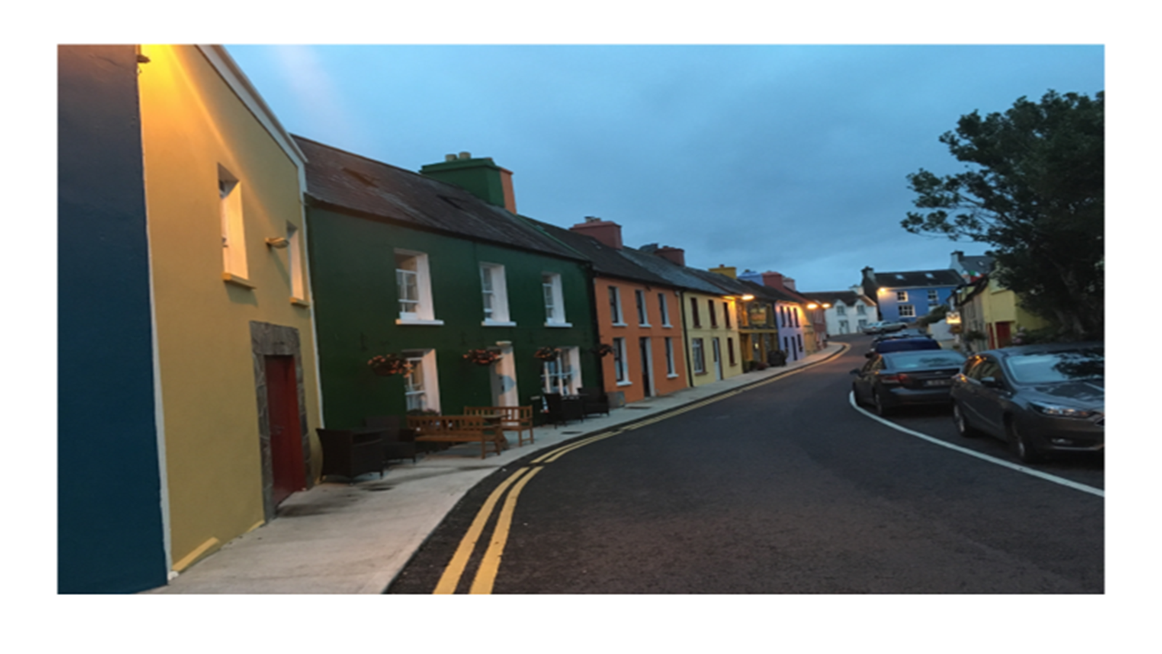
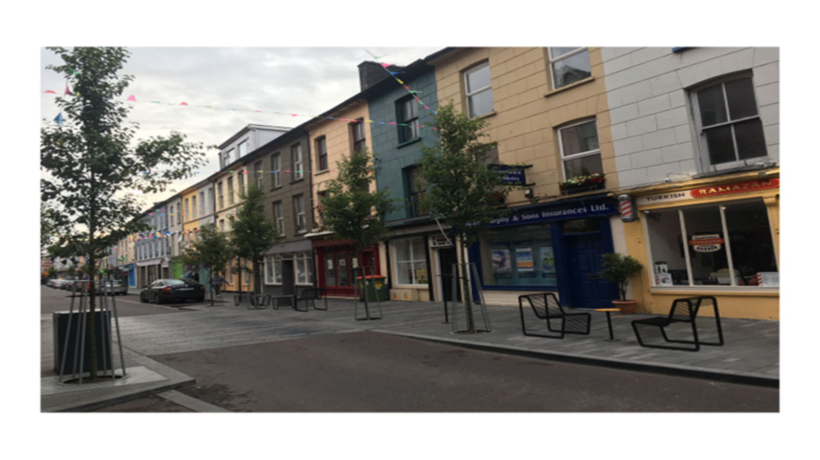
Elements of Streetscape
Buildings (including focal buildings)
Footpaths and Pedestrian Areas
Kerbs and Medians
Trees and Soft Landscaping
Planters
Street Furniture - various
Bus Shelters
Cycle Facilities
Public Art
Village Green/ Parks / Gardens / Playgrounds
Outdoor cafes and Markets

Slide 11
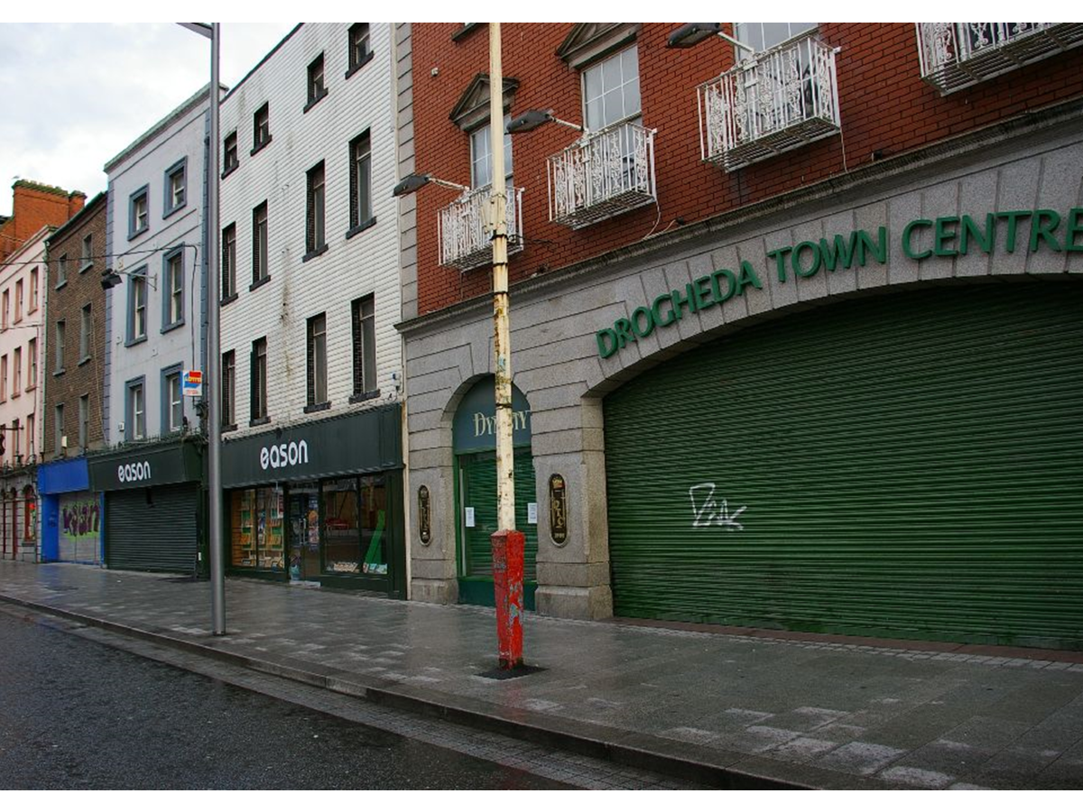
What the Adjudicator considers
Elements that influence Architectural Character
1. Public and Private Buildings including Derelict
Sites and Buildings
2. Building Materials and Colour
3. Shopfronts & Upper Storeys
4. Graveyards
5. Public Places – the Public Realm
Streets
Street furniture
Paving
Monuments, Sculptures and Art Forms
Overhead Cables
6. Signage
7. Boundary Treatments

Slide 12
Green Spaces & Landscaping
Maximum mark 80

Slide 13
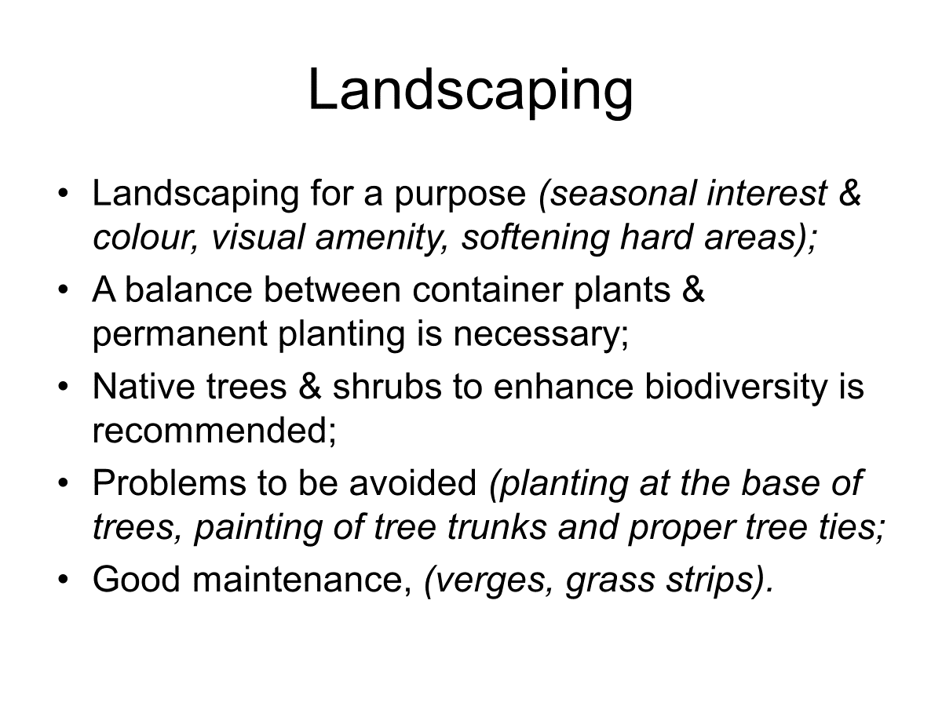
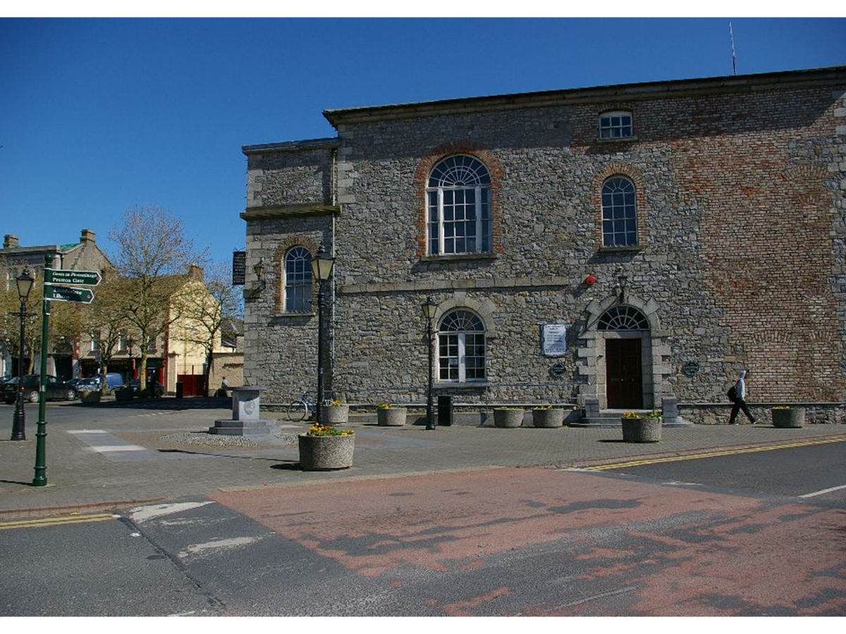

Slide 14
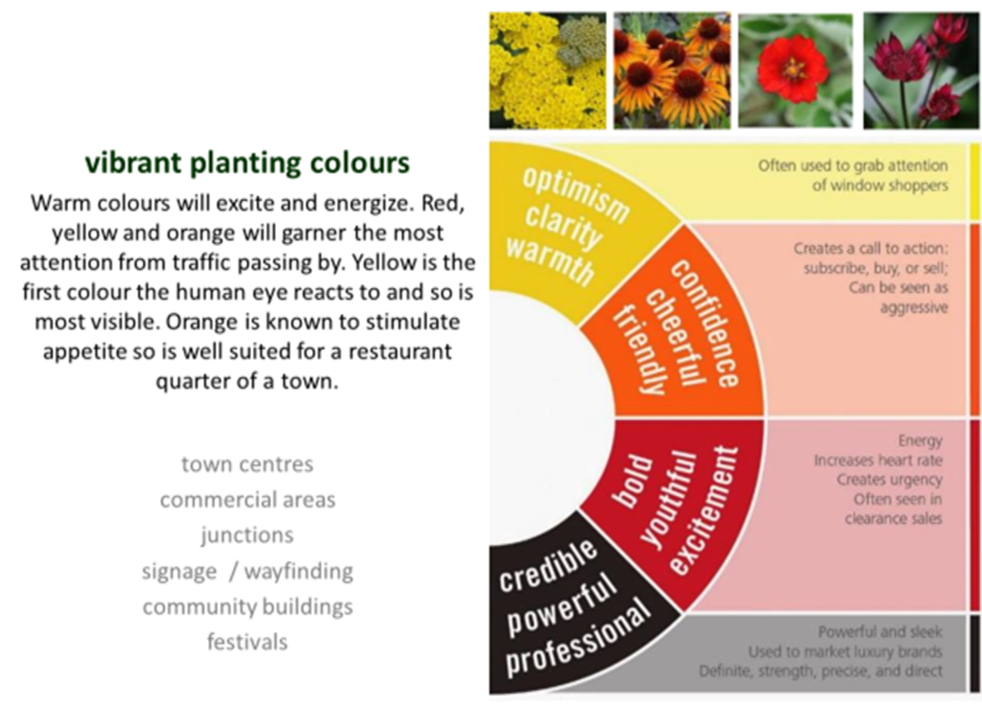

Slide 15
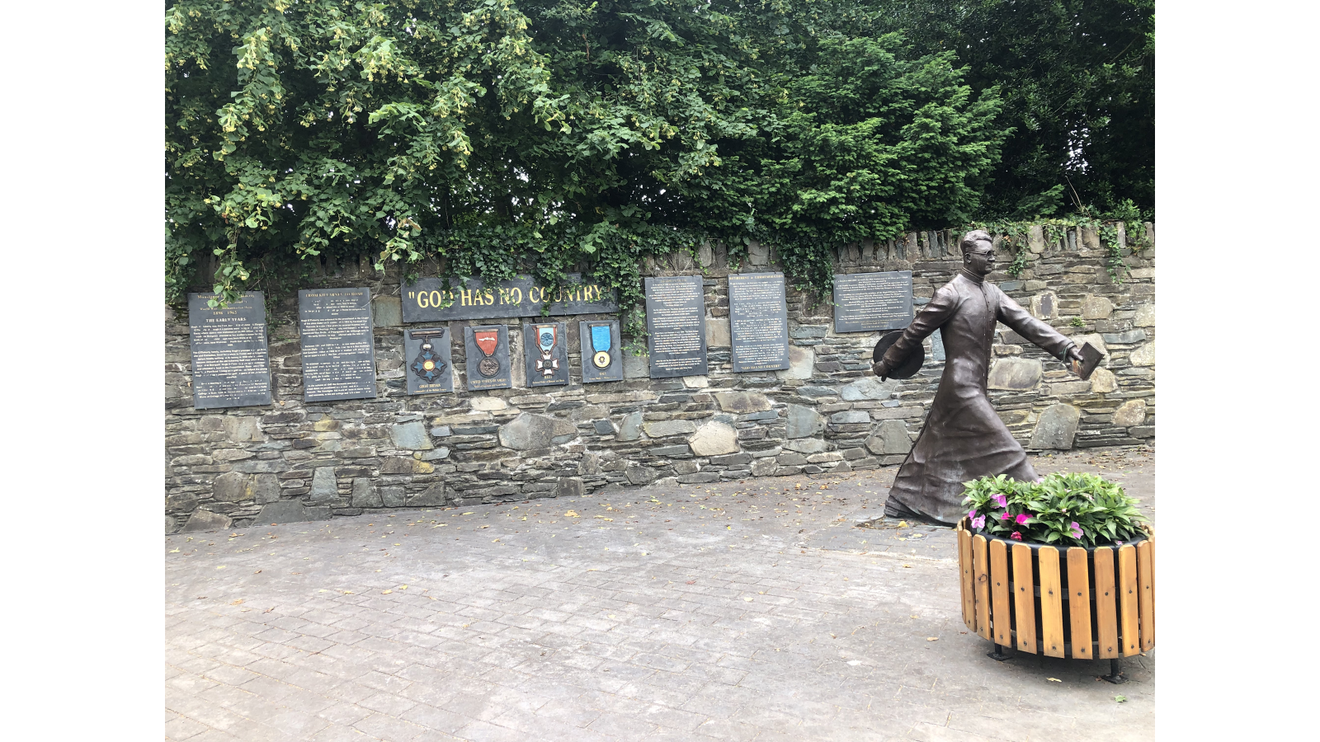
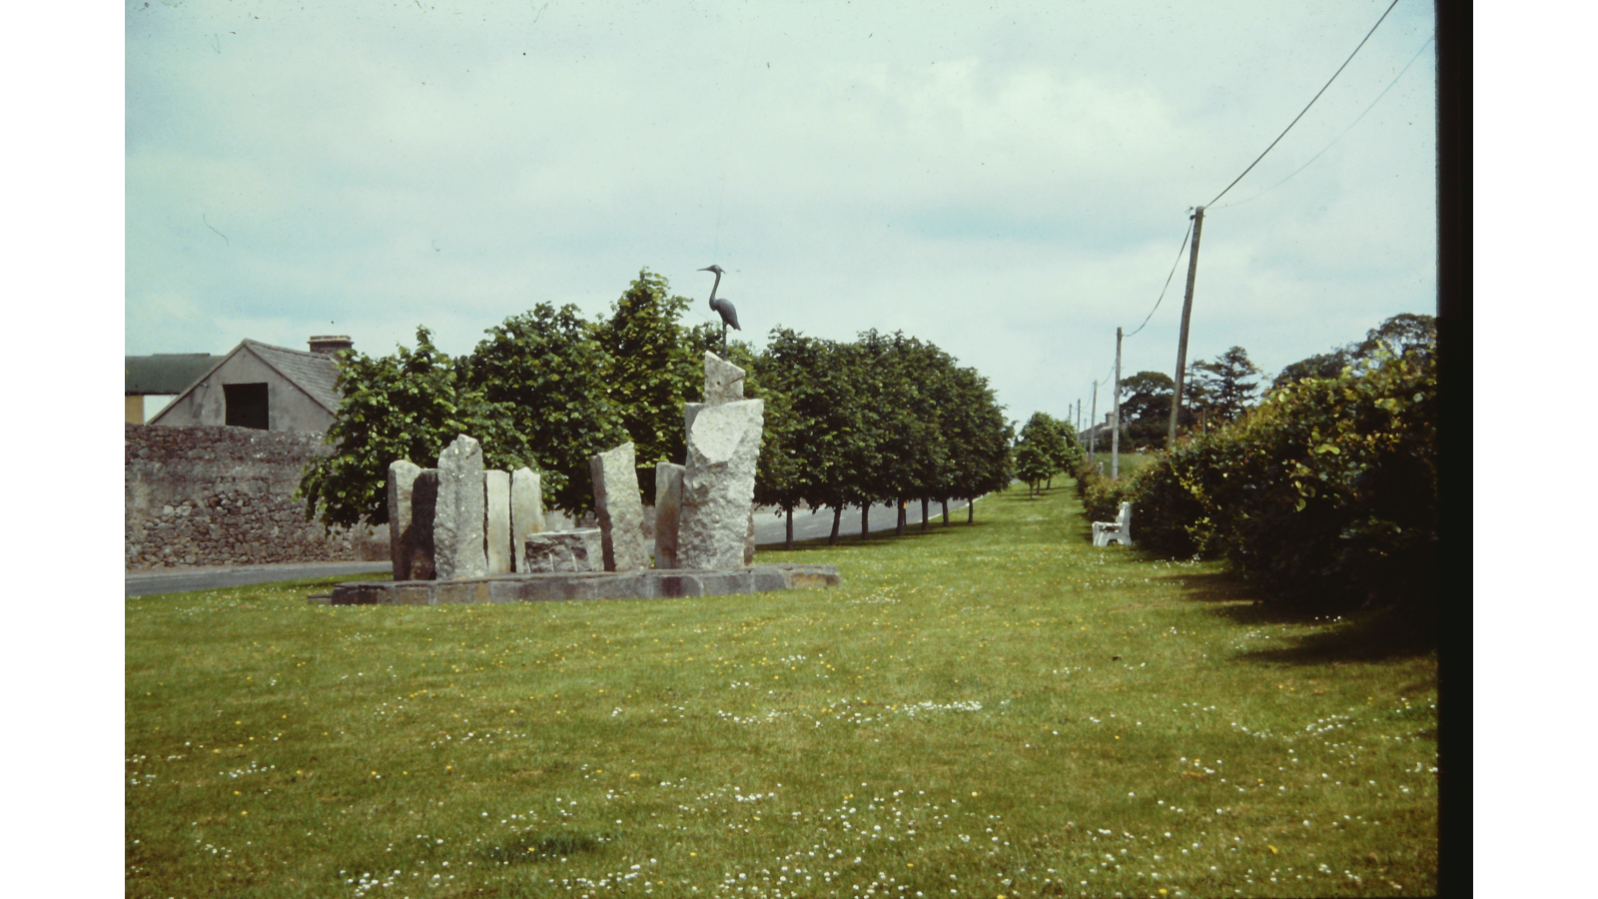

Slide 16
What the Adjudicator considers
• The appropriate selection and siting of trees, hedges, shrubs and flowers for year-round effect.
• The maintenance of trees, including formative pruning (if required), watering and attention to the stakes and ties. Over-pruning and pruning when not required can be a common issue.
• Incorporation of native and pollinator friendly plants into planting schemes where appropriate.
• The planting of the incorrect species of trees, such as the use of nonnative trees where a native tree would be much more appropriate e.g. at the edges of towns and villages where they meet the countryside.
• The location, design and maintenance of planted areas.
• The planning, design and management of green spaces.
• Presentation of landscaping of all entrances to your town/village/locality.

Slide 17
Nature & Biodiversity In Your Locality
Maximum Mark 55

Slide 18
Common Invasive Species
JAPANESE KNOTWEED (BY FAR THE MOST FAMILIAR INVADER) PERNICIOUS, RESILIENT, WIDESPREAD, SPREAD PHYSICALLY BY US
GIANT KNOTWEED
HIMALAYAN KNOTWEED
HIMALAYAN BALSAM
THREE-CORNERED LEEK
MONTBRETIA
GIANT HOGWEED
IT’S ALL ABOUT ABILITY TO PERSIST AND TO DO ECONOMIC HARM WHILE DOING SO
Monotary Costs
PESTS OF FOOD CROPS
CONTAMINATORS
PREDATORS OF POLLINATORS
DAMAGE TO BUILDINGS
Biodiversity Costs
Disease & Displacement of Native Species
Predation & Outcompeting Natives

Slide 19
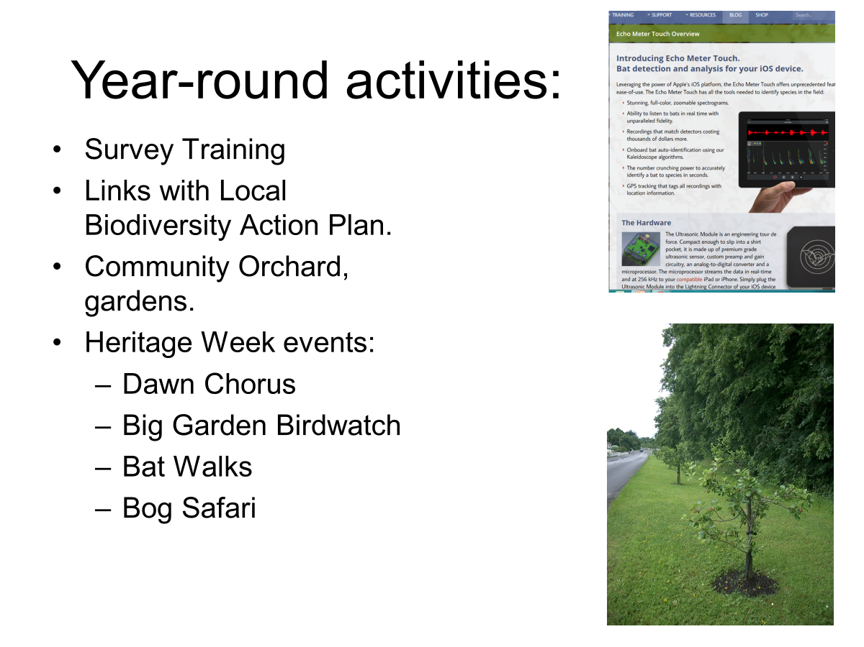

Slide 20
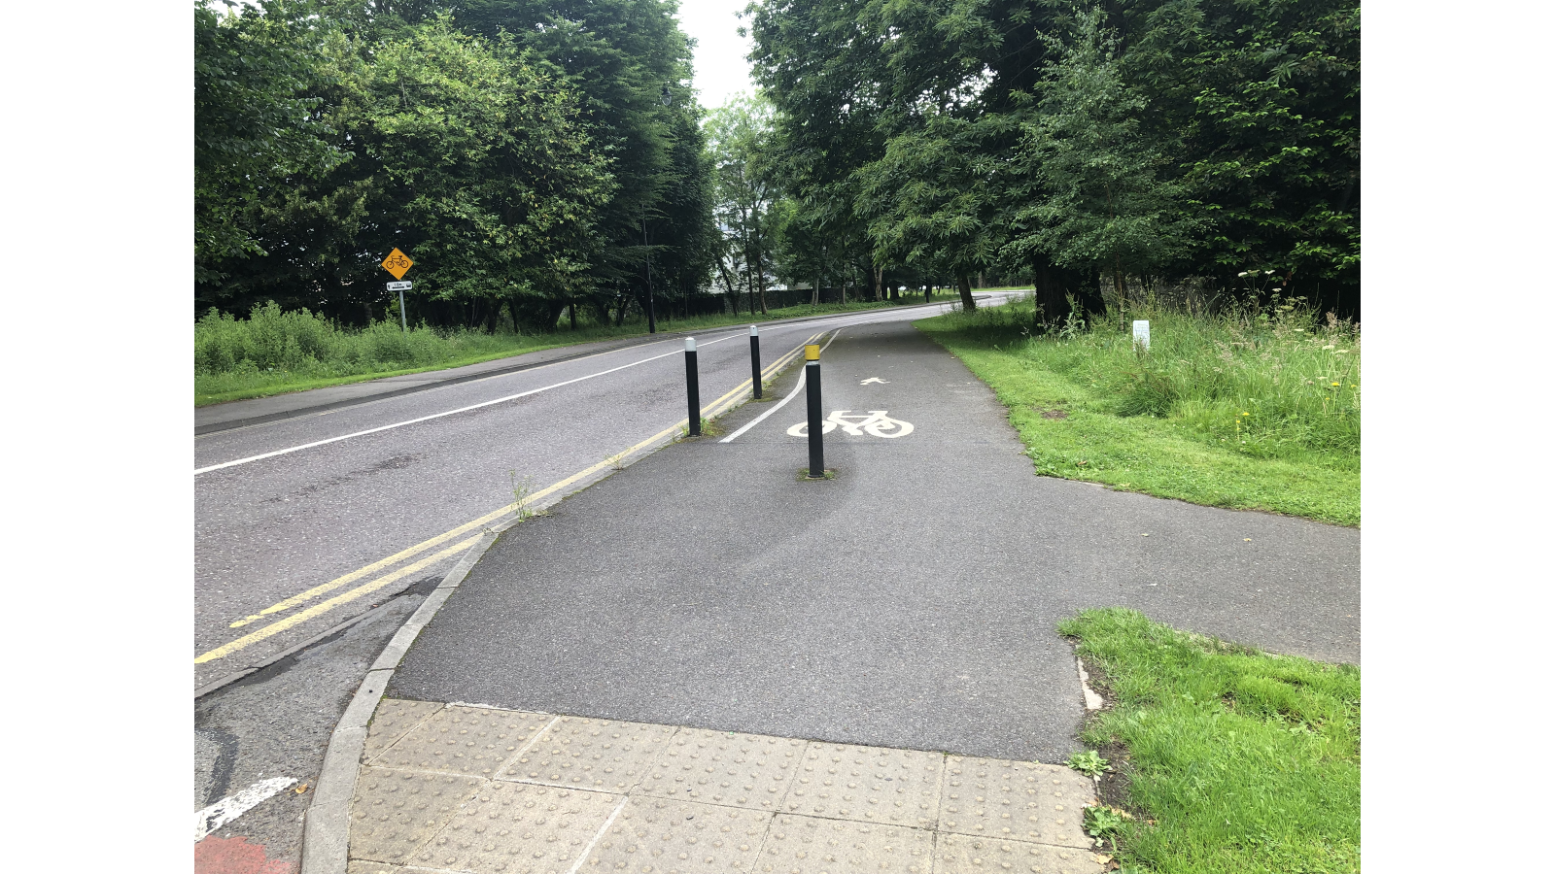
What your Adjudicator considers
1. Knowing and Understanding Nature and Biodiversity in your Locality
2. Habitats and Species in your Locality
3. Actions for Nature and Biodiversity
4. Awareness

Slide 21
Good Sources of Information
www.pollinators.ie
www.fisheriesireland.ie
http://invasivespeciesireland.com
www.irishwildflowers.ie/
BSBI Plant Atlas of Ireland 2020
Dublin Naturalists Field Club Papers February 2024

Slide 22
Sustainability-Doing More With Less
Maximum Mark 55

Slide 23
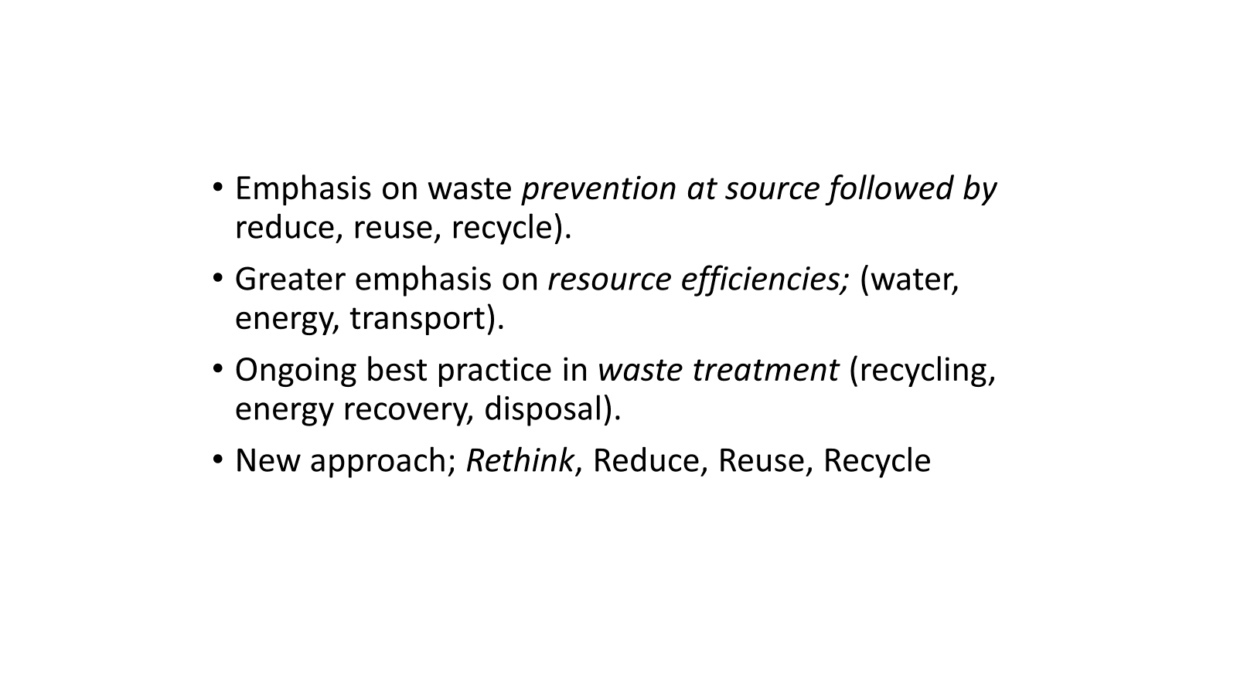
Encouraging Best Practice:

Slide 24


Slide 25
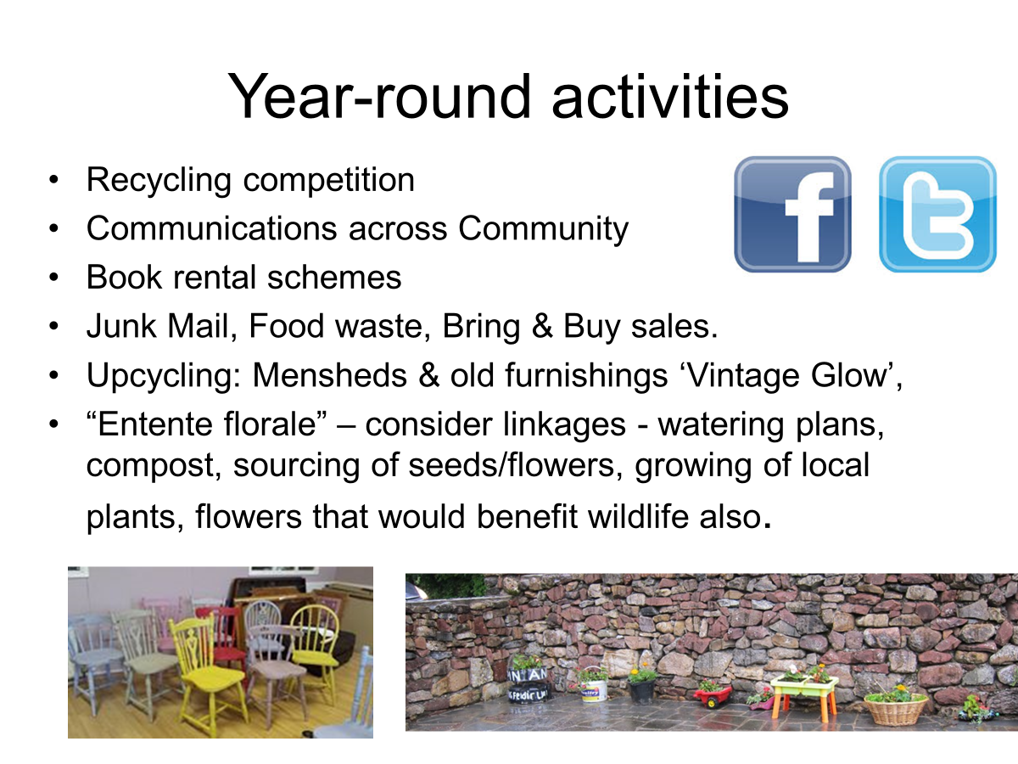

Slide 26
Recommendations
Know your Starting Point; (simple waste awareness surveys with schools/ households/ businesses etc).
Evidence of Environmental Awareness Campaigns; (leaflets, social media, press release).
Ongoing promotion to ‘Reduce, Reuse, Recycle’ (alongside prevention at source).
Links with Green Schools/Homes & Business.

Slide 27
Tidiness & Litter Control
Maximum Mark 90

Slide 28
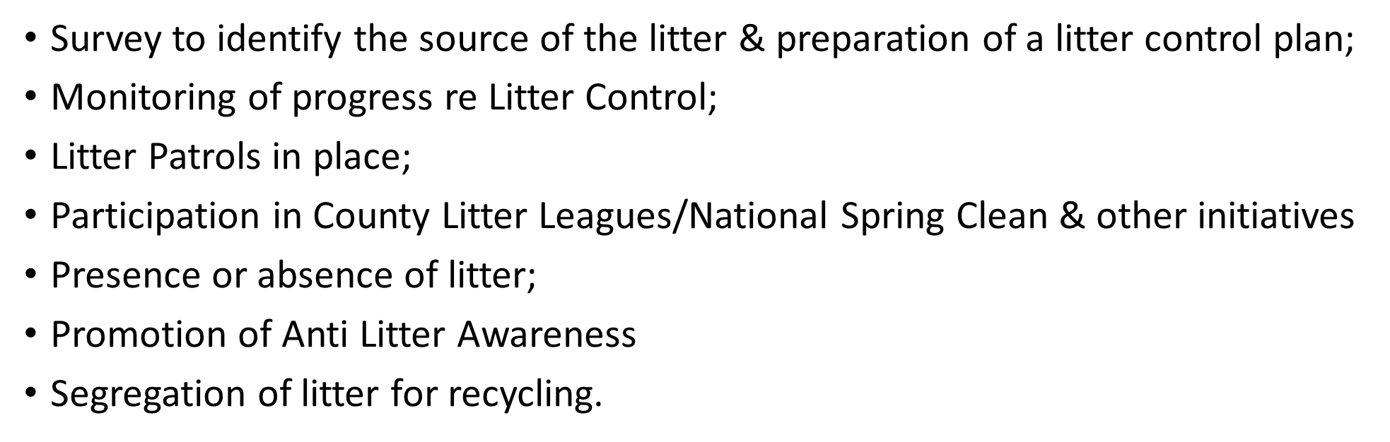

Slide 29
Boundary walls / fencing and their maintenance;
Advertisment hoardings & their scale / condition;
Presentation of / or absence of signage;
Open undeveloped sites / dumped vehicles;
Street clutter & sign pole clutter;
Weed growth along kerbs and walls;
Unsightly wire-scape;
Graffiti & fly posting;
Traffic management & parking arrangements.

Slide 30
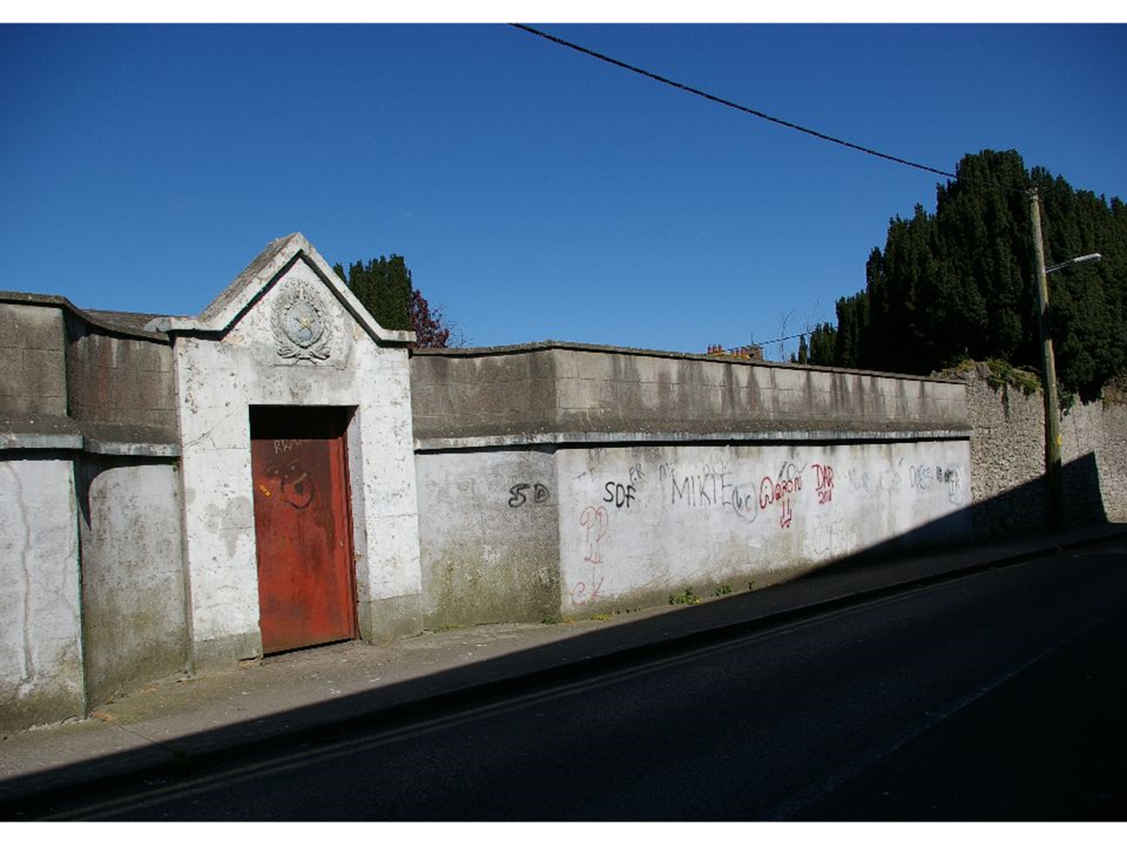
What the Adjudicator considers under Tidiness & Litter Control
• Lack of physical and visual clutter
• Presentation of signage
• Absence of inappropriate advertisement hoardings
• Redundant and useless poles
• Presence of unsightly overhead wires
• Prevalence of graffiti and flyposting
• Traffic management and parking arrangements
• General weed and plant management
• Any outstanding tidiness issues that may not have been
picked up in other categories
• Treatment of vacant buildings; derelict /undeveloped sites; management of graveyards.
• Presentation of curtilage areas viewed from the public realm
• Presentation of street furniture

Slide 31
Residential Streets & Housing Areas
Maximum Mark: 55

Slide 32
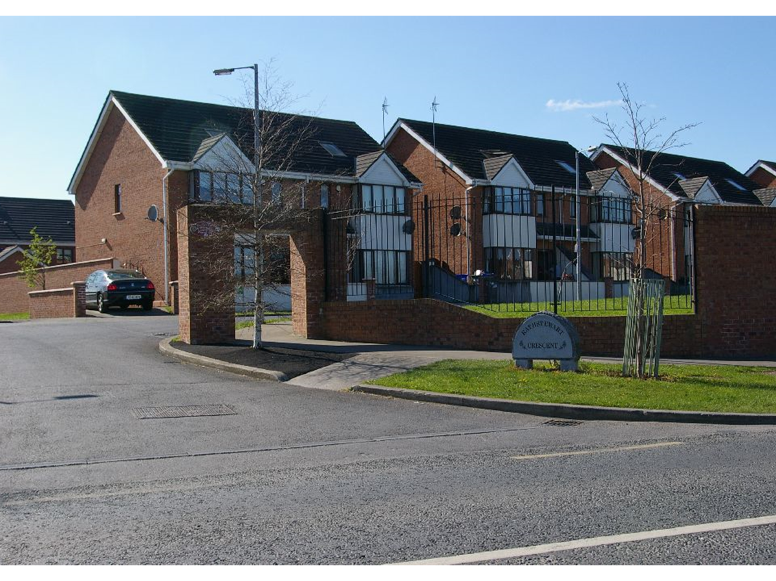
Residential Areas 55 Marks
Presentation and Maintenance of private property;
Roadside boundary walls & fencing & gables;
Estate entrance, identification & directional signs;
Green and hard open spaces;
Play areas & equipment for children & families;
Side & back areas of dwellings visible from
the public realm;
Litter Control.

Slide 33
What the Adjudicator considers:
The presentation and appearance of:
Private dwellings including their roadside boundary walls, fences and private open spaces
Communal open spaces - their maintenance, presentation, function and universal accessibility
Landscaping
Estate signage and entrances
Links to town centre and facilities
Contribution to Sustainable Development Goals

Slide 34
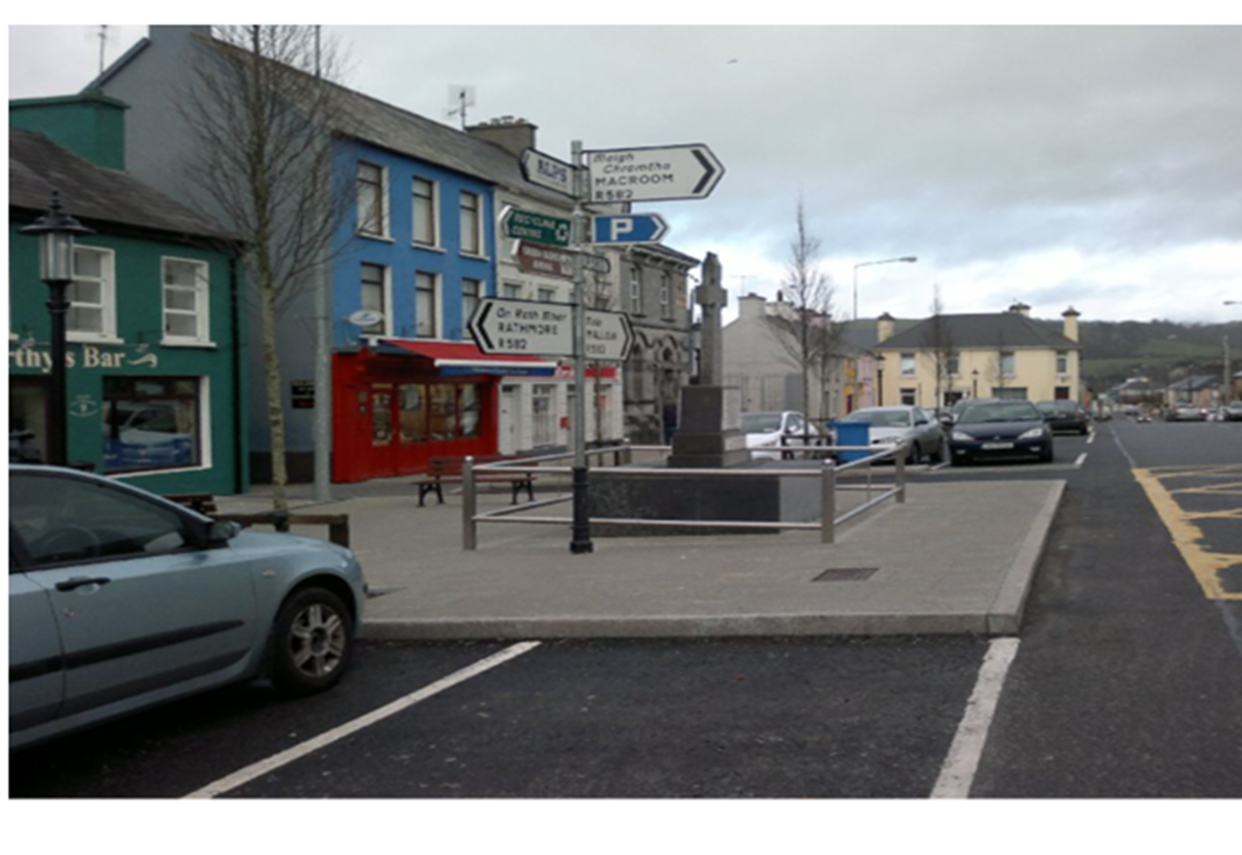
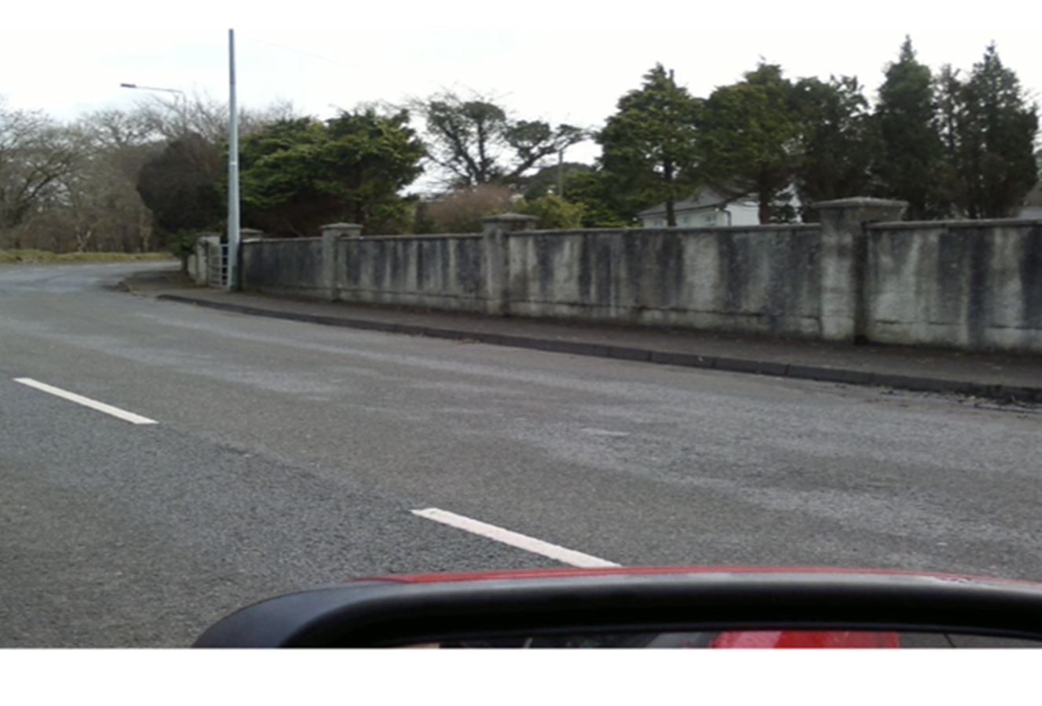
Approach Roads, Streets & Lanes
Maximum Marks: 55

Slide 35
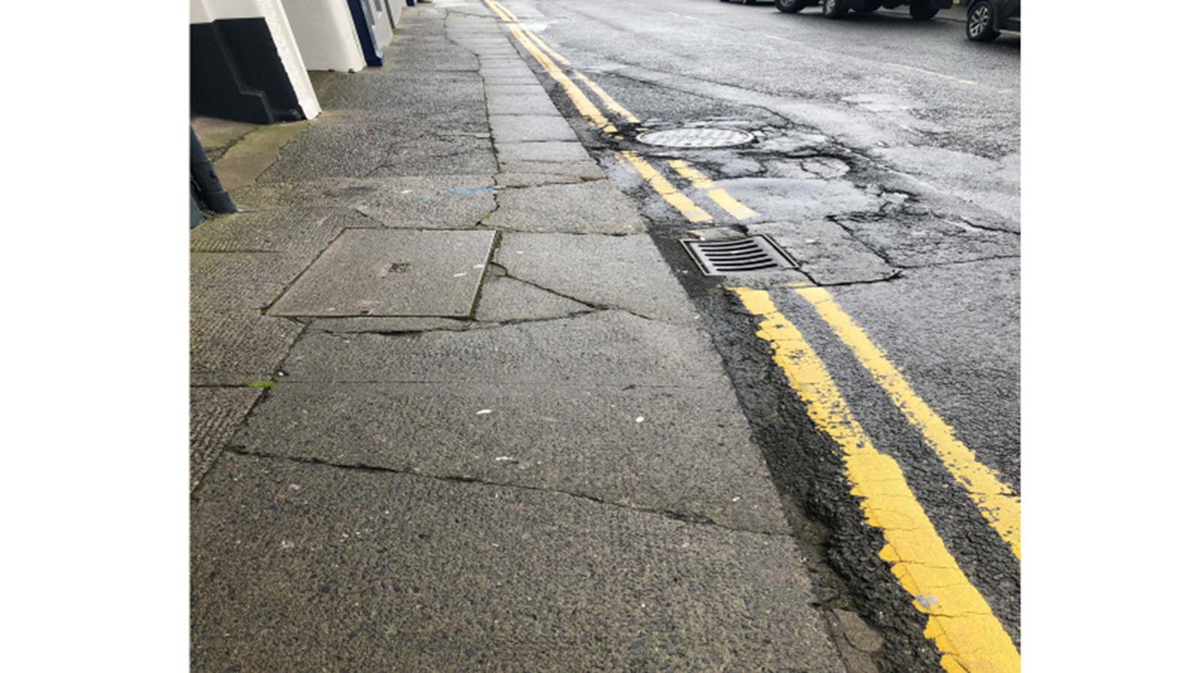
Approach Roads, entrances & (bilingual) name signs;
Road and footpath surfaces, kerbing & (bilingual) signage;
Grass verges & cut grass;
Walls, fencing, hedges, field gates;
Back areas & lanes;
Bridges, cycle lanes, connectivity, parking,
universal accessibility.

Slide 36
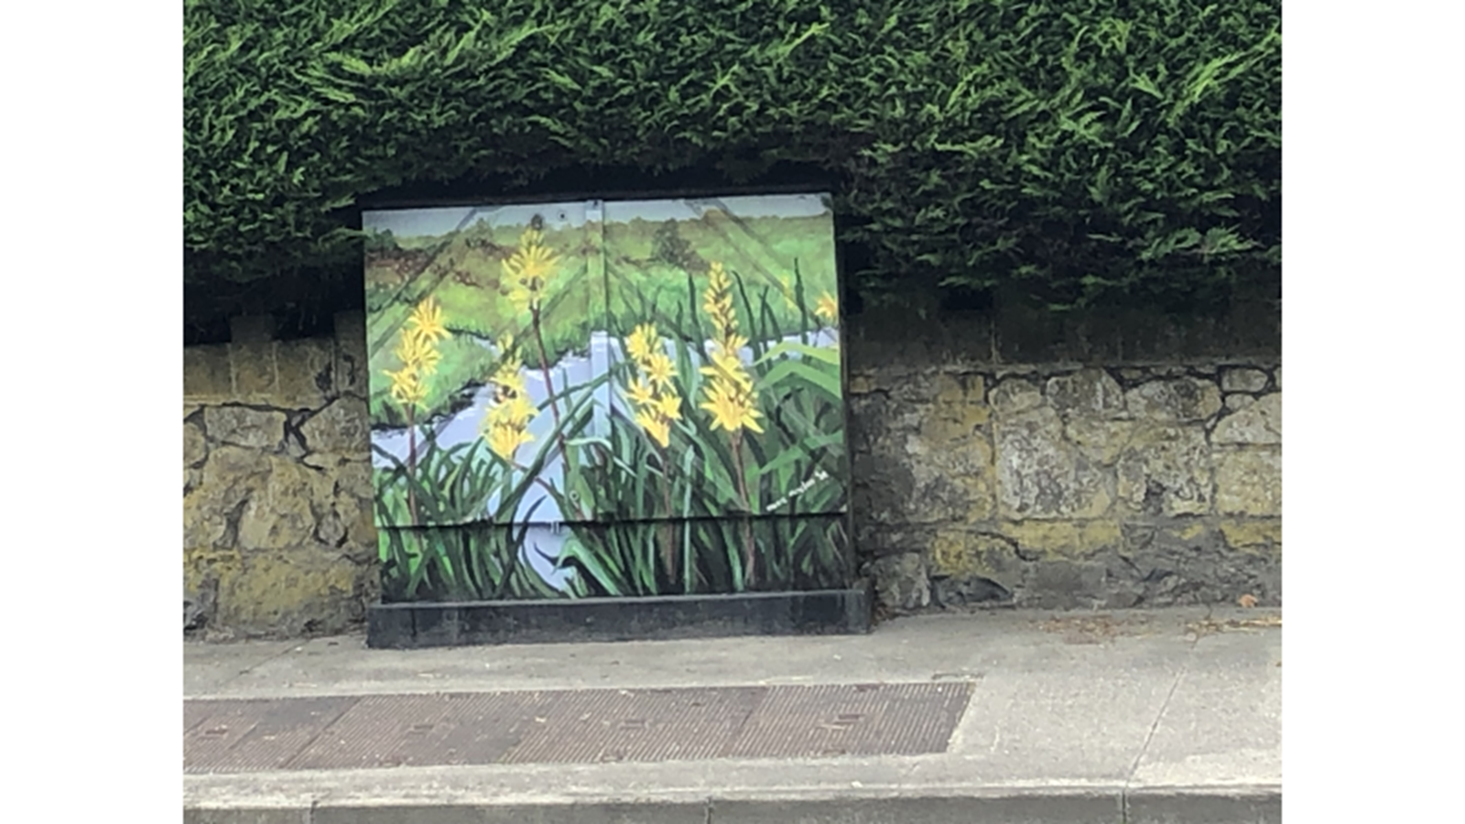
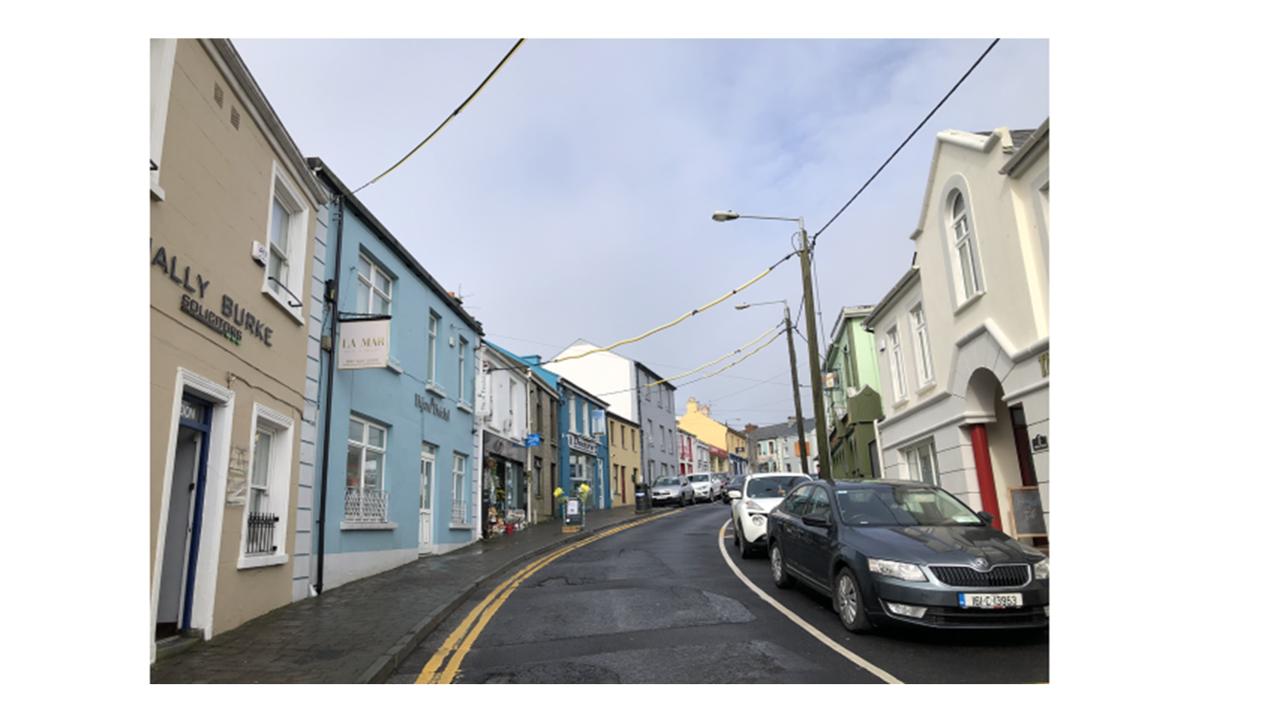

Slide 37
What the Adjudicator considers
The presentation and appearance of:
Approach roads, including roadside verges and boundary treatments
Town / Village streets and connecting roads
Roundabouts within the 60 kmph zone
Laneways, back areas and bridges
Cycle lanes
Pedestrian connections and inclusive access
Contribution to Sustainable Development Goals

Slide 38
Q & A

