Slide 1



Longford County Council
TidyTowns Engagement Event Saturday, 27 April 2024
Agenda:
11.30 Arrive and welcome by Sylvia Kilcline, a/Senior Executive Officer
11.50 Carla McGoey, Environmental Awareness Officer
12.00 Adam Mulvihill, Biodiversity Officer
12.15 Ann O’Leary, Tidy Towns Adjudicator
12.40 Questions and Answers
12.55 Closing Remarks
13.00 Refreshments and an opportunity to connect

Slide 2



Carla McGoey
Role of the Environmental Awareness Officer
Longford County Council
longfordcoco.ie
Notes:
Looking forward to working with you all very closely, as we have a shared vision for collective action, to foster environmental awareness in our community.
In a nutshell my role is to inform, engage, and support your positive actions in your community.

Slide 3
Objective of the Environmental Awareness Officer:
Promote environmental policies and plans at local level; Longford Climate Action Plan Litter Management Plan
Increase education and awareness of sustainable practices; Waste reduction, water conservation, reducing energy consumption
Develop and deliver education programmes for Schools, TidyTowns Groups and Community Groups
Collaborate with interested groups; Local TidyTowns and Community Groups, to promote and support projects at local level
Provide information and advice via; Awareness campaigns, seminars, workshops, events, website, social media
Explore funding opportunities and grant schemes for TidyTowns and Community Groups
2
Notes:
Promotion of environmental policies and plans - Longford litter management plan and Climate Action Plan. Education and awareness of sustainable practices such as reducing waste, conserving water, and minimizing energy consumption.
Developing and delivering education programmes and resources for schools and community groups and supporting their initiatives.

Slide 4

Principal Action Areas and Campaigns:
1. TidyTowns Group – Engagement and Support
30,000 volunteers, 924 committees, 3 million hours
30 Groups in Longford – Great success!
Passionate groups work tirelessly to enhance
your local environment and create a sense of pride
Collaborate with your group to promote and
support projects at local level
2. An Taisce Green Schools Coordinator
38 Primary, 9 Secondary Schools – 28 flags in May
Green Schools Coordinator/Committee – 10 Themes
TidyTowns link with schools crucial to success
Marks awarded for schools' interaction – 70/80%
Overlap in objectives can help each other
For example: Surveys, poster competitions, gardens
3

Slide 5
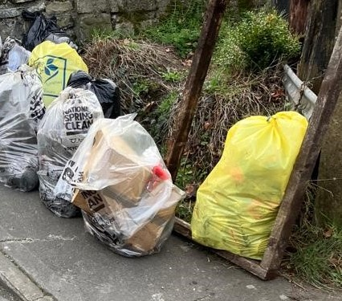
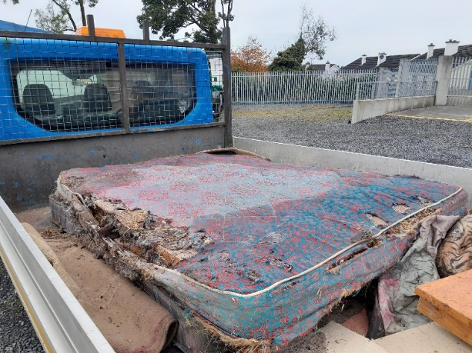
Principal Action Areas and Campaigns:
3. National Spring Clean – April Annually
Organised litter picks across Longford
Bags, pickers, supplied to groups
Collections supported by LCC
Thank you!
4. Large Goods Collections
20 April 2024
Pearse Park and Granard Mart
Household waste not suitable for general waste
Fee applied for collection
4
Notes:
25th Anniversary

Slide 6
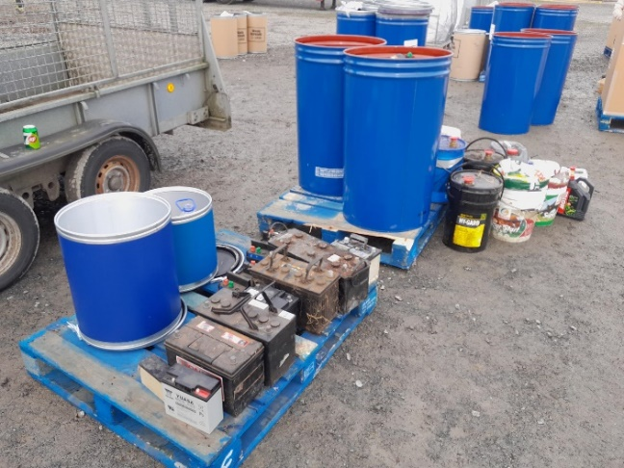
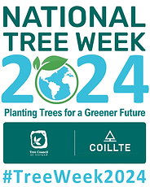
Principal Action Areas and Campaigns:
5. Hazardous Waste Collections
Potential May date to be confirmed
Old paint, oil, batteries etc.
Fee applies for collection
6. National Tree Week 3 – 10 March 2024
Tree Council of Ireland, supported by Coillte and LCC
Remove carbon – Plant trees!
400 saplings available
Native tree species – Oak, Alder, Beech
Contact me for the 2025 campaign
5

Slide 7
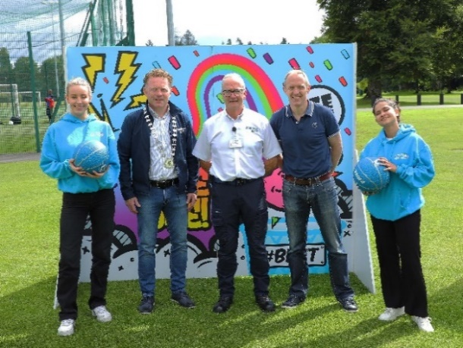
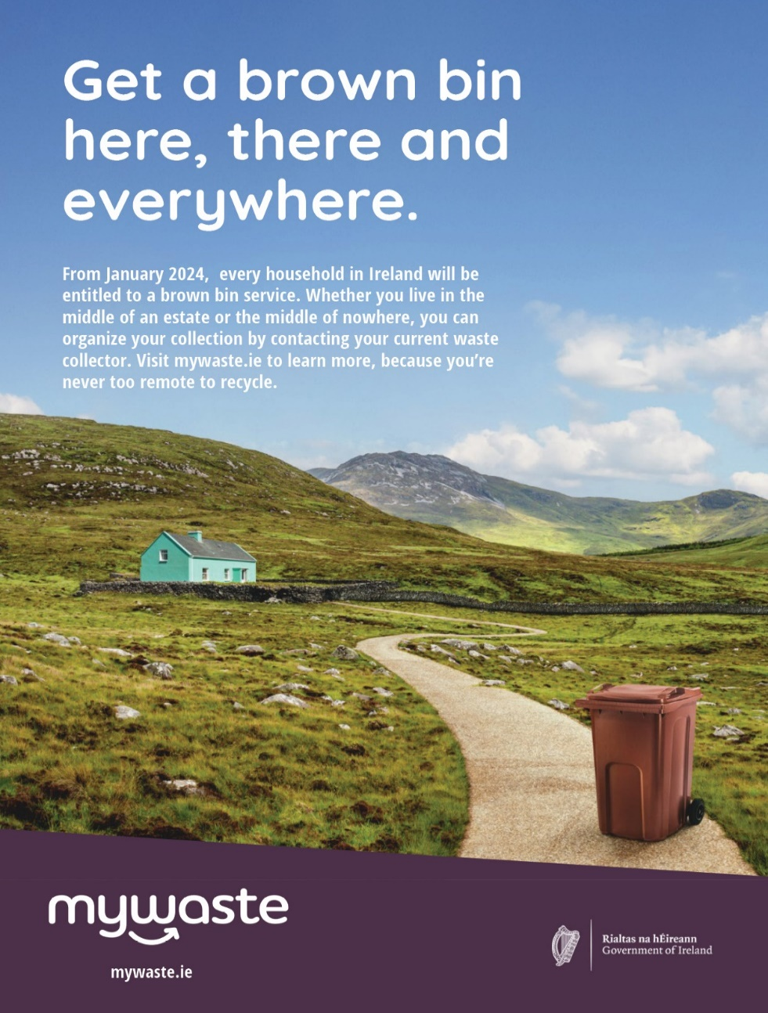

Principal Action Areas and Campaigns:
7. Gum Litter Taskforce Campaign Participation
Aim is to encourage the public to bin gum responsibly
Longford launch, media and school’s education campaign
Environmental Awareness Officer promotion
8. Promotion of National Waste Reduction Campaigns
Organic waste caddy and Re-turn deposit return scheme
Increases waste recycling rates
Ensures cleaner waste streams
6

Slide 8


Principal Action Areas and Campaigns:
9. Seasonal Awareness Campaigns e.g. Halloween, Christmas
Raise awareness that bonfire emissions are a major source of pollution
Household waste burning is an offence
Christmas Rethink, reduce, reuse, recycle campaign
LCC free real tree collection campaign
10. Grant and Funding Opportunities
Point of contact for grant schemes
More information to follow
7

Slide 9
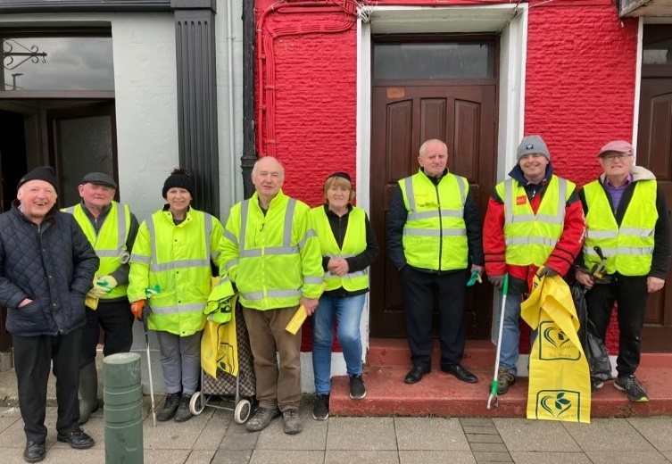
TidyTowns Recognition and Collaboration:
Cornerstone of community spirit and pride
Recognise effort of all Longford groups
30 groups – 14 represented today
Grow our engagement with county groups
Partnership approach – assist and support you
Develop environmental projects – increase marks!
Edgeworthstown Spring Clean 2023
8

Slide 10
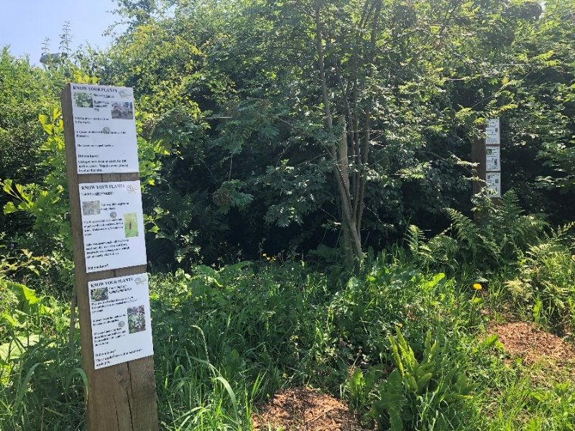
TidyTowns Environmental Awareness Projects:
Additional Marks Recommendations:
1. Active and inclusive community involvement with all citizens – Planting trees, gardens
2. Water harvesting project – Plant watering
3. Sensory gardens – Universal access
4. National Spring Clean – Participation is key
Dual points awarded in the litter and
community category
Kill, Co. Kildare – Know your plants signage (Courtesy Ann O’Leary)
9

Slide 11
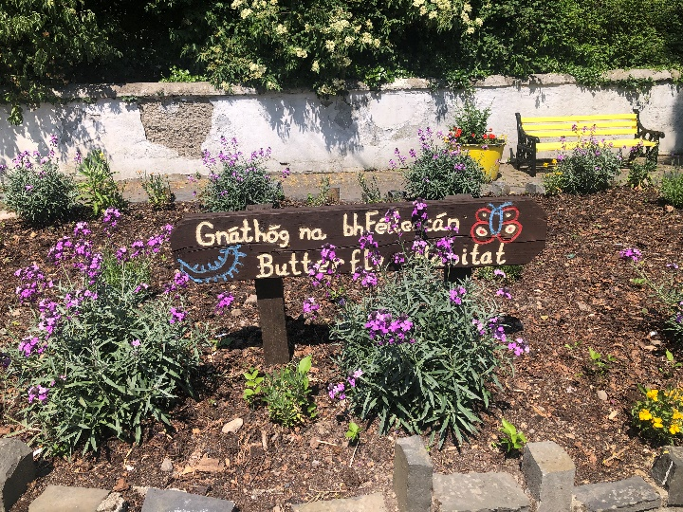
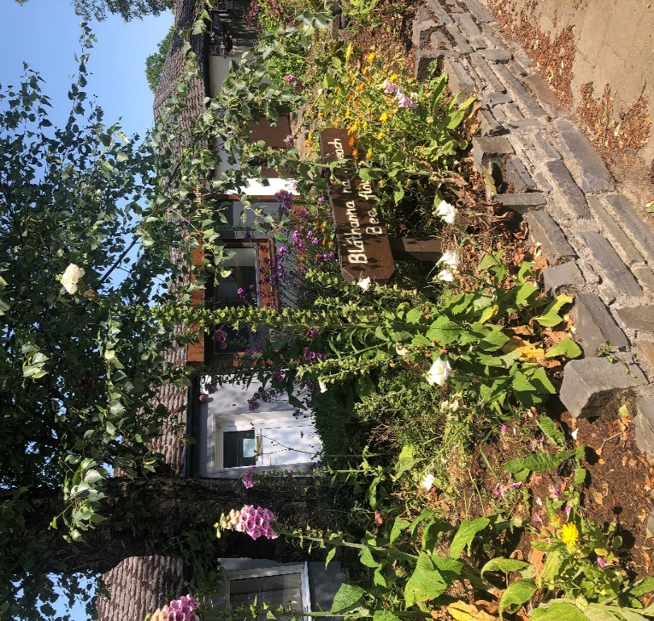
TidyTowns Environmental Awareness Projects:
5. Kill, Co. Kildare – Butterfly and Bee flower beds (Courtesy Ann O’Leary)
10

Slide 12
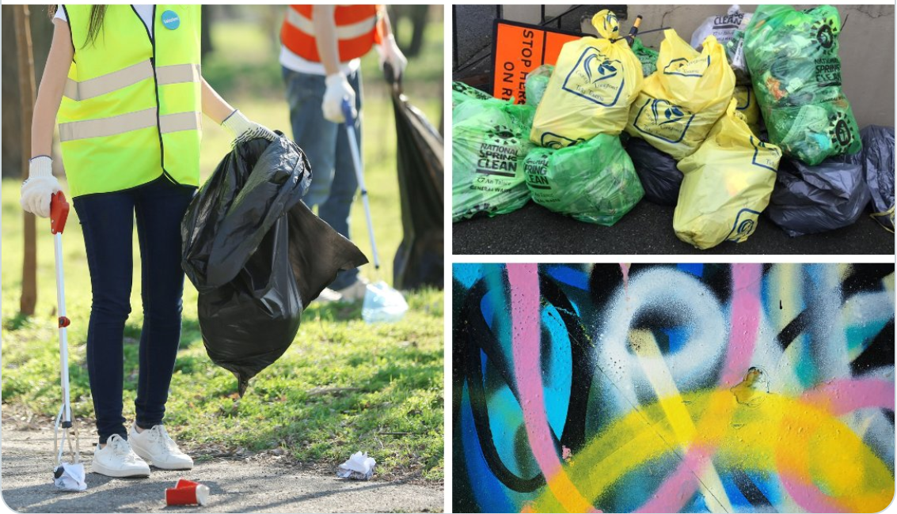
Grant and Funding Opportunities:
Anti-Litter and Anti-Graffiti Awareness Grants:
  Promotes public awareness, education, and community engagement relating to litter, waste management, graffiti removal, etc.
  Receive 70% of expenditure. Max €1,000
  Provide support with applying for grants
  Projects completed by September annually
  Awaiting details from the Department
Contact: litter@longfordcoco.ie
Cemetery Support Scheme:
  Assists the maintenance and upkeep of cemeteries
  Max €400 – You must supply receipts for costs incurred in previous year
  1 grant per group per year
Contact: burials@longfordcoco.ie

Slide 13





Contact Details:
Carla McGoey
Environmental Awareness Officer
cmcgoey@Longfordcoco.ie
#Longford
#YourCouncil

Slide 14
THANK YOU

Slide 15

Longford’s Biodiversity
longfordcoco.ie

Slide 16

Introduction
The Biodiversity Officer Programme is being rolled out in Local Authorities throughout the country. This is under action 1B9 of the 4th National Biodiversity Action Plan which was launched on the 25th of January 2024.
The Biodiversity Officer Programme in Local Authorities is funded by the Heritage Council.
Name: Adam Mulvihill
Email: amulvihill@longfordcoco.ie
Phone: 086 1928247
Page 2

Slide 17

Biodiversity – What is it good for?
Absolutely Everything
Food
Medicine
Clothes
Climate Mitigate
Page 3

Slide 18
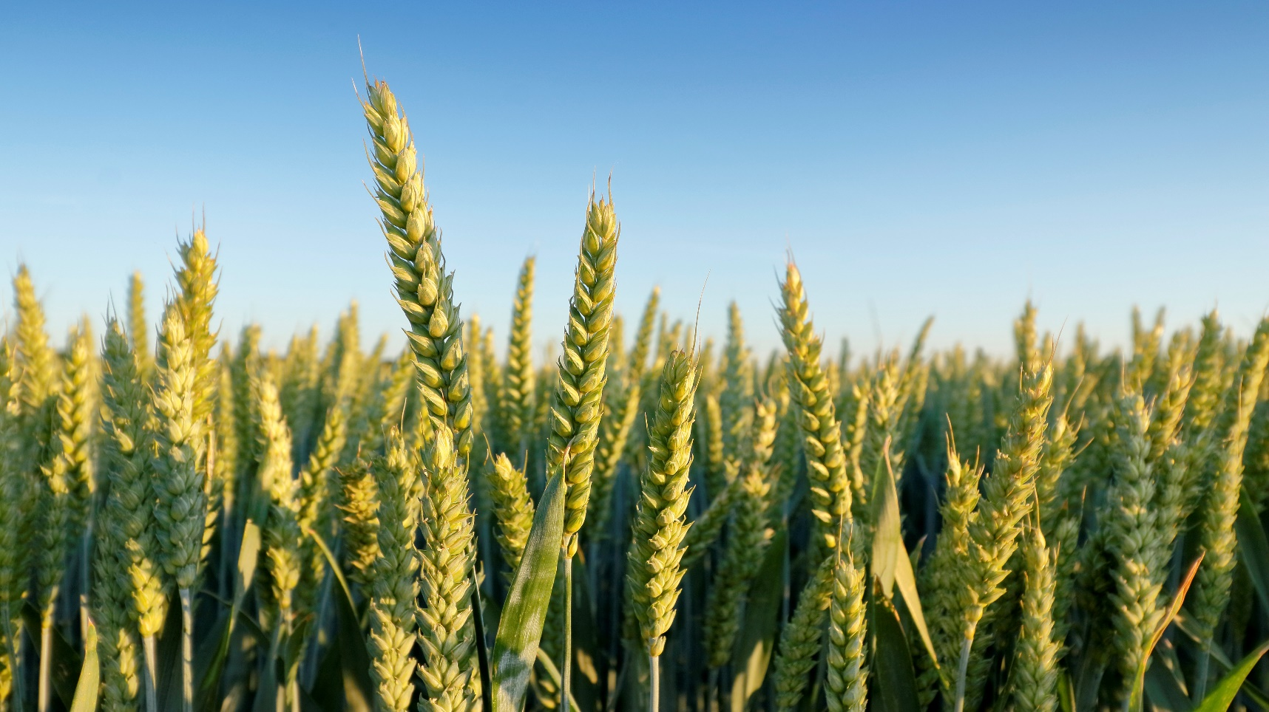
Biodiversity and food
Page 4

Slide 19
Biodiversity and food
Threats to food security:
Irish famine 1845 – 1852 was caused by disease to the potato crops. A heavy reliance on one crop type meant that disease to that crop caused widespread starvation.
Chinese famine 1958 – 1962 was caused by large scale extermination of sparrows. Sparrows were seen as a pest as they ate grain, however although they did eat some grain their main diet consisted of locusts. Without the sparrows the locusts decimated the grain crops leading to famine in China with estimated deaths of 45 million people.
A decline in pollinator numbers has the potential to severely disrupt the global agricultural output. UN estimates suggest that 75% of our crops for the food we eat rely upon pollinators. Pollinators across the world are facing several threats including; climate change, pollution, land use change, pests and pesticides.
Page 5

Slide 20
The Importance of Pollinators
Page 6

Slide 21
The importance of pollinators
Pollinators are hugely important for a variety of reasons:
    They pollinate our fruit and nut trees that feed both human and animal populations.
    They pollinate plants to ensure a new generation of plants grow to feed future human and animal populations.
    Pollinators themselves are food for other animals such as other insects, birds, bats, and mammals.
    Pollinators are good indicator species for wider biodiversity.
    Studies show that fruit plants pollinated by insects have higher yields and perform better in taste tests than fruit plants pollinated by artificial means.
Page 7

Slide 22
Threats to Pollinators
Pollinators in Ireland, and across the world are in decline. There are a number of common reasons for this.
Habitat loss – Land use change such as urbanisation, or intensification of farming, or forestry, leads to reduced nesting sites for many of our pollinators. (Homelessness)
General declines in wildflowers – Changes in farming practices, application of fertilisers, monoculture grasslands, “tidy” roadsides, public spaces, and private gardens. (Hunger)
Pesticide use – pesticides cover herbicides, insecticides, and fungicides. Food production pressures, as well as gardening and public body maintenance works all contribute to large scale pesticide use. This has the effects of directly killing pollinators, reducing their food supply. Further effects on non-pollinators include potentially killing off soil living species. (Poisoning and potentially hunger)
Page 8

Slide 23
Threats to Pollinators (cont’d)
Climate Change – This affects pollinators in a number of ways. Changes in temperature affect the timing of flowering plants and can mean that pollinators life cycles are not synced with their environment in a way that they previously were. Although temperature changes may also lead to changes in pollinators emerging from hibernation, temporal flowering plants rely on day length rather than temperature as a cue to flower. (changing environment and ultimately hunger)
Page 9

Slide 24
Interesting pollinator facts
People talk most about bees, but other pollinators include midges, hoverflies, wasps, butterflies, beetles, and moths to name a few.
Our chocolate is pollinated by midges! So maybe lets, not give out about them next time you are at a barbeque.
Figs are pollinated exclusively by a single species of wasp. The mother wasp lays eggs inside the fig and dies. The males hatch and dig tunnels and die. The females hatch and escape, carrying pollen with them for the next fig plant they land on. The fig digests the dead wasps.
Ireland has 101 species of bee. Of these there are 21 Bumble bees, 79 solitary bees, and 1 honeybee. The honeybee is managed, and it is not in decline but one third of the 100 wild species in Ireland are threatened with extinction from the island of Ireland.
Page 10

Slide 25
How we can help pollinators!!
Page 11

Slide 26
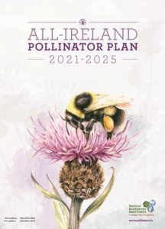
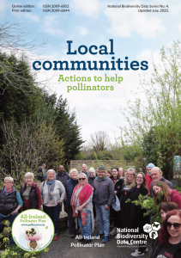
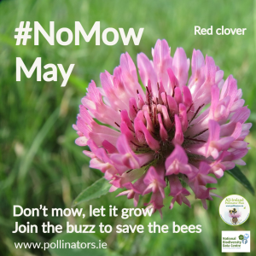
The All Ireland Pollinator Plan
Page 12

Slide 27
Helping our pollinators
The All-Ireland Pollinator plan brings together different sectors across the whole island of Ireland to create a better landscape for our native pollinators.
The All-Ireland Pollinator plan sets out actions that all groups, and members of the public, can take to improve the whole island for pollinators.
Programmes such as no mow May, let it bloom June, and help them fly July give contributors simple ways to help improve the landscape for pollinators
Pollinators.ie website has guidance documents for a variety of groups, areas and infrastructure types.
Page 13

Slide 28
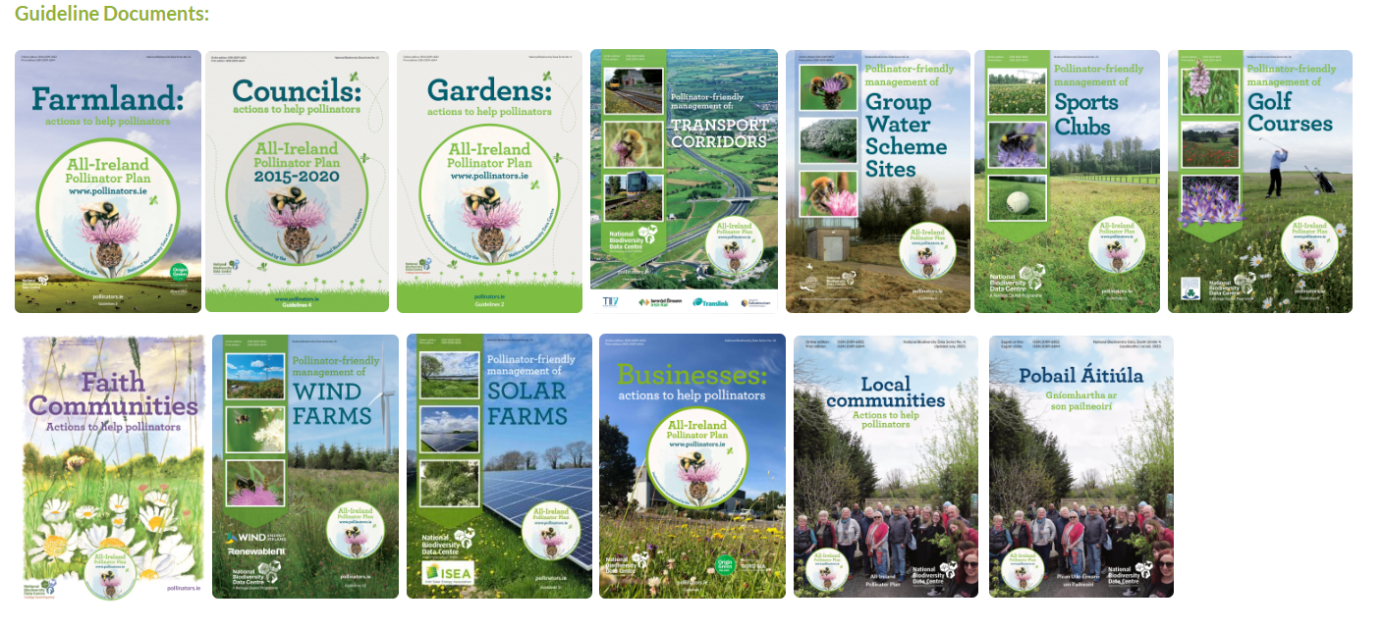
Page 14

Slide 29
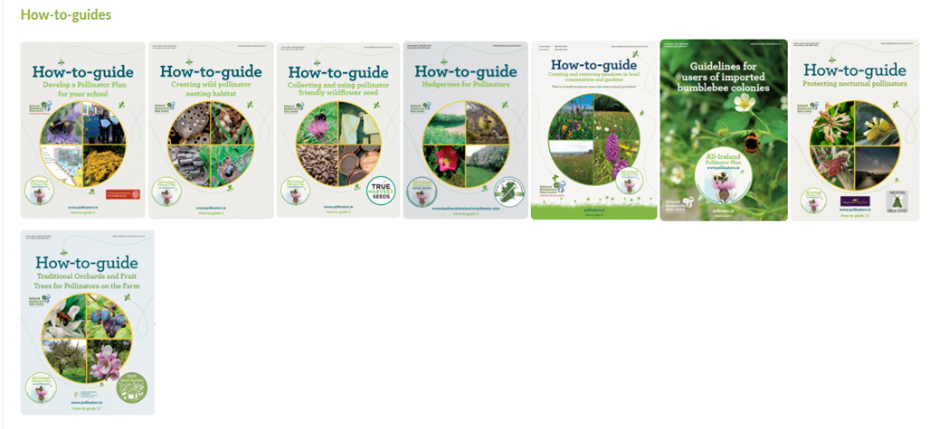
Page 15

Slide 30
Tidy Towns Pollinator award
There is a €10,000 prize fund up for grabs for tidy towns groups that enter the pollinator awards
This is split into €1000 for the best large town or urban centre and the best small town or village in each region.
A further €1000 to the overall winner
€1000 to the best newcomer. This means that if you haven’t entered before there is great incentive to do so.
Applications are open until the 5th of June 2024.
Application forms can be found on the pollinators.ie website
Page 16

Slide 31
Tidy Towns Pollinator award (cont’d)
Points available for actions related to:
    Protecting existing areas that are good for pollinators.
    Mowing less to allow native wildflowers to grow.
    Pollinator friendly planting.
    Providing nesting habitats for wild pollinators.
    Eliminating or reducing the use of pesticides.
    Raising awareness of pollinators in your local area.
    Tracking progress.
Page 17

Slide 32

Flower Insect Timed (FIT) Counts
A simple and fun activity for recording pollinators, and checking on the effectiveness of measures taken, is to undertake FIT counts.
These counts involve watching a 50cm-by-50cm area of flowers for 10 minutes and recording the insects that are present or visit during that time.
Can be undertaken from the 1st of April to the 30th of September each year.
No need to identify insects to species level but rather to within broad groups e.g. bumblebee, butterfly, wasp, beetle
Count each insect that lands on a flower in the target area and try not to count an individual multiple times if they travel from flower to flower.
Can be carried out using the FIT Count app or the data can be entered at the web address on the fit count forms.
Page 18

Slide 33
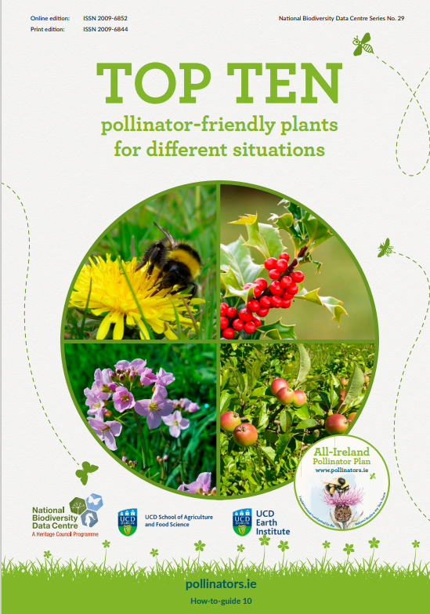
Pollinator Planting lists
Pollinators.ie website has a booklet that lists the top 10 pollinator friendly plants for different situations.
Example for gardens: Lungwort, Comfrey, Perennial Wallflower, Lambs’ ear, Catmint, Lavender, Sage, Vervain, Michaelmas Daisy, Heleborne
Urban planters: Heather, Skimmia, Lungwort, Rosemary, Sea Thrift, Lavender, Coronilla, Hardy Geranium, Michaelmas Daisy, Sweetbox
Page 19

Slide 34
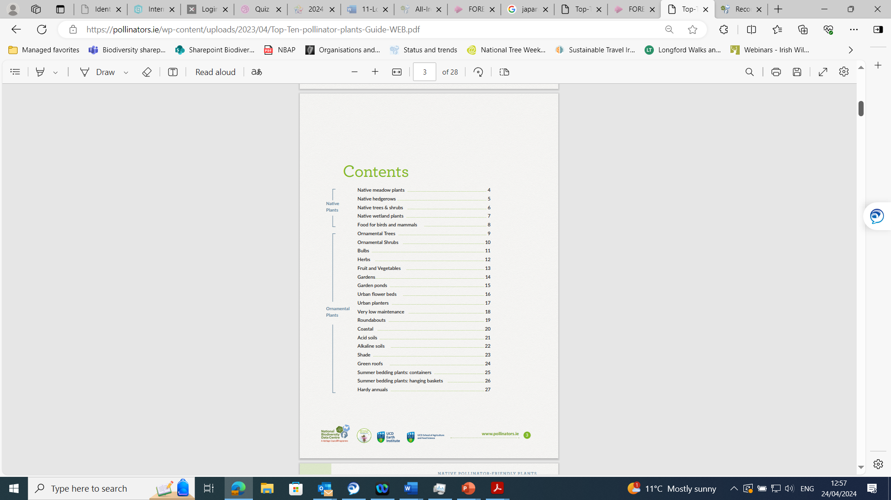
Page 20

Slide 35
No Mow May
No Mow May offers members of the public, community groups, and organisations a chance to make a meaningful contribution to the survival of our pollinators.
The biggest threat to bees (and other pollinators) in Ireland is a scarcity of food. Not mowing allows native wildflowers to grow and feed our little friends.
Flowers such as dandelions, clover, and daisy are often the first to appear.
Lifting grass cuttings when you do cut your grass will ensure the soil becomes more nutrient poor. This will help native wildflowers to become established and so you may find that you get more wildflowers in subsequent years during no mow May.
“Spot native wildflowers” checklist with photos available on the pollinators.ie website under the “No Mow May” tab.
Page 21

Slide 36
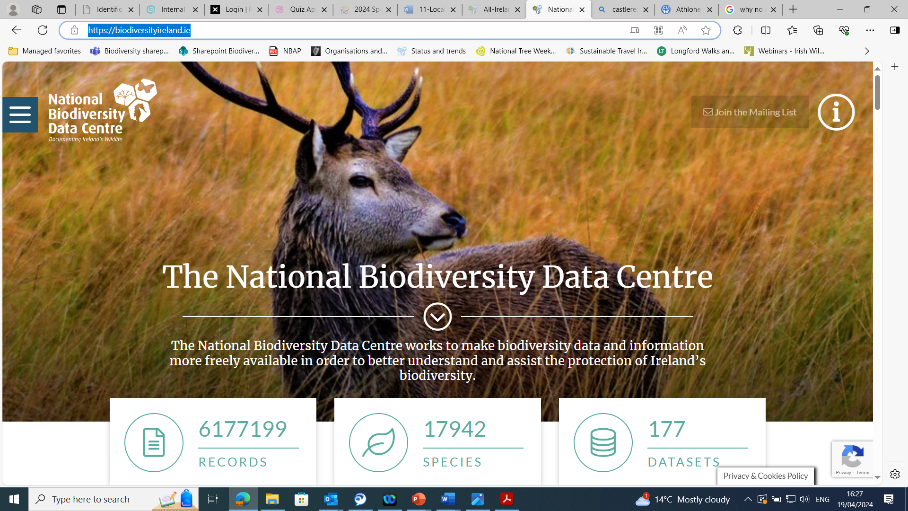
Recording Biodiversity
Page 22

Slide 37
Recording biodiversity
The biodiversity data centre keep track of records of Irelands plants, animals, and fungi.
Their website is biodiversityireland.ie and you can submit records or look at maps of all the recorded species and their distributions.
There have been roughly 21,300 records submitted for Co. Longford, with birds (133 species) accounting for over 8,000 of these records.
Recording species of pollinators can help to garner points for the tidy towns pollinators awards.
Going forward records will help Ireland to assess the success of such initiative.
When sending records, it is helpful to include a photo as this helps in the verification of the data.
Page 23

Slide 38
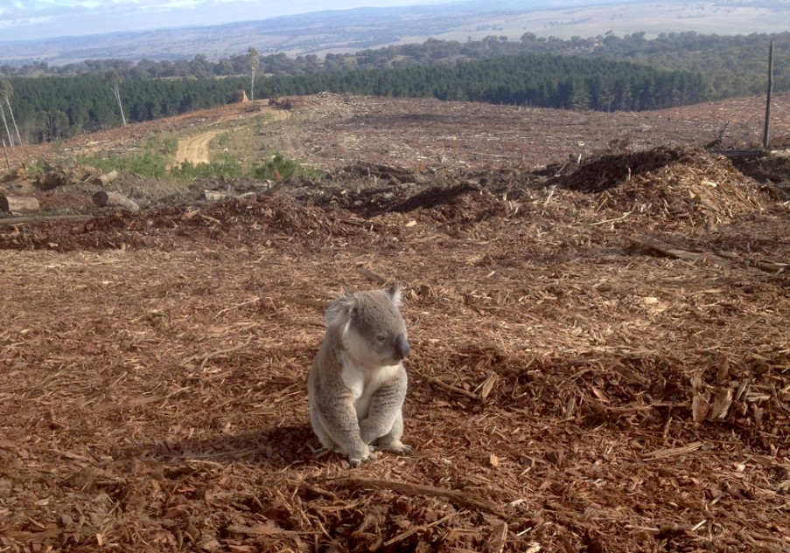
Threats to Biodiversity
This Photo by Unknown Author is licensed under CC BY-NC-ND
Page 24

Slide 39
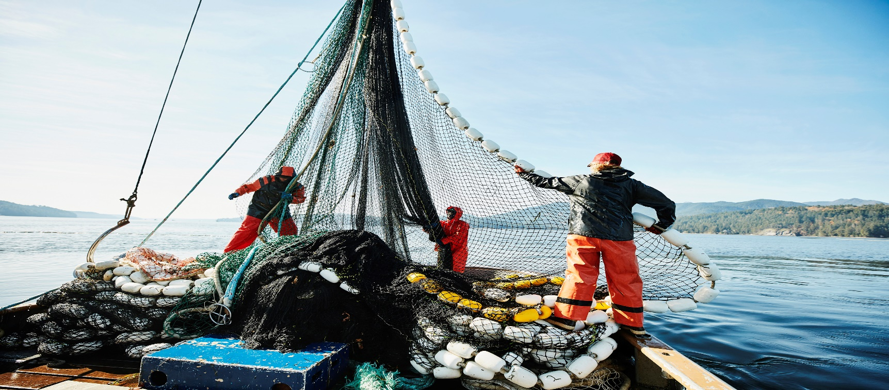
Threats to Biodiversity
Overexploitation (overfishing, hunting, tree harvesting, intensive farming and associated monoculture, and in the past fur, ivory and medicine)
Page 25

Slide 40
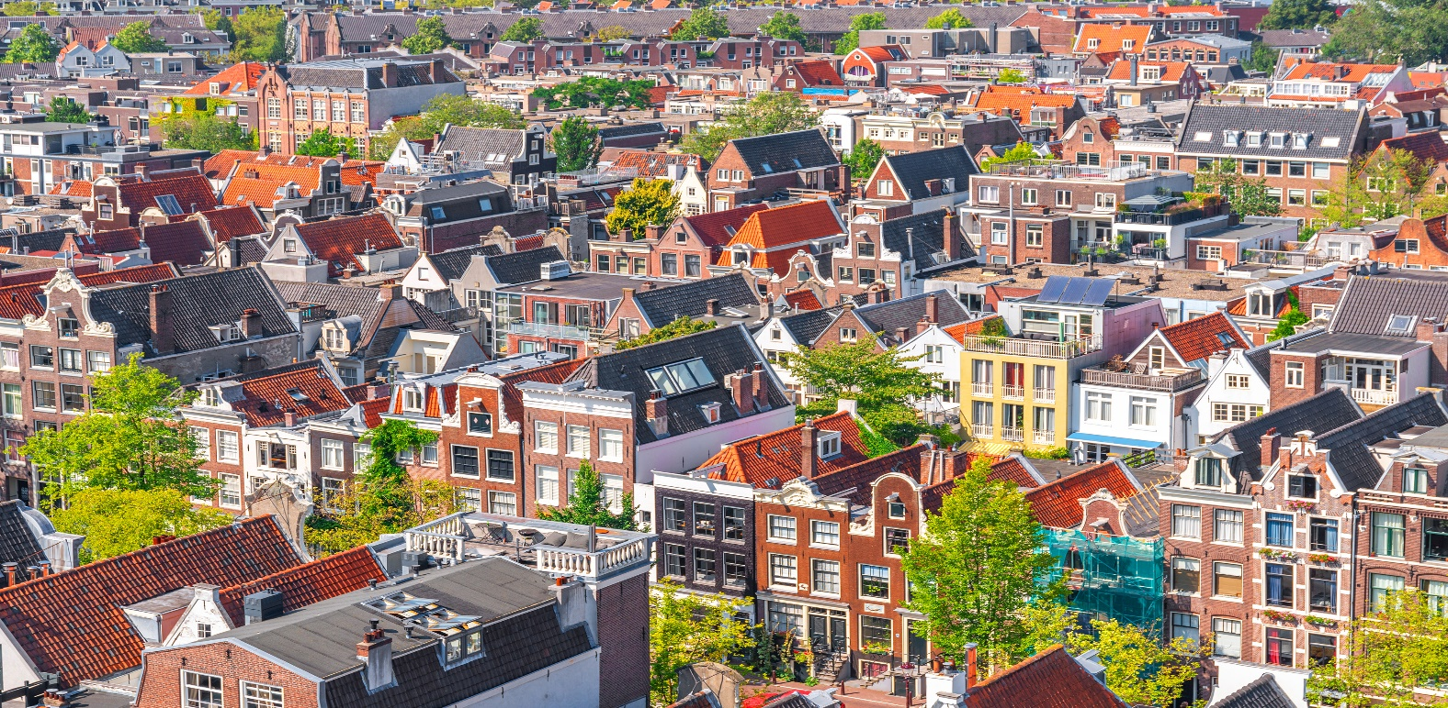
Threats to Biodiversity
Habitat loss (Urbanisations, resource extraction, agriculture, logging, trawling)
Page 26

Slide 41
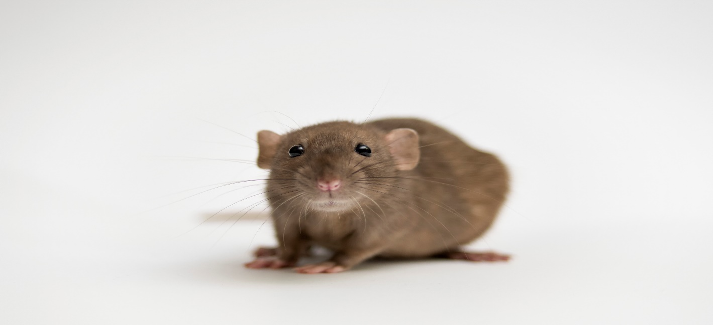
Threats to Biodiversity
Invasive species (introduced to new areas by human activity invasive species can have devastating effects and cause local and regional extinctions. e.g. black rats have been blamed for a raft of extinctions worldwide after being introduced to new areas by hitching on boats. They often feed on eggs from ground nesting birds, and reptiles)
Page 27

Slide 42

Threats to Biodiversity
Pollution (pollution from human activities can alter habitats, and affect plant and animal species present)
Page 28

Slide 43

Threats to Biodiversity
Climate Change (temperature rises are affecting plant germination as well as hibernation periods. Storm events, flooding, and drought, are creating further pressures on flora and fauna)
Page 29

Slide 44
Extinctions!
There have been 5 great extinctions on earth so far:
    Ordovician – 445mya. 85% of marine species became extinct. 2 pulses of climate change. First cooling caused glaciation, then warming ended this ice age.
    Devonian – 370mya. 75% of species. Anoxic bottom waters and mass cooling (both likely due to the evolution and spread of vascular plants)
    Permian – 250mya. 90% (96% of marine) species. Known as the great dying this was caused by a volcanic eruption in Siberia that lasted 2 million years, and the knock-on effects to the atmosphere caused by this.
Page 30

Slide 45
Extinctions! (cont’d)
    Triassic – 201mya. 76% of species. Many causes put forward including gradual climate change, sea level changes, and a central Atlantic magma field (that caused anoxia, ocean acidification, climate change, and mercury poisoning)
    Cretaceous – 65mya. 76% of species. 6-mile-wide meteor. Caused the extinction of all non-avian dinosaurs and allowed the proliferation of mammals.
    Anthropocene – now? Some estimates put the current extinction rate at between 10 and 100 times faster than in previous major extinction events.
Page 31

Slide 46
The good news!!!
The study and effort to understand previous mass extinctions has increased our knowledge of the potential effects of changing climates and of cataclysm.
This means that we can look forward and make predictions better than might otherwise be the case.
We also have a good awareness that more biodiverse ecosystems have a better durability to changing climates and shock events, and thus we understand some of the needs for protecting biodiversity.
Society at a global, national, and local level have all taken notice of the plight of wildlife and measures are being taken to protect flora and fauna.
The plants and animals alive today have a major advantage over the flora and fauna of previous epochs, and that is……..
Page 32

Slide 47
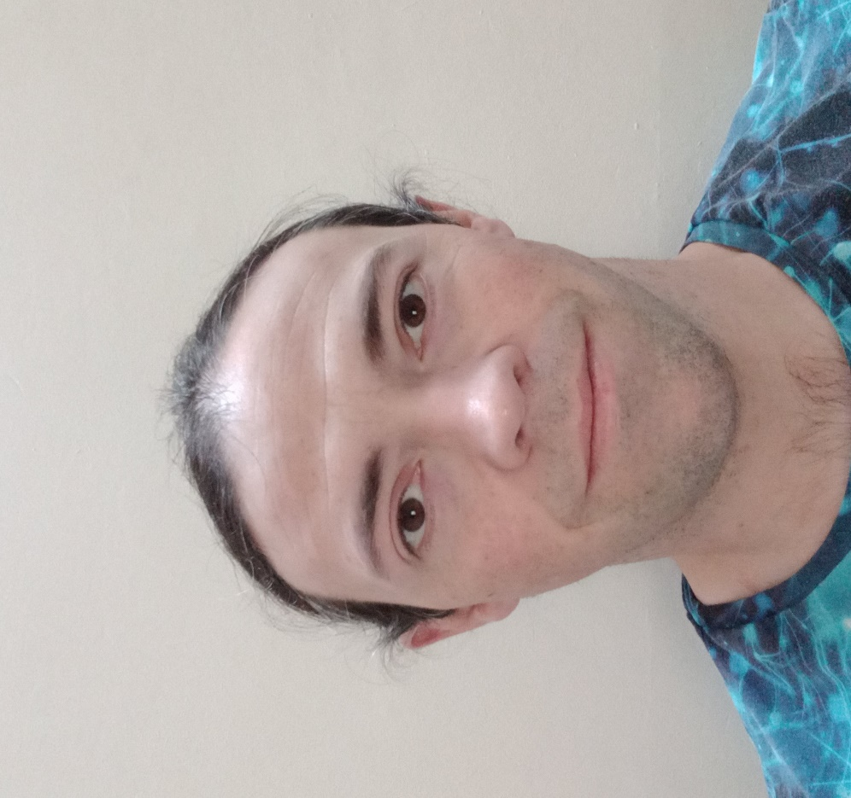
Page 33

Slide 48
The good news!!!
Okay not specifically me!
Humans are the most adaptable species to ever exist.
Despite humans having a destructive impact so far, we are powerful ecosystem engineers with the ability to alter and save ecosystems and species on a huge scale.
Many people often argue that we as a community or country are too small to make an impact on global climate change (an argument I disagree with anyway!).
For biodiversity visible impacts can be made at the local level, from where plant and animal populations can then grow and spread.
So, initiatives like no-mow may and the tidy towns pollinator awards have a tangible impact on the biodiversity at a local, regional, and national level.
Let’s all remember that one thing that will always exist is hope.
Page 34

Slide 49
And Finally….
Under the 4th national Biodiversity Action Plan all Local Authorities must create a local Biodiversity Action Plan.
Longford County Council have developed a biodiversity working group that will soon sit to develop this plan.
Remembering that one of the great hopes the current flora and fauna have for surviving the threats against them is people, I want to invite you to make contact with me if you wish to make a pre-draft suggestion or submission to the LBAP.
Email: amulvihill@longfordcoco.ie
Phone: 086 1928247
Thanks for listening!!!!
Page 35

